Slide 1
DRIVER DROWSINESS AND ALCOHOL DETECTION WITH CAR TRACKING SYSTEM USING IOT
Presented by | Guided by
Student name | Faculty Name
Reg. Number | Designation
Department Name | Department Name

Slide 2
Abstract
Drowsiness in driving causes the major road accidents. Now a day’s drowsiness due to drunken driving is increasing. If driver is found to be drowsiness in eyes more than 5 secs, then the eye blink sensor senses the blink rate. If the eyes are found to be closed, then the speed of the car slows down.
In our proposed system, along with drowsiness, alcohol detection is detected by using alcohol MQ3 sensor. If alcohol is detected in driver’s breathe, then the car slows down and also water level sensor and buzzer rings in case of less water.
These sensors are interfaced with Node MCU .DC motor not run in case of alcohol detection drowsiness detection and speed of the car varies on detection of both cases.

Slide 3
Contributions to the Work
The drowsiness of driver and impact of collision monitoring or alert system is constructed using IoT technology.
When the drowsiness is detected, the driver is alerted by vibrate sensor to avoid suppose any sudden collision happens due to drowsiness.
The eye-blink sensor works by illuminating the eye and eyelid area with infrared light, then monitoring the changes in the reflected light using a phototransistor and differentiator circuit.
MQ-2 alcohol sensor can detect the presence of alcohol at concentrations from 0.05mg/l to 10 mg/l.Used for detecting alcohol concentration on your breathe.

Slide 4
Aim and Objectives (Should be their contributions)
The driver exhaustion is the difficult issue right now age, considering the way that on account of the downiness ,alcohol consumption and check water level in engine to avoid issue step by step incidents are extended.

Slide 5
Literature Survey
S.NO | TITLE,JOURNAL,YEAR | METHODOLOGY | MERITS/DEMERITS
1 | Implementation of the Driver Drowsiness Detection System K.Srijayathi and M.Vedachary, 2013. | The system is dynamic, it can update and modify its components like current drivers eye model and skin model throughout its life cycle. Such an eye model can always be upgraded, thus increase its quality, through frequent use of the system. | The driver influences the performance of used face/eye detection algorithm as well as the consistency of its detection. The driver might also be asked to hold their eyes closed and then open for a matter of few seconds each time.
2 | An IoT Approach to Vehicle Accident Detection, Reporting and Navigation Elie Nasr, Elie Kfoury and David Khoury, 2016 | This method is applicable for any vehicle used in transportation and mainly for cars accidents. The vehicle’s owner must prepare the vehicle for this system by installing the IoT device. | An NFC reader is used to identify each passenger by detecting his/her ID. The main disadvantage is that it serves only as a form of manual reporting about the accident after it is being taken place.

Slide 6
Scope of the Project
In this project, the author will focus on these following procedures:
Basic concept of drowsiness detection system
Familiarize with the signs of drowsiness
Determine the drowsiness from these parameters
    Eye blink
    Area of the pupils detected at eyes
    Yawning
Data collection and measurement.
Integration of the methods chosen.
Coding development and testing.
Complete testing and improvement

Slide 7
Need for the current study
The current study confirmed that drivers with chronic fatigue, acute sleepiness, and careless driver behavior may significantly increases the risk of road crashes which can be lead to serious injuries.
Also, the study confirmed that young drivers are more likely to be involved in collisions during lane-changing than non lane-hanging drivers.
The levels of acute driver sleepiness measured by the Stanford score were in strong association with the risk of injuries.
The findings of the current study will be beneficial in prevention of MVC, its related complications and which could be vital for policy decision makers, public health service directors, private sectors and stakeholders.

Slide 8
Feasibility Analysis
The feasibility Analysis is an analytical program through project manager determines the project success ratio and through feasibility study project manager able to see either project. The key considerations involved in the feasibility analysis are:
          Economic Feasibility
          Technical Feasibility
          Operational Feasibility
          Environmental Feasibility

Slide 9
Proposed Methodology
This paper approaches a system towards automobile safety with autonomous region based automatic car system.
We propose three distinct concepts namely, a Drowsy Driver Detection system and vibrate to alert him. alcohol consumption detection system using MQ2 sensor when driver consume alcohol then the DC motor will not run.
The proposed system is used to avoid various road accidents caused by drowsy driving, alcohol consumption during driving also this system used for security purpose of a driver to caution the driver if any of these state occurs.

Slide 10
Choice of Components
EQUIPMENT
Gas sensor
Eye blink sensor
Water level Controller
Vibrator
Node MCU
LCD Display
Buzzer alarm
DC Motor
Website

Slide 11
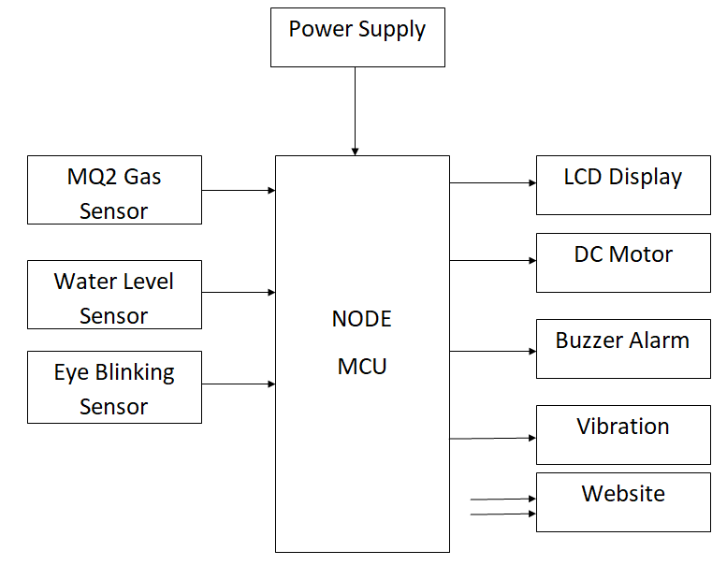
Design

Slide 12
Novelty of the Project
The novelty of this project lies in making use of EDA as a measure to detect if a person is drowsy or not.
Much of the challenge lies in building a device equipped with the necessary sensors and processing the data on real-time.
The novelty of this work lies in development of an embedded device interfaced with sensors and actuators to detect and alert a driver when found drowsy using sweat as a parameter.
With the constant improvement and novelty in technology, there is an advancement in transportation modes. Our dependencies on it have started increasing at a high rate.

Slide 13
Reference(s)
K.Srijayathi and M.Vedachary, “Implementation of the Driver Drowsiness Detection System,” International Journal of science, Engineering and Technology Research(IJSETR), vol. 2, pp. 1751-1754, September 2013.
Elie Nasr, Elie Kfoury and David Khoury, “An IoT Approach to Vehicle Accident Detection, Reporting and Navigation,” IEEE International Multidisciplinary Conference on Engineering Technology (IMCET), 978-1- 5090-0996-1, 2016.
Pragyaditya Das and S.Pragadeesh, “A Microcontroller based Car-Safety System: Implementing Drowsiness Detection And Vehicle-Vehicle Distance Detection In Parallel,” International journal of Scientific & Technology Research , vol. 4, issue 12 , pp. 161-163, December 2015.

