Slide 1
iPhosS(Deep)-PseAAC: Identification of Phosphoserine Sites in Proteins Using Deep Learning on General Pseudo Amino Acid Compositions

Slide 2
Abstract
Phosphoaspartate is one of the major components of eukaryotes and prokaryotic two-component signaling pathways, and it communicates the signal from the sensor of histidine kinase, through the response regulator, to the DNA alongside transcription features and initiates the transcription of correct response genes. Thus, the prediction of phosphoaspartate sites is critical, and its experimental identification can be expensive, time-consuming, and tedious. For this purpose, we propose iPhosD-PseAAC, a new computational model for predicting phosphoaspartate sites in a particular protein sequence using Chou’s 5-steps rues: (1) Benchmark dataset.

Slide 3
.
(2) The feature extraction techniques such as pseudo amino acid composition (PseAAC), statistical moments, and position relative features. (3) For the classification, artificial neural network AAN will be used. (4) In this step, 10-fold cross-validation and self-consistency testing will be used for validation. For self-consistency testing, 100% Acc is achieved, whereas, for 10-fold crossvalidation 95.14% Acc, 95.58% Sn, 94.70% Sp and 0.95 MCC are observed. (5). The final step is the development of a user-friendly web server for the ease of users. Thus, the iPhosD-PseAAC is the first and novel predictor for accurate and efficient identification of phosphoaspartate sites.

Slide 4
Existing System
The feature vector was formulated from both positive and negative samples (Cheng et al., 2018b). In 2018, Khan et al. (2018) proposed a strategy named iPhosTPseAAC for an expectation of phosphothreonine destinations utilizing PSeAAC, measurable minutes, and different position relative highlights. ANN was utilized for classification while testing was performed by 10-overlay Cross-Validation and Jackknife testing.
Formulation of the proposed predictor based on the 5-step rule brings a large dividend. It renders the model clarity of rationale, sets a benchmark for improvements, and makes it easily accessible to the wide-spread scientific community.

Slide 5
Disadvantage of Existing System
Commonly, the experimentally proven datasets are used for model prediction; sometimes for testing, we do not have an experimentally proven dataset to test the model against the actual available data. By chance, if the data is available, it might be possible that data are not sufficient to test the accuracy of the predicting model. Only those samples could be incorporated into the model which exists in nature as for such a biological problem, it is not possible to build hypothetical datasets. To score the four metrics of Eq. what kind of testing should be done to meet sufficient accuracy reliability? Usually, the dataset is split into 3 partitions. One partition is used for training while another is used for testing, and the leftover partition is used for validation.

Slide 6
PROPOSED SYSTEM :
In a comparative analysis, the results of iPhosD-PseAAC for the metrics are compared with already existing PTM site prediction models, i.e., iPhosT-PseAAC (Khan et al., 2018) and PhosphoSVM (Dou et al., 2014). Both the models iPhosT-PseAAC and PhosphoSVM are merely used benchmarks for comparison of accuracy metrics. Since no earlier model for identification phosphorylation sites of aspartic acid has been found in texts. Considering these benchmark values, the metrics yielded by iPhosD-PseAAC has higher values than iPhosT-PseAAC and PhosphoSVM for all Acc, Sp, Sn, and MCC. This indicates better prediction as compared to others

Slide 7
ADVANTAGE
If an obvious dataset is not available to validate the model prediction, cross-validation is the best option to choose and to give the validation that the developed model is working fine. Herein, we performed 10-fold cross-validation and calculated accumulated accuracy by adding the accuracy of each fold. The average accuracy was 95.14%, as shown in Tab. 2 and Fig. 3. We also validate the prediction model using jackknife to verify the quality of iPhosD-PseAAC. For jackknife validation training, every instance of both the datasets is used for training and testing for unique output and received 94.46% of the prediction validation accuracy.

Slide 8
TITTLE | AUTHOR | DESCRIPTION
Identification of N6- methyladenosine sites by extending the idea of SAAC into Chou’s PseAAC to formulate RNA sequences. | iMethyl-STTNC, | Among these codes, identification of methylated or not methylated GAC motif is highly indispensable.
Prediction of N-linked glycosylation sites using position relative features and statistical moments., | MA, Rasool N, Khan YD | Glycosylation is one of the most complex post translation modification in eukaryotic cells.

Slide 9
TITTLE | AUTHOR | DESCRIPTION
a two-level model for discrimination of membrane proteins and their types by extending the notion of SAAC into Chou’s pseudo amino acid composition. | M, Jan Z | Membrane proteins execute significant roles in cellular processes of living organisms, ranging from cell signaling to cell adhesion.
Focus on phosphoaspartate and phosphoglutamate. | P, Besant P, Piggott MJ | Protein phosphorylation is a common signalling mechanism in both prokaryotic and eukaryotic organisms.

Slide 10
OVERVIEW
Uniprot is a huge database of proteins that contain annotated descriptions based on several experimental studies. The advanced query option of Uniprot was used to query PTM annotated protein sequences to form a benchmark dataset. The term 4-aspartyl phosphate was specified as modified residue to filter the protein having phosphoaspartate sites. Subsequently, to increase the reliability of data, only the proteins which have been reviewed and their post-translation modification identification is based on experimental assertion, were selected.

Slide 11
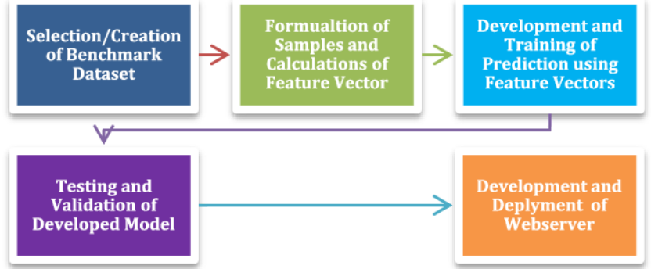
Block Diagram

Slide 12
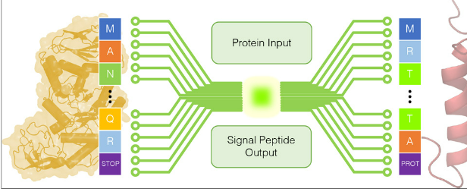
Architecture Diagram

Slide 13
SOFTWARE REQUIREMENTS:
Operating System : Windows 10
Platform : python

Slide 14
HARDWARE REQUIREMENTS:
Keyboard
Mouse
Hard disk 500GB
Ram 4 Gb

Slide 15
CONCLUTION
In this study, we have proposed a prediction model named iPhosD-PseAAC for phosphoaspartate site prediction using Chou’s 5-steps rule. Phosphoaspartate plays many fundamental roles in a number of biological processes, including signal transduction pathways, energy metabolism, various cellular processes, and ripening and circadian rhythms in plants. The aim of the current study was to propose a new and more accurate phosphoaspartate sites predictor and make it easy-to-use, user-friendly, and publicly available to experimental biologists to get their desired results. In PseAAC, it uses the various compositional and positional features of the protein sequence

Slide 16
REFERENCE
[1]S, Hayat M (2018). iMethyl-STTNC: Identification of N6- methyladenosine sites by extending the idea of SAAC into Chou’s PseAAC to formulate RNA sequences. Journal of Theoretical Biology 455: 205–211. DOI 10.1016/j. jtbi.2018.07.018.
[2] MA, Rasool N, Khan YD (2017). Prediction of N-linked glycosylation sites using position relative features and statistical moments. PLoS One 12: e0181966. DOI 10.1371/ journal.pone.0181966.
[3] M, Hayat M, Jan Z (2018). iMem-2LSAAC: a two-level model for discrimination of membrane proteins and their types by extending the notion of SAAC into Chou’s pseudo amino acid composition. Journal of Theoretical Biology 442: 11– 21. DOI 10.1016/j.jtbi.2018.01.008

Slide 17
[4]P, Besant P, Piggott MJ (2011). Focus on phosphoaspartate and phosphoglutamate. Amino Acids 40: 1035–1051. DOI 10.1007/s00726-010-0738-5.
[5] , Khan SA, Jamil H, Rasool N, Khan YD (2016). A prediction model for membrane proteins using moments based features. BioMed Research International 2016: 1–7. DOI 10.1155/ 2016/8370132 .
[6] Rasool N, Khan YD (2017). A treatise to computational approaches towards prediction of membrane protein and its subtypes. Journal of Membrane Biology 250: 55–76. DOI 10.1007/s00232-016-9937-7.

Slide 18
[7] Huang T, Su J, Zhang X, Chen W, Zhang F, He L, Chou KC (2018). Implications of newly identified brain eQTL genes and their interactors in Schizophrenia. Molecular TherapyNucleic Acids 12: 433–442. DOI 10.1016/j.omtn.2018.05.026
[8] Chou KC (2004). Predicting subcellular localization of proteins in a hybridization space. Bioinformatics 20: 1151– 1156. DOI 10.1093/bioinformatics/bth054
[9] EJ, Laub MT (2012). Evolution of two-component signal transduction systems. Annual Review of Microbiology 66: 325–347. DOI 10.1146/annurev-micro-092611-150039.

Slide 19
[10]Predicting structural classes of proteins by incorporating their global and local physicochemical and conformational properties into general Chou’s PseAAC. Journal of Theoretical Biology 454: 139–145. DOI 10.1016/j. jtbi.2018.05.033.
[11]Ding H, Feng P, Lin H, Chou KC (2016a). iACP: a sequence-based tool for identifying anticancer peptides. Oncotarget 7: 16895–16909. DOI 10.18632/oncotarget.7815
[12] Ding H, Zhou X, Lin H, Chou KC (2018). iRNA(m6A)- PseDNC: identifying N6-methyladenosine sites using pseudo dinucleotide composition. Analytical Biochemistry 561–562: 59–65. DOI 10.1016/j.ab.2018.09.002.

Slide 20
[13] Feng P, Ding H, Lin H, Chou KC (2016b). Using deformation energy to analyze nucleosome positioning in genomes. Genomics 107: 69–75. DOI 10.1016/j.ygeno.2015.12.005.
[14] P, Yang H, Ding H, Lin H, Chou KC (2017). iRNA-AI: identifying the adenosine to inosine editing sites in RNA sequences. Oncotarget 8: 4208–4217. DOI 10.18632/ oncotarget.13758.
[15] pLoc-mPlant: predict subcellular localization of multi-location plant proteins by incorporating the optimal GO information into general PseAAC. Molecular BioSystems 13: 1722–1727. DOI 10.1039/C7MB00267J.

