Slide 1
TRANSMISSION LINE FAULT DETECTION USING IOT

Slide 2
Abstract
The fault occurred in transmission line is very much dangerous for the locality.
In HV and EHV transmission line there are less fault occurrence but in locality the fault occurrence is more as compared to outer transmission line.
In our prototype we design a model which is to be detect the fault in transmission line by comparing the voltage signal between the transmission line and a reference value, the reference value is predetermined and if the transmission line voltage is more than or less than reference value then fault is to be shown in display.

Slide 3
The information regarding fault occurrence in particular phase is send to web page via IOT device which is NODE MCU(Esp8266) and also shown in display.
The optocoupler is used to sense the voltage and send output to microcontroller IC. Here microcontroller IC ATMEGA 16 is used in this IC programming is done which compare the voltage signal and send output to IOT module and display.
The power supply is provided to supply 5-volt dc power to all component this supply is separate from the supply which is used to check the fault occurrence.

Slide 4
Existing System
The electric power grid is highly vulnerable to a variety of natural actions, which can have a considerable effect on power system operation.
A faulted segment can be determined from audible or electromagnetic signals and requires dispatching crew members to the outage area. There have been various techniques largely used in the industries, including the tracing approach through acoustic, electromagnetic or current.
It is a technique used to detect fault location of cable from one or both ends without tracing.

Slide 5
Disadvantage of Existing System
There is lack of GPS signal in some rural areas.
High initial cost.
The only work that addresses the problem of finding optimal locations of cellular transceivers is presented.
This problem is to come up with a mechanism that can detect the fault in electricity transmission line automatically and intimate the authorities with a specific location.

Slide 6
PROPOSED SYSTEM :
The use of sensor networks has been proposed for several applications like mechanical state processing and dynamic transmission line rating applications.
The hierarchical model proposed in, offers a very expensive solution with the idea of deploying cellular transceivers on every tower.
The proposed neural fault detector and locator were trained using various sets of data available from a selected power network model and simulating different fault scenarios and different power system data (source capacities, source voltages, source angles, time constants of the sources).

Slide 7
ADVANTAGE
There is an approaching need to equip the age old transmission line infrastructure with a high performance data communication network, that supports future operational requirements like real in the time record and control necessary for smart grid integration.
The electric power infrastructure is highly vulnerable against many forms of natural and malicious physical events, which can adversely affect the overall performance and stability of the grid.
The paper proposes a very simple, fast efficient and cost-effective approach to identify the fault location in the transmission network.

Slide 8
TITLE | AUTHOR | DESCRIPTION
Strategic power infrastructure defense | H. Li, G. W. Rosenwald, J. Jung, and C. Liu, | The proposed Strategic Power Infrastructure Defense (SPID) system methodology is a real-time, wide-area, adaptive protection and control system involving the power, communication, and computer infrastructures.
Vehicle Communication System Using LiFi Technology | G. Vidhya Krishnan, R.Nagarajan, T. Durka,M.Kalaiselvi, M.Pushpa and S. Shanmuga priya, | The vehicle to vehicle communication is the most effective solution that has been used in order to reduce vehicles’ accidents.

Slide 9
TITLE | AUTHOR | DESCRIPTION
Intelligent Smart Home Automation and Security System Using Arduino and Wi-Fi | J. Chandramohan, R. Nagarajan, K. Satheeshkumar, N. Ajith kumar, P. A. Gopinath and S.Ranjith kumar, | In continued growth of popularity and functionality by mobile devices, demand advanced mobile applications widespread in human life.
A survey on communication net-works for electric system automation | V. C. Gungor and F. C. Lambert, | The operational and commercial demands of electric utilities require a high-performance data communication network that supports both existing functionalities and future operational requirements.

Slide 10
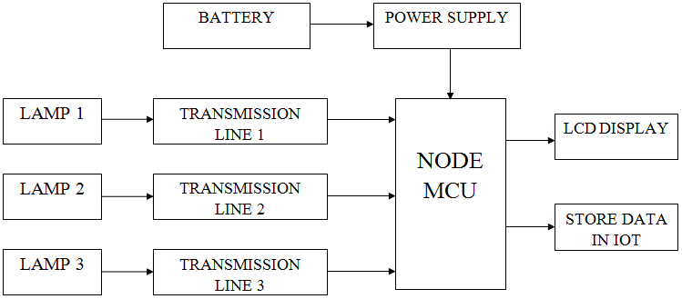
Block Diagram

Slide 11
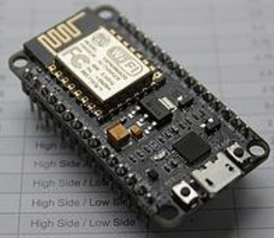
NODE MCU
The Node MCU- ESP8266 is a microcontroller with wifi capability. It is an open source Io T platform.
This small board allows microcontrollers to connect to a Wi-Fi network and make simple TCP/IP connections using Hayes-style commands.
The operating system and processor used in it is XTOS and ESP8266. It has a memory of 128KB and storage of 4MB. The power for the controller is provided through USB.

Slide 12
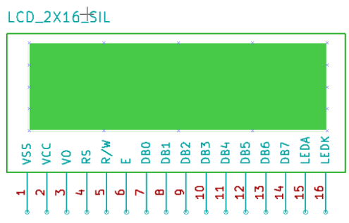
LCD DISPLAY
LCD is a combination of two states of matter, the solid and the liquid. It is an electronic display module with a 16x2 LCD screen which says that it has 16 characters with respect to 2 rows.
LCD uses a crystal liquid to produce a visible image. This technology used for displaying the image in the notebook or some other electronic devices. It has a unique advantage of having low power consumption than the LED or cathode ray tube.

Slide 13
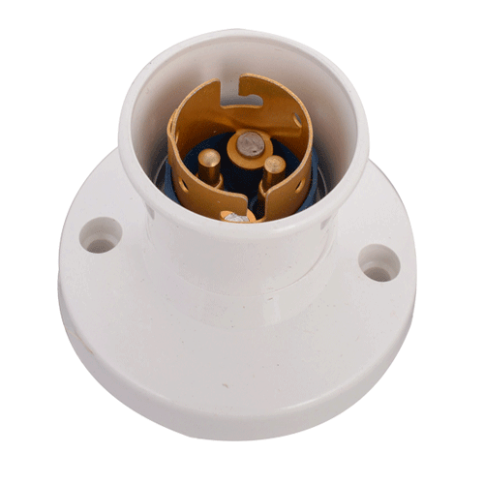
LAMP HOLDER
A device which mechanically supports a lamp for the purposes of making electrical contact with the lamp.
Lamps are usually inserted in lamp holder sockets which provide electrical connections to the lamp and support it in the lighting fixture. Some miniature lamps have wire leads suitable for direct connection to wires; some reflector lamps have screw terminals for wire connections.

Slide 14
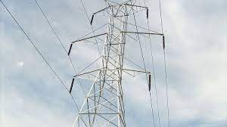
TRANSMISSION LINE
In electrical engineering, a transmission line is a specialized cable or other structure designed to conduct electromagnetic waves in a contained manner.
The term applies when the conductors are long enough that the wave nature of the transmission must be taken into account.

Slide 15
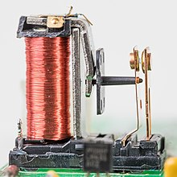
RELAY
A relay is an electrically operated switch. It consists of a set of input terminals for a single or multiple control signals, and a set of operating contact terminals.
The switch may have any number of contacts in multiple contact forms, such as make contacts, break contacts, or combinations thereof. Relays were first used in long-distance telegraph circuits as signal repeaters: they refresh the signal coming in from one circuit by transmitting it on another circuit.

Slide 16
CONCLUSION
The model design in such a way to solve the problems faced by consumer.
By using such method, we can easily detect the fault and resolve it.
It is highly reliable and locate the fault in three phase transmission line and also supposed to data storage.
It works on real time so we maintain all data sheet and avoid the future problem in transmission line.

Slide 17
REFERENCE
[1] G. Vidhya Krishnan, R.Nagarajan, T. Durka,M.Kalaiselvi, M.Pushpa and S. Shanmuga priya, "Vehicle Communication System Using LiFi Technology," International Journal of Engineering and Computer Science (IJECS), Volume 6, Issue 3, pp. 20651-20657, March 2017.
[2] J. Chandramohan, R. Nagarajan, K. Satheeshkumar, N. Ajith kumar, P. A. Gopinath and S.Ranjith kumar,"Intelligent Smart Home Automation and Security System Using Arduino and Wi-Fi," International Journal of Engineering And Computer Science (IJECS), Volume 6, Issue 3, pp. 20694-20698, March 2017.

Slide 18
[3] V. C. Gungor and F. C. Lambert, “A survey on communication net-works for electric system automation,” Comput. Netw. vol. 50, no.7, pp.877– 897, May 2006.
[4] P. Ramachandran, V. Vittal, and G. T. Heydt, “Mechanical state estimation for overhead transmission lines with level spans,” IEEE Trans. Power Syst., vol. 23, no. 3, pp. 908– 915, Aug. 2008.
[5] P. Zhang, F. Li, and N. Bhatt, “Next generation monitoring, analysis, and control for the future smart control center,” IEEE Trans. Smart Grid, vol. 1, no.2, pp. 186– 192, Sep. 2010.

Slide 19
[6]H. Li, G. W. Rosenwald, J. Jung, and C. Liu, “Strategic power infrastructure defense,” Proc. IEEE, vol. 93, no. 5, pp. 918– 933, May 2005.
[7] R. Nagarajan and S. Sathishkumar, K. Balasubramani, C. Boobalan, S. Naveen and N. Sridhar, “Chopper Fed Speed Control of DC Motor Using PI Controller,” 7. IOSR-Journal of Electrical and Electronics Engineering (IOSR-JEEE), Volume 11, Issue 3, Ver.I, pp. 65-69, May– Jun. 2016.

