Slide 1
Traffic Light Monitoring System based on Node MCU using Internet of Things

Slide 2
Abstract
The increasing numbers of the private car cause the road traffic congestion. That is becoming important problems in the big cities.
Another solution to reduce the traffic jam is developing intelligent transportation system such as intelligent traffic light system.
However, the solution of such problems is one of the mandatory concern. In recent years, a smart city is the hottest topic for the efficiency of traffic light using the Internet of Things.

Slide 3
Based on that issue, this research proposed traffic light monitoring system that can monitor and display a real-time traffic congestion through smartphones.
The system utilized NodeMCU (ESP 8266 12E) equipped by IR obstacle sensor to indicate the road traffic congestion. To connect the internet, the system uses ESP8266 12E wifi in the chip of NodeMCU. It will send a notification to smartphones user.
With this research, it is expected to improve road traffic tremendously such as to predict traffic congestion and the system can give some efficient routes for a user.

Slide 4
Existing System
In the existing system ,the main problem is maintaining and controlling the traffic was doing manually .In our country no where is using IOT technology to control the traffic and also to track the person who is not following the traffic rules .
Our government spending lot of money to control the traffic by providing money to the traffic polices. Two different classes of TOF depth sensors exist, depending on the method they adopt to measure distances and the properties of the transmitted signal.
The first class is represented by Pulse Modulation (PM) sensors. Distance is computed directly from the time of flight using a high resolution timer that measures the delay between signal emission and reception.

Slide 5
Disadvantage of Existing System
The main concern of the modern automotive industry is passenger safety and accidents due to drivers' negligence are one of the problems for the roadside people.
This problem is being partly solved with the use of this vehicle speed control system. Hence a system that does ensure safety is in huge demand.
To overcome the mentioned problem, we are designing a system that controls vehicle speed in particular zone. And detects alcohol consumption and also detect the accident and sends the accident location to the family person.
Globally road accident is considered to be an important issue, which can be reduced by proper vehicle speed monitoring system.

Slide 6
PROPOSED SYSTEM :
In our proposed work, the count of vehicles passing through a passage that is at a few distance before the active traffic jam points can be conveyed to control station for managing the traffic flow.
The proposed system manages the traffic on local and centralized servers by exploiting the concepts of IoT and Intelligent Image Processing.
It is divided into frames, and then after binary conversion and noise removal, blob detection is performed and finally the count is estimated using the proposed vehicle counting method.
An automatic traffic light control system was proposed in using IoT, IR sensor and cameras.
A system to control traffic was proposed in, which used wireless transmitter to transmit the images directly to main server.

Slide 7
ADVANTAGE
Automatically control the traffic.
Tracking the person.
We can reduce excessive traffic jams.
Daily feedback.
The system automatically override the signals in emergency conditions.
Operated remotely over the internet

Slide 8
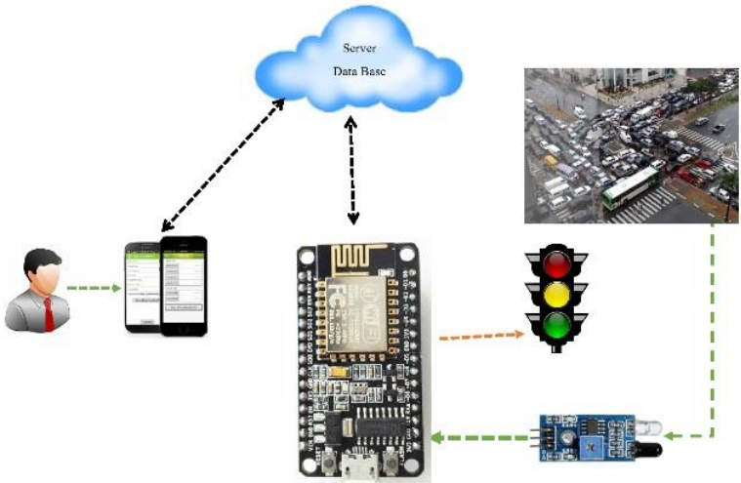
Block Diagram

Slide 9
SOFTWARE REQUIREMENTS:
Operating System : Windows 10
Platform : DOT NET TECHNOLOGY
Front End : ASP.Net 4.0
Back End : SQL SERVER 2014

Slide 10
HARDWARE REQUIREMENTS:
Keyboard
Mouse
Hard disk 500GB
Ram 4 Gb

Slide 11
CONCLUSION
The design of monitoring traffic light system on this research is not too much developing as a whole. Need future research about ITS.
The monitoring traffic congestion system was presented traffic connection routes with IoT to develop a real-time software for managing traffic conditions.
This system used a web server and an Android client application for reporting and displaying traffic condition. The system for administrators includes a web application, and for the interface of the client application, it is easy and safe to use while driving. The focus on this research about efficiency and traffic density using ITS and IoT technologies.

Slide 12
REFERENCE
[1] Wang Y and Qi H 2012 “Research of Intelligent Transportation System based on the Internet of Things frame” Wirel. Eng. Technol. 3 (3) pp. 160–166.
[2] Xu X, Gao X, Zhao X, Xu Z and Chang H 2016 “A novel algorithm for urban traffic congestion detection based on GPS data compression” Int. Conf. Serv. Oper. Logist. Informatics pp. 107– 112.
[3] Wu N and Fang H 2017 “A Novel Traffic Light Recognition Method for Traffic Monitoring Systems” 2 nd Asia-Pasific Conference on Intelligent Robot System (ACIRS) pp. 141–145.
[4] Chepuru A and Pradesh A 2015 “a Survey on Iot Applications for Intelligent Transport Systems” (8) pp. 116–127.
[5] Pyykonen P, Laitinen J, Viitanen J, Eloranta P and Korhonen T 2013 “IoT for intelligent traffic system” Proc. - 2013 IEEE 9th Int. Conf. Intell. Comput. Commun. pp. 175–179.

Slide 13
[6] Sherly J and D.Somasundareswari, “Internet of Things Based Smart Transportation Systems,” Int. Res. J. Eng. Technol. 2 (7) pp. 1207–1210.
[7] Nor, Mohd R F A, Zaman F H K and Mubdi S 2017 “Smart Traffic Light for Congestion Monitoring using LoRaWAN” IEEE 8th Control and System Graduate Research Colloquium (ICSGRC) pp. 4–5.
[8] Choosri N 2015 “IoT-RFID Testbed for Supporting Traffic Light Control” Int. J. Inf. Electron. Eng. 5 (2) pp. 102–106.
[9] U M V “ESP8266 Handson Technology” pp. 1–22.
[10] De Nunzio G and Marsella G “FC-51 : IR Infrared Obstacle Detection Sensor Module 2 - 30cm” pp. 0–8.

