Slide 1
SOLAR POWERED DC HOME WITH MPPT& INTEGRATING VOLTAGE CONTROL

Slide 2
Abstract
The increase in consumption of low power DC appliances in home, accounts to high AC-DC conversion loss. The solar source is inherently a DC source which mainly provides the supply for DC home with low power DC appliances.
This paper presents a DC Home model powered by solar source integrated with conventional backup.
The power backup is provided by the integration of the AC supply and a battery where AC Supply is treated as secondary source and the battery is treated as tertiary source.

Slide 3
The output of solar panel is fed to the DC home through an efficient Flyback converter with power control which is achieved by implementing incremental conductance algorithm in it.
The voltage control is implemented by Inverting buck boost converter with closed loop integrating control in order to provide a desired voltage to the DC appliances.
In the proposed system, flyback converter controls the power and the inverting buck boost converter controls the output voltage to the load. The proposed model is simulated using MATLAB Simulink and the results convey that the model maintains the desired power and voltage for the DC home.

Slide 4
Existing System
The PV solar systems exist in many different configurations with regard to their connections with inverter systems, external grid, battery bank, or other electrical loads.
In that ,existing system has a new solar power generation system. The solar power generation system is composed a dc-dc power converter and a seven level inverter The seven level inverter contains only six power electronics switches.
This switch is switched at high frequency at any time to generate the seven level output voltage, the switching losses is reduced, and the power efficiency is improved.

Slide 5
Disadvantage of Existing System
The extensive use of fossil fuel has resulted in the global problem of greenhouse emissions.
Solar energy is not available at night, storing its energy is an important issue in order to have continuous energy availability.
Electrical circuits can be designed to present arbitrary loads to the photovoltaic modules and then convert the voltage, current, or frequency to suit other devices or systems, and MPPT solves the problem of choosing the best load to be presented to the PV system in order to get the most usable power out.

Slide 6
PROPOSED SYSTEM :
This paper proposes a MPPT controller based solar power generation system, which consist of dc/dc converter and a new nine-level inverter.
The input voltage of the solar panel is dc and it takes the dc input from the solar panel. The dc-dc boost converter boost up the input voltage and gives to the multilevel inverter.
This paper proposes a solar power generation system to convert the dc energy generated by a solar cell array into ac energy that is fed into the utility.

Slide 7
ADVANTAGE
The switching operation for a multilevel inverter is in order to improve power conversion efficiency. In theory multilevel inverter should be designed with higher voltage levels in order to improve the conversion efficiency and reduce harmonic content and electromagnetic interface.
This switch is switched at high frequency at any time to generate the seven level output voltage, the switching losses is reduced, and the power efficiency is improved.
The advantage of multilevel inverter is very small output voltage, results in higher output quality and lower switching losses.

Slide 8
TITLE | AUTHOR | DESCRIPTION
Design and implementation of a universal input flyback converter | U. S. Padiyar and V. Kamath, | Due to rapid increase in use of mobile devices, development of power supply for these devices has become a challenge. There is demand for smaller size adapter with high efficiency, power density etc.
An improved Flyback converter | G. M. Ponzo, G. Capponi, P. Scalia and V. Boscaino, | In particular, the proposed converter allows the mosfet off voltage to be reduced and clamped to the input, thus recovering the transformer leakage energy.

Slide 9
TITLE | AUTHOR | DESCRIPTION
Sustainable E- Bike Charging Station that Enables AC DC and Wireless Charging from Solar Energy | G.R Chandra Mouli, P Van Duijsen, F Grazian, A Jamodkar, P. Bauer and O Isabella, | The charging station has integrated battery storage that enables for both grid-connected and off-grid operation.
On voltage standards for DC home micro–Secondary Supplys energized by distributed sources | W. Li, X. Mou, Y. Zhou and C. Marnay, | An alternative path is designed to supply the high-power load groups through the public AC grid with less power conversion stages, when local sources are deficient.

Slide 10
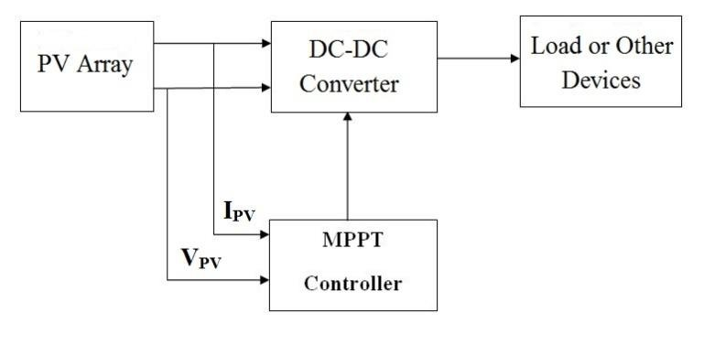
Block Diagram

Slide 11
SOFTWARE REQUIREMENTS:
Operating System : Windows 10
Platform : DOT NET TECHNOLOGY
Front End : ASP.Net 4.0
Back End : SQL SERVER 2014

Slide 12
HARDWARE REQUIREMENTS:
Keyboard
Mouse
Hard disk 500GB
Ram 4 Gb

Slide 13
CONCLUSION
This paper proposes a solar power generation system to convert the dc energy generated by a solar cell array into ac energy that is fed into the utility.
The proposed solar power generation system is composed of a buck-boost converter and a nine-level inverter. The switching power loss and improves the power efficiency.
The proposed solar power generation system generates a nine-level output voltage and outputs a sinusoidal current that in phase with the utility voltage. The proposed solar power generation system can effectively trace the maximum power of solar cell array.

Slide 14
REFERENCE
1.U. S. Padiyar and V. Kamath, "Design and implementation of a universal input flyback converter", 2016 International Conference on Electrical Electronics and Optimization Techniques (ICEEOT), pp. 3428-3433, 2016.
2.G. M. Ponzo, G. Capponi, P. Scalia and V. Boscaino, "An improved Flyback converter", 2009 6th International Conference on Electrical Engineering/Electronics Computer Telecommunications and Information Technology, pp. 310-313, 2009.
3.G.R Chandra Mouli, P Van Duijsen, F Grazian, A Jamodkar, P. Bauer and O Isabella, "Sustainable E- Bike Charging Station that Enables AC DC and Wireless Charging from Solar Energy", Energies 2020, vol. 13, no. 3549, pp. 1-21.

Slide 15
4.R. P. Nair and P. Kanakasabapathy, "Control of a DC microgrid under dynamic load condition", International Conference on Technological Advancements in Power and Energy (TAP Energy), pp. 1-6, 2017.
5.A. Rasheed, S. Khan, H. E. Gelani and F. Dastgeer, "AC vs. DC home: An efficiency comparison", 2019 International Symposium on Recent Advances in Electrical Engineering (RAEE), 2019.
6.A. Jain, M. D. Vijay, G. Bhuvaneswari and B. Singh, "Design and simulation of a solar powered DC home with Secondary Supply and battery back-up", 2016 IEEE 7th Power India International Conference (PIICON), pp. 429-434, 2016.
7.S. Iyer, W. G. Dunford and M. Ordonez, "DC distribution systems for homes", 2015 IEEE Power & Energy Society General Meeting, 2015.

Slide 16
8. V. Nandhini, K. Bharathi, S. Giri, S. Sowvav and A Suyampulingam, "Energy management and smart control of home appliances", Journal of Physics: Conference Series Open Access, vol. 1706, no. 1, pp. 1-9, December2020.
9. A Suyampulingam and V Subbiah, "PMSG Based Wind Turbine System Connected to DC Micro-Grid With MPPT Control", International Journal of Pure and Applied Mathematics, vol. 118, no. 10, pp. 99-105, 2018.
10.G. Arunkumar, D. Elangovan, P. Sanjeevikumar, J. B. H. Nielsen, Z. Leonowicz and P. K. Joseph, "DC Secondary Supply for domestic electrification", Energies, vol. 12, no. 11, pp. 2157, 2019.

