Slide 1
SMART WEARABLE FOR RESCUERS/VICTIMS

Slide 2
Abstract
In today’s scenario, there are risks at every moment of our life. People rambling around are found insecure, especially at remote outdoor locations where there are no rescue services provided.
One of these scenarios is an aquatic environment such as waterfalls, lakes, trekking, remote locations, water parks, swimming pools, beaches, etc.
Many lives are at risks in spite of lifeguard resources.

Slide 3
Therefore, to get rid of life’s endangering situations at such scenarios there must be the wearable device which sends the immediate signal to the lifeguards to provide rescue service to the individuals in danger.
Such a wearable device is a need for such scenarios.
According to this context, the following review is undertaken.

Slide 4
Existing System
In particular, the issues of Inter-BANs coexistence and interoperability were very little addressed.
The use of temperature and pulse rate sensors to automatically identify the possibility of an emergency and alert family and friends through a mobile app.
The three sensors for the automatic mechanism, namely pressure, temperature, and pulse rate sensors, along with the other hardware needed, such as GPS, GSM, which are all present inside the model.

Slide 5
Disadvantage of Existing System
A limitation of this equipment is that if too many swimmers, occlusion problem will appear. This system needs constant observation, expensive installation costs which are the main disadvantage.
To circumvent these drawbacks, the proposed system is based on a network of highly mounted overhead cameras.
That large-scale disasters might be caused by a combination of either natural, man-made or unexpected factors, and their negative impact on the human being is amplified due to the increased population densities in cities, public areas or buildings.

Slide 6
PROPOSED SYSTEM :
The proposed system connects deployed rescuers to extended networks and the Internet. CROW2 is an end-to-end system that runs the recently-proposed Optimized Routing Approach for Critical and Emergency Networks (ORACE-Net) routing protocol.
These proposed systems seem to solve the connectivity issues on-the-field between rescuers and trapped survivors.
Using sensors not only for worst case scenarios as the actual accident, but also for monitoring health and fitness, as heart rate monitors do, may be another incentive for users to upgrade their devices.

Slide 7
ADVANTAGE
As this system is based on health monitoring sensors, this has an advantage of convenience, lifesaving and real time. Sensors usually have different features (e.g. location), the performance is variable when putting different sensors into the common time slots.
If the combination of sensor pairs is carefully designed, the performance of CM mode could be much better than the schemes totally separating BANs on time domain.
These models are a key requirement for the accurate and realistic performance evaluation of high level MAC/Networking protocols in the specific context of mixed On-Body and B2B communications.

Slide 8
TITLE | AUTHOR | DESCRIPTION
Automated Drowning Detection and Security in Swimming Pool | S. Hemalatha, P.Nandhini, J.Vimala, V.Ramesh; | Thus arises the requirement for having a system that will consequently detect the drowning individuals and alarm the life guard at such risk.
Sensors and Functionalities of Non-Invasive Wrist-Wearable Devices: A Review | Aida Kamišali´c, Iztok Fister, Jr., Muhamed Turkanovi´c, Sašo Karakatiˇc | This paper provides a comprehensive review of sensors used in wrist-wearable devices, methods used for the visualization of parameters measured as well as methods used for intelligent analysis of data obtained from wrist-wearable devices.

Slide 9
TITLE | AUTHOR | DESCRIPTION
Design and Development of an IOT based wearable device for the Safety and Security of women and girl children | Anand Jatti, MadhviKannan , Alisha RM, Vijayalakshmi P, ShresthaSinha; | This objective is achieved by the analysis of physiological signals in conjunction with body position.
Wearable Sensors for Remote Health Monitoring | Sumit Majumder, Tapas Mondal, M. Jamal Deen | These systems will also allow healthcare personnel to monitor important physiological signs of their patients in real time, assess health conditions and provide feedback from distant facilities.

Slide 10
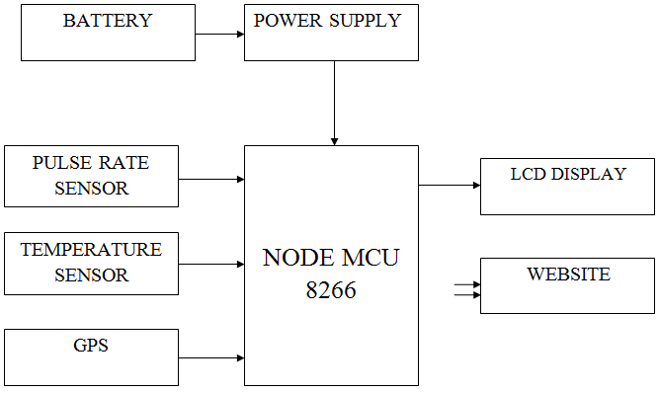
Block Diagram

Slide 11
SOFTWARE REQUIREMENTS:
Operating System : Windows 10
Platform : DOT NET TECHNOLOGY
Front End : ASP.Net 4.0
Back End : SQL SERVER 2014

Slide 12
HARDWARE REQUIREMENTS:
Keyboard
Mouse
Hard disk 500GB
Ram 4 Gb

Slide 13
CONCLUSION
After review from the aforementioned source, it can be analysed that, every person want to be in a better and secure world.
Sensing technology could also trigger avalanche airbags or release an emergency call including vital sign functions and GPS position automatically.
Hence, any rescue effort could be initiated much earlier than those in which includes developing a coherent framework for inferring semantic events involving beach where it is virtually impossible to track.

Slide 14
REFERENCE
[1] S. Hemalatha, P.Nandhini, J.Vimala, V.Ramesh; Automated Drowning Detection and Security in Swimming Pool; IJIRCCE (An ISO 3297: 2007 Certified Organization) Vol. 3, Special Issue 2, March 2015
[2] A Kanchana, Kavya G.R, Kavitha C, Soumya shree V, Salila Hegde; Automated Drowning Detection and Security in Swimming Pool; (IRJET) e-ISSN: 2395 -0056 Volume: 04 Issue: 06 | June -2017 www.irjet.net p-ISSN: 2395-0072
[3] Aida Kamišali´c, Iztok Fister, Jr., Muhamed Turkanovi´c, Sašo Karakatiˇc; Sensors and Functionalities of Non-Invasive Wrist-Wearable Devices: A Review; Received: 27 April 2018; Accepted: 22 May 2018; Published: 25 May 2018; sensors.

Slide 15
[4] Isha Goel, Dilip Kumar; Design and Implementation of Android-Based Wearable Smart Locator Band for People with Autism, Dementia, and Alzheimer; Received 7 August 2014; Revised 1 December 2014; Accepted 9 December 2014; http://dx.doi.org/10.1155/2015/140762
[5] Anand Jatti, MadhviKannan , Alisha RM, Vijayalakshmi P, ShresthaSinha; Design and Development of an IOT based wearable device for the Safety and Security of women and girl children; IEEE International Conference On Recent Trends In Electronics Information Communication Technology, May 20-21, 2016, India
[6] Johan Carlén, Jonas Larsson, Civilingenjör, Teknisk design 2017; Luleå tekniska universitet, Institutionen för ekonomi, teknik och samhälle.

Slide 16
[7] World Health Organization (WHO), Drowning Fact Sheet (2018), http://www.who.int/mediacentre/factsheets/fs347/en/
[8] Sumit Majumder, Tapas Mondal, M. Jamal Deen; Wearable Sensors for Remote Health Monitoring; Received: 30 September 2016; Accepted: 21 December 2016; Published: 12 January 2017; Sensors; Review
[9] Mohamed Kharrat, Yuki Wakuda, Shinsuke Kobayashi, Noboru Koshizuka, Ken Sakamura; Near drowning detection system based on swimmer’s physiological information analysis; World Conference on Drowning Prevention 2011; ID:18/Paper: 370
[10] Nasrin Salehi and Maryam Keyvanara Seyed Amirhassan Monadjemmi, “An Automatic Video-based Drowning Detection System for Swimming Pools Using Active Contours”, MECS I.J. Image, Graphics, and Signal Processing, 2016, 8, 1-8

