Slide 1
SMART LPG CYLINDER MONITORING AND EXPLOSION MANAGEMENT SYSTEM

Slide 2
Abstract
In India, Liquified Petroleum Gas Cylinder is used as the primary source for cooking.
The level of Liquified Petroleum Gas (LPG) Cylinder decreases gradually on daily usage. Upon complete utilization of the LPG Cylinder, a new cylinder can be availed by booking with LPG vendors which may take up to two to three days.
Users have no provision to view the level of the LPG Cylinder used daily and sudden depletion of the LPG cylinder causes discomfort to the user which will result in frustration as the delivery of a new LPG cylinder takes time.

Slide 3
The LPG is coupled to the burner via a regulator that can Turn ON / OFF the flow of LPG to the burner.
Also, fire accidents are unpredictable when there is a leakage from the LPG cylinder that may cause serious damage to people and property.
In order to address the above issues, an Internet of Things (IoT) - based Monitoring and Management system is built to measure the level of LPG inside the cylinder and to turn off the regulator of the cylinder automatically when LPG leakage is detected.

Slide 4
Existing System
When the target combustible gas exists, the sensor conductivity increases along with the rising gas concentration.
There are many existing systems which can detect leakage using different gas sensors.
In all existing methods, different gas sensing technologies are used. However most of the accidents happen because of our negligence to not switch off the regulator.
The detection of gases and its monitoring has already been done.

Slide 5
Disadvantage of Existing System
Most of the analphabets are unable to complete the booking, and usually , these phone line telephones are moreover not reachable because of the overcrowded calls or else telephones that are not functioning because of about procedural problems.
As we shortened the problems faced by consumers of LPG gas, we found some solution to meet the few requirements, as we finished our structure fully mechanize the refill reservation process without any human intervention.
The other problem which is faced by the users of LPG cylinder is the untimely emptying of the cylinder.

Slide 6
PROPOSED SYSTEM :
The design of a sensor-based automatic gas leakage detector with an alert and control system has been proposed.
As safety and security is the most important factor we have proposed a LPG monitoring and gas leakage detection system.
The proposed system uses the Text Loacal API to alert the person about the gas leakage via SMS and status of cylinder.
The proposed system when successfully implemented can also be used in mines where gas sensors will detect leakage of toxic gases and can send a signal for the emergency evacuation of workers.

Slide 7
ADVANTAGE
The system is very efficient, user friendly, portable, small in size and cost effective.
This is a low-cost, low power, lightweight, portable, safe, user friendly, efficient, multi featured and simple system device for detecting gas.
It insures the security from the gas leakage and hazards.
It is very less time consuming and cylinder replace in time.
Easy implementation.

Slide 8
TITLE | AUTHOR | DESCRIPTION
LPG Gas Monitoring System | Arun Raj, Athira Viswanathan, Athul T S | In this system, the gas sensor detects the leakage of the LPG and alert the owner about the leak by sending SMS to his personal mobile and activate the alarm.
Design of Smart LPG Regulator using Internet-of-Things | Ankur Bachchan,Kajal Bhasharkar,Mohammad Zaki Gundagi,Vinish Bhan, | This paper aims at designing a basic home automation system using the internet which can be monitored and accessed from anywhere in the world

Slide 9
TITLE | AUTHOR | DESCRIPTION
Automatic Gas Controller Unit | Krishnadas. K, N. P. Prajith, Pooja Sidharthan, Safa Mariyam, Arul. V. H, 2019, | The proposed system with its weighing sensor helps to measure the cylinder weight and continuously updates the user about the concentration of gas left in the cylinder.
Early Detection of Leaks on Gas Cylinders Using Arduino Based MQ-6 Sensors | Fatkiyah, E & Persada, D & Andayati, D. (2019). | The gas leak early detection device is a very appropriate effort in dealing with early detection of LPG leak in order to minimize the occurrence.

Slide 10
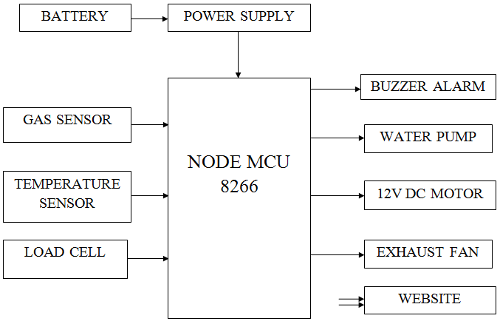
Block Diagram

Slide 11
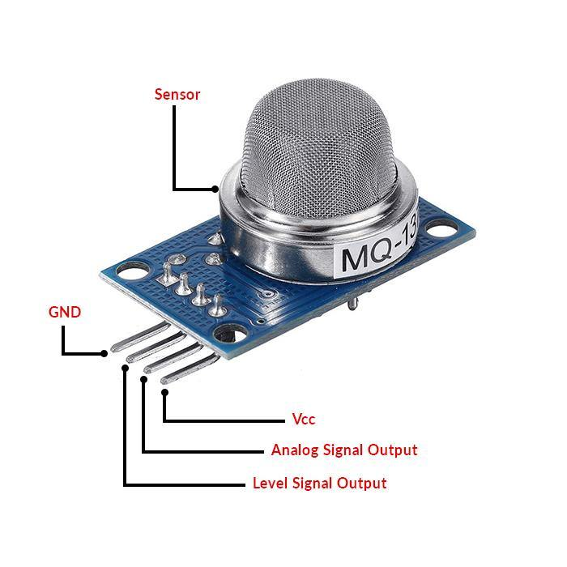
Gas sensor
The gas cylinders mostly contains LPG. The main constituents of LPG are propane and butane gas. The sensor available to detect this gases is MQ-6 and MQ-5. But MQ-6 sensor detects only LPG and butane gas. So, we selected it.
This sensor is stable, durable, has fast response, and can be used in simple drive circuit. It has analog output and wide detection range. This are the characteristics of the sensor.

Slide 12
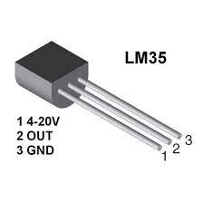
Temperature sensor
A temperature sensor is a device used to measure temperature. This can be air temperature, liquid temperature or the temperature of solid matter.
There are different types of temperature sensors available and they each use different technologies and principles to take the temperature measurement.

Slide 13
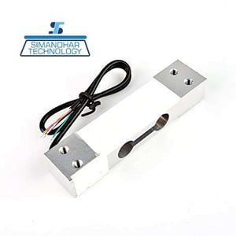
Load cell
A load cell is a force transducer. It converts a force such as tension, compression, pressure, or torque into an electrical signal that can be measured and standardized.
As the force applied to the load cell increases, the electrical signal changes proportionally.

Slide 14
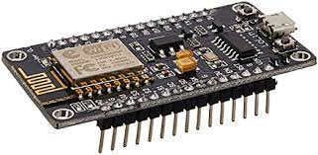
Node MCU
The NodeMCU (Node Micro Controller Unit) is an open source software and hardware development environment that is built around a very inexpensive System-on-a-Chip (SoC) called the ESP8266.
The ESP8266, designed and manufactured by Espressif Systems, contains all crucial elements of the modern computer: CPU, RAM, networking (wifi), and even a modern operating system and SDK.

Slide 15
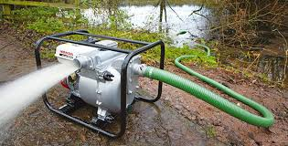
WATER PUMP
Water pumps and dewatering systems are water control equipment that utilise pumping or evaporation to remove or drain various forms of water from construction sites, riverbeds, mine shafts, underground metro networks, tunnels, caisson, and even residential buildings.

Slide 16
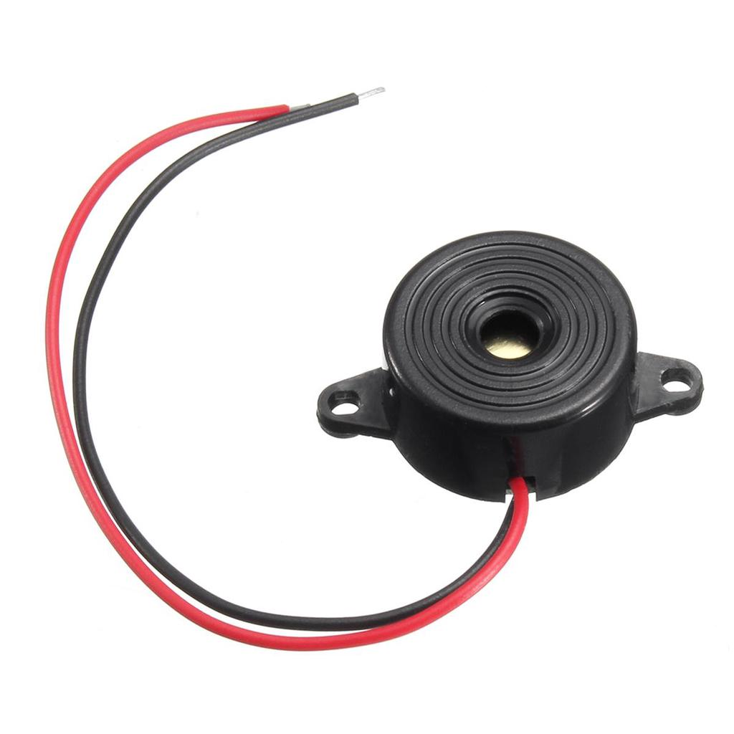
BUZZER ALARM
A buzzer or beeper is an audio signaling device, which may be mechanical, electromechanical, or piezoelectric (piezo for short).
Typical uses of buzzers and beepers include alarm devices, timers, and confirmation of user input such as a mouse click or keystroke.

Slide 17
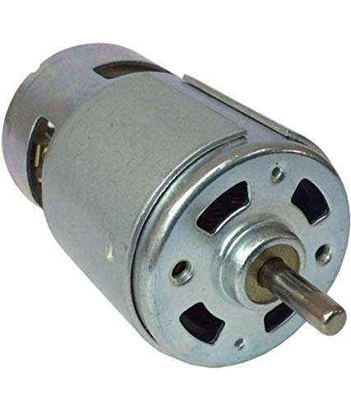
12V DC MOTOR
A DC motor is any motor within a class of electrical machines whereby direct current electrical power is converted into mechanical power.
Most often, this type of motor relies on forces that magnetic fields produce. Regardless of the type, DC motors have some kind of internal mechanism, which is electronic or electromechanical.

Slide 18
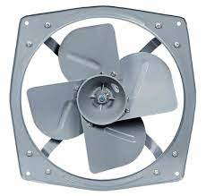
EXHAUST FAN
An exhaust fan is a fan which is used to control the interior environment by venting out unwanted odors, particulates, smoke, moisture, and other contaminants which may be present in the air.
Exhaust fans can also be integrated into a heating and cooling system.

Slide 19
WEBSITE
A website (also written as web site) is a collection of web pages and related content that is identified by a common domain name and published on at least one web server. Notable examples are wikipedia.org, google.com, and amazon.com.
All publicly accessible websites collectively constitute the World Wide Web. There are also private websites that can only be accessed on a private network, such as a company's internal website for its employees.
Websites are typically dedicated to a particular topic or purpose, such as news, education, commerce, entertainment, or social networking. Hyperlinking between web pages guides the navigation of the site, which often starts with a home page.

Slide 20
SOFTWARE REQUIREMENTS:
Operating System : Windows 10
Platform : DOT NET TECHNOLOGY
Front End : ASP.Net 4.0
Back End : SQL SERVER 2014

Slide 21
HARDWARE REQUIREMENTS:
Keyboard
Mouse
Hard disk 500GB
Ram 4 Gb

Slide 22
CONCLUSION
In this paper, the proposed idea is for the household gas cylinder users, where the users can be aware of how much gas is present in their gas cylinder and it also makes easy booking of a new cylinder.
Additionally, the system provides the gas cylinders to the LPG vendors, so that they can maintain their cylinder stock accordingly.
Also, the proposed system automatically turns off the gas cylinder regulator when there is excessive gas leakage around the system in order to avoid accidents by sending gas leakage messages to the user.

Slide 23
The system can also be integrated with shops, hotels, and industries where they can use it for both monitoring and safety purposes.
Thus, the low-cost system can be used for gas leakage monitoring and also plays an important role to prevent explosion due to leakage.

Slide 24
REFERENCE
[1] Arun Raj, Athira Viswanathan, Athul T S - “LPG Gas Monitoring System”, 2015.
[2] J. Clerk Maxwell, A Treatise on Electricity and Magnetism, 3rd ed., vol. 2. Oxford: Clarendon, 1892, pp.68-73.
[3] I.S. Jacobs and C.P. Bean, “Fine particles, thin films and exchange anisotropy,” in Magnetism, vol. III, G.T. Rado and H. Suhl, Eds. New York: Academic, 1963, pp. 271-350.
[4] Ankur Bachchan,Kajal Bhasharkar,Mohammad Zaki Gundagi,Vinish Bhan, Design of Smart LPG Regulator using Internet-of-Things, International Journal of Engineering Technology, Management and Applied Sciences, February 2016, Volume 4, Issue 2, ISSN 2349-4476.

Slide 25
[5] K. Elissa, “Title of paper if known,” unpublished.
[6] R. Nicole, “Title of paper with only first word capitalized,” J. Name Stand. Abbrev., in press.
[7] Krishnadas. K, N. P. Prajith, Pooja Sidharthan, Safa Mariyam, Arul. V. H, 2019, Automatic Gas Controller Unit, INTERNATIONAL JOURNAL OF ENGINEERING RESEARCH & TECHNOLOGY (IJERT) Volume 08, Issue 05 (May 2019)
[8] Maier, Alexander & Sharp, Andrew & Vagapov, Yuriy. (2017). Comparative Analysis and Practical Implementation of the ESP32 Microcontroller Module for the Internet of Things. 10.1109/ITECHA.2017.8101926.

Slide 26
[9] Muller, Ivan & Machado de Brito, Renato & Pereira, Carlos & Brusamarello, Valner. (2010). Load cells in force sensing analysis - Theory and a novel application. Instrumentation & Measurement Magazine, IEEE. 13. 15 - 19. 10.1109/MIM.2010.5399212.
[10] Fatkiyah, E & Persada, D & Andayati, D. (2019). Early Detection of Leaks on Gas Cylinders Using Arduino Based MQ-6 Sensors. Journal of Physics: Conference Series. 1413. 012030. 10.1088/1742- 6596/1413/1/012030.

