Slide 1
PREDICTION OF CHRONIC KIDNEY DISEASE USING DEEP NEURAL NETWORK

Slide 2
Abstract
Deep neural Network (DNN) is becoming a focal point in Machine Learning research. Its application is penetrating into different fields and solving intricate and complex problems.
DNN is now been applied in health image processing to detect various ailment such as cancer and diabetes. Another disease that is causing threat to our health is the kidney disease.
This disease is becoming prevalent due to substances and elements we intake. Death is imminent and inevitable within few days without at least one functioning kidney.

Slide 3
Ignoring the kidney malfunction can cause chronic kidney disease leading to death.
Frequently, Chronic Kidney Disease (CKD) and its symptoms are mild and gradual, often go unnoticed for years only to be realized lately.
Bade, a Local Government of Yobe state in Nigeria has been a center of attention by medical practitioners due to the prevalence of CKD.
Unfortunately, a technical approach in culminating the disease is yet to be attained.

Slide 4
We obtained a record of 400 patients with 10 attributes as our dataset from Bade General Hospital.
We used DNN model to predict the absence or presence of CKD in the patients.
The model produced an accuracy of 98%. Furthermore, we identified and highlighted the Features importance to provide the ranking of the features used in the prediction of the CKD.
The outcome revealed that two attributes; Creatinine and Bicarbonate have the highest influence on the CKD prediction.

Slide 5
Existing System
A large number of features exist in the raw data in which some may cause low information and error; hence feature selection techniques can be used to retrieve useful subset of features and to improve the computation performance.
The proposed MDFS model performs superior to existing works in terms of accuracy and the number of reduced features.
The effect of sodium intake on the progression of CKD is controversial, and multiple inconclusive studies exist. The effect of sodium intake on the progression of CKD is controversial, and multiple inconclusive studies exist.

Slide 6
Disadvantage of Existing System
In any machine learning problem preprocessing of the data before applying any algorithm. Data mining statistical techniques are used for data preprocessing.
Wrapper methods are better than filter methods in selecting the most useful features but they need a large dataset otherwise there is a problem of overfitting.
SMOT technique is used to oversample minority class in the dataset in classification problem. In our dataset, we have more patient records having CKD disease than nonCKD. Classifier's performance reduces because of imbalanced classes.

Slide 7
PROPOSED SYSTEM :
Using commonly available health parameters, the proposed system can assess the risk of CKD for public health.
The proposed model will fail to classify, and the classification result will not be acceptable when we consider actual data.
They proposed to compare Decision Tree to Support Vector Machine (SVM) technique in predicting CKD.
The classification stage revealed that Decision Tree has more successful than SVM recognition in correct classification.

Slide 8
ADVANTAGE
It enhances the comprehensibility of data, facilitates better visualization of data, reduces training time of learning algorithms, and improves the performance of prediction.
They usually work according to a specific learning algorithm which helps in optimizing the performance of a learning algorithm.
The performance of Decision tree method is 91% accurate when compared with naive Bayes method.
Various performance parameters like accuracy, specificity, precision, sensitivity, false-positive rate, Fmeasure are used in health care to analyze the performance of the model.

Slide 9
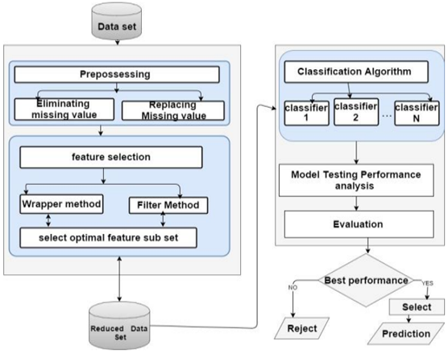
Block Diagram

Slide 10
SOFTWARE REQUIREMENTS:
Operating System : Windows 10
Platform : DOT NET TECHNOLOGY
Front End : ASP.Net 4.0
Back End : SQL SERVER 2014

Slide 11
HARDWARE REQUIREMENTS:
Keyboard
Mouse
Hard disk 500GB
Ram 4 Gb

Slide 12
CONCLUSION
The main goal of this research is to use DNN model for the prediction of kidney disease to high degree of accuracy.
We succeeded in classifying kidney disease dataset into CKD and non-CKD with 98% overall accuracy when the model was tested with a set of data that were not used during the training process.
The adopted DNN model proved to be efficient and suitable for the prediction of kidney disease.

Slide 13
The study also highlighted the importance of the features used in the prediction of kidney disease.
This revealed that from the 10 attributes, Creatinine and Bicarbonate are the attributes with highest influence on CKD as opposed to the findings by Ahmed and Alshebly (2019) that found that Creatinine and Urea has the highest influence on CKD prediction.

Slide 14
REFERENCE
1. Koh, H. C., & Tan, G. (2005). Data mining applications in healthcare. Journal of Healthcare Information Management : JHIM, 19(2), 65.
2. Lote, C. J. (2013). Principles of renal physiology. In Principles of Renal Physiology.
3. Purusothaman, G., & Krishnakumari, P. (2015). A Survey of Data Mining Techniques on risk prediction: Heart disease. Indian Journal of Science and Technology, 8(12), 1.
4. Jain, D., & Singh, V. (2018). Feature selection and classification systems for chronic disease prediction: A review. Egyptian Informatics Journal, 19(3), 179-189,
5. Başar, M. D., & Akan, A. (2018). Chronic Kidney Disease Prediction with Reduced Individual Classifiers. Journal of Electrical and Electronics Engineering, 18(2), 249-255.

Slide 15
6.Chahal, A., & Gulia, P. (2019). Machine learning and deep learning. International Journal of Innovative Technology and Exploring Engineering, 8(2), 2278-3075.
7.Chimwayi, K. B., Haris, N., Caytiles, R. D., & Iyengar, N. C. S. N. (2017). Risk Level Prediction of Chronic Kidney Disease Using Neuro- Fuzzy and Hierarchical Clustering Algorithm (s). International Journal of Multimedia and Ubiquitous Engineering, 12(8), 23-36
8. Deshpande, A. (2016). A beginner's guide to understanding convolutional neural networks. Retrieved March, 31(2017).
9. FRANÇOIS CHOLLET. (2018). Deep Learning Using Python. In 2018 21st International Conference on Information Fusion, FUSION 2018.
10. Ge, Y., Wang, Q., Wang, L., Wu, H., Peng, C., Wang, J. & Yi, Y. (2019). Predicting post-stroke pneumonia using deep neural network approaches. International Journal of Medical Informatics, 132, 103986.

