Slide 1
PIR SENSOR BASED DOOR OPEN WITH CAMERA AND TELEGRAM

Slide 2
Abstract
In modern world, the IoT is at its peak. The world is becoming smarter, the home automation is emerging.
Smart Door control system is a latest technology in home automation.
The main purpose of smart Door technology is to provide a complete security to the door, ease and comfort for users.
The aim of this paper is to enlarge the door automation technique using Raspberry pi and android phone.

Slide 3
Raspberry pi controls PIR sensor, camera module, bell button, which is used in detecting the motion of a arrival of a person, capturing an image of a person as soon as the bell is being pressed and sends the still image to the android device through telegram app and alerts the owner about the person standing at the door.
The entire systems programming has been established in python 3.5 domains for raspberry pi operations.

Slide 4
Existing System
When PIR sensor signal is high then PI camera captures the image of the visitor and sends through cloud based messaging app (telegram) to the user i.e. owner and turn ON the entirely lights through relay existing in home as well as buzzer also.
The photos, the existence of people on the photo is detected or in other words, the system is able to detect people or not from the photos.
If the suspicious object is detected, then the alarm is activated and sends an email to warn the house owner about the existence of the intruder.

Slide 5
Disadvantage of Existing System
Home automation and security systems face four main challenges these are excessive cost of ownership, inflexibility, poor manageability, and difficulty in achieving home security.
The main ideas of this exploration is to design and contrivance a home automation system using IoT and that is capable of controlling most of the house appliances through an easy manageable telegram app interface with raspberrypi.
The process of face verification is a binary classification problem that it works on a pair of input faces, there are two main elements which can verify the approach: face representation and face matching.

Slide 6
PROPOSED SYSTEM :
Smartphone application incorporated with the proposed system to advance smart motion detecting camera security system and find human faces for houses and offices.
The proposed system is cost effective solution for security home entry and notification via telegram. A facial recognition system is a technology that is capable of matching a human face from a digital image.
Telegram is one most secure social media apps used by all kinds of citizens (senior citizens).

Slide 7
ADVANTAGE
The advantage of using Telegram App for this project is to send notification to the user as it provides an instant secure communication between the user and the home automation system.
The advantage of using telegram is that some of the senior citizens does not use G-mail or Twitter as it requires the account creation and find it difficult to operate. One of the advantages of this proposal is the Telegram notification.
It relies on an efficient action which is helpful in the localization of the destination to guide the camera to get a close-up of the required target.

Slide 8
Applications
In industrial areas
In homes
Protect law enforcement
Aid forensic Investigation
Smarter advertising
Unlocking

Slide 9
TITLE | AUTHOR | DESCRIPTION
Smart Door Security Control System Using Raspberry Pi | Nareshkumar R. M.,Dnyaneshvari Shinde, | Wireless network is one of the technologies that have been used to provide remote monitor and control for the home appliances.
Smart Secure Door Lock System Using IoT And Eigenface Approach | Reeta R | This paper proposes the design and the development of an interactive smart home security system with the raspberry pi, Web-based control systems and using the Eigenface technology.

Slide 10
TITLE | AUTHOR | DESCRIPTION
IoT Based Door Entry System | Rishabh Kumar Gupta, S. Balamurugan, K. Aroul-IoT Based Door Entry System | The door entry system proposed here consists of a switch for guest monitoring, camera for guest authentication, solenoid actuator for opening of the door and a speaker set for making the system intimate the responses to the guest.
Iot Based smart Home Security System with Alert Door And Access Control Using Smart phone | D.Kishore ,Shaik Anwar | A PIR motion sensor and Camera module are used to detect motion and capture images respectively are dedicatedly make the security system alive as per the request.

Slide 11
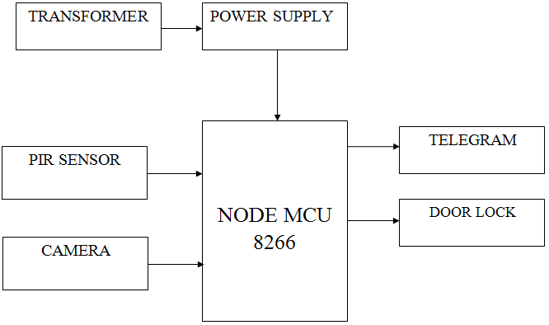
Block Diagram

Slide 12
Working principle
We propose IOT based theft detection using Raspberry Pi . In this proposed system, theft can be prevented using Raspberry pi and IR sensors. PIR sensors are able to detect the presence of human being.
When the user is not authorized, the the image/video will be captured using the camera and send it to the telegram application.
When the home is empty the owner will ON the theft mode. if any human behavior detected the message will be send to the owner via the telegram application.

Slide 13
SOFTWARE REQUIREMENTS:
Operating System : Windows 10
Platform : DOT NET TECHNOLOGY
Front End : ASP.Net 4.0
Back End : SQL SERVER 2014

Slide 14
HARDWARE REQUIREMENTS:
Keyboard
Mouse
Hard disk 500GB
Ram 4 Gb

Slide 15
CONCLUSION
We have a designed a smart system which reduces the human efforts and provide the ease to operate the Smart door, can access it from any corner of the world, providing a good security. It is easy to upgrade, portable.
The smart door lock system using telegram is very efficient technique, which allows the user to grant the access to the known person by sending a back message to RPI and unlock the door.
The system uses various components like PIR sensor, camera module, switch and telegram app on an android phone.

Slide 16
The networks security is also playing a vital role so that raspberry pi could not be hacked.
The coding is done using python language and installation of a telegram is done using CLI Telegram and some concept of Linux The networks security is also playing a vital role so that raspberry pi could not be hacked.
The SSH key is used, which provides a good network security. The Fail2ban software can also be used as an additional security to Raspberry pi.

Slide 17
REFERENCE
[1] Nareshkumar R. M.,Dnyaneshvari Shinde,- Smart Door Security Control System Using Raspberry Pi Volume 6, 2347 – 8616 Issue 11 November 2017
[2] Reeta R -Smart Secure Door Lock System Using IoT And Eigenface Approach,Volume 5, Issue 4 December 2017, 2320-2882
[3] Rishabh Kumar Gupta, S. Balamurugan, K. Aroul-IoT Based Door Entry System Vol 9(37), DOI: 10.17485/ijst/2016/v9i37/102136,October 2016,0974- 6846
[4] D.Kishore ,Shaik Anwar- Iot Based smart Home Security System with Alert Door And Access Control Using Smart phone, vol-5 Issue 12,December 2016,2278-0181

