Slide 1
ONLINE E-LEARNING MANAGEMENT SYSTEM

Slide 2
Abstract
One of the main important resources for higher education is a Learning Management System (LMS), which has shown an enhancement of students’ progress with high quality learning outcomes worldwide.
Many e-learning tools exist, each one has its own weaknesses and strongest points to the online learning process. This number increases continuously, and the existing tools are being updated, redeveloped, and upgraded.
The aim of this study is to present a comprehensive comparative analysis between existing e-learning management systems.

Slide 3
Unlike other relevant studies that have narrow scope either in terms of the number of tools or the number of comparative features, this work considers top twenty, highly recommended tools, both open source and commercial.
Furthermore, more than twenty evaluation features were used carefully to fulfil students’ and instructors’ current needs. The results of this study have shown that Moodle outperforms the others and it is considered as the best free open source tool for educational purposes.
It supports more than 100 different languages and provides its services to more than tens of millions of customers worldwide.

Slide 4
Besides to Moodle, Chamilo, TotaraLearn, Open edX and Sakai have more built-in features that provide services to educational institutions. Also, this study showed that Docebo, SkyPrep, ProProfs, SAP Litmos, Moodle, TotaraLearn, Open edX and Opigno systems have more built-in security mechanisms such as antispam, antivirus, IP Blocker, data protection and complex password enforcement.
Most considered systems have gamification features except Schoology, ATutor, Sakai, and Ilias, and most commercial systems can offer 24/7 customer care services, except Edmodo and Telnet, whereas open source tools offer this service on specific time slots except Opigno, Ilias, TotaraLearn, Chamilo, and Canvas where the service is offered 24/7.

Slide 5
Existing System
An argument for the adoption of elearning environments using CMSs is the flexibility of such environments when reaching out to potential learners in remote areas where brick and mortar institutions are non-existent.
All students receive the same exercises irrespective of their pre-existing knowledge and experience. It is not taken into consideration that the educational material is presented to a large number of learners who have varied knowledge levels, skills, and learning strategies.
Existing research on metacognition and study strategies indicates that metacognitive knowledge about cognitive strategies improves recall for a particular content.

Slide 6
Disadvantage of Existing System
It was observed that there are gaps in e-learning theories, especially regarding the use of an LMS for managing distance education, since none of the theoretical framework studies presented this issue in depth.
With the e-learning advance, educational institutions managers started to deal with different activities, requiring the development of new procedures and finding alternatives to address emerging challenges that go beyond educational issues.
However, according to the author, they are not the main problem, but the way they are designed, structured and crafted.

Slide 7
PROPOSED SYSTEM :
Many researchers have proposed that cognitive and metacognitive strategies instruction can result in improved learning when learners consciously apply these strategies.
Both currently available e-learning platforms and architectures proposed in research publications generally fail to abstract the functionality used in e-learning from its domain context.
While proposed architectures envision for operators of e-learning platforms to be able to mix and match e-learning services from different sources according to their requirements.
We have proposed an innovative approach for assessing, visualizing, and comparing the functionality of e-learning platforms.

Slide 8
ADVANTAGE
It should facilitate the organization of courses, enable monitoring the performance of students and tutors; and incorporate mechanisms to assess the student’s cognitive development and define the player’s roles.
It is necessary to consider that an LMS must seek to get the best advances in technology available today, for reasons of efficiency and for enabling the maximum degree of interactivity and communication among users.
E-learning is complex and requires efficient management so that educational outcomes can be achieved.
It reflects the transition of many universities to distance education as well as the existing arguments over their advantages and limitations.

Slide 9
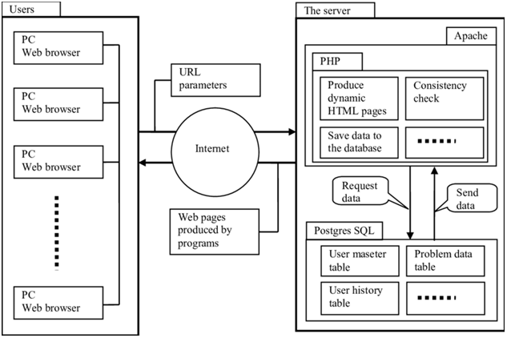
Block Diagram

Slide 10
SOFTWARE REQUIREMENTS:
Operating System : Windows 10
Platform : DOT NET TECHNOLOGY
Front End : ASP.Net 4.0
Back End : SQL SERVER 2014

Slide 11
HARDWARE REQUIREMENTS:
Keyboard
Mouse
Hard disk 500GB
Ram 4 Gb

Slide 12
CONCLUSION
This paper presented an updated feature-based comparative analysis of highly recommended LMSs, both commercial and open source. More than twenty evaluation criteria were used to conduct this comparative study.
The results have shown that there is no optimal LMS that offers all-in-one package to the online educational process, but the best system is the system that adapt its features and capabilities to meet users’ evolving needs.
For most of the tested features, Moodle remains on the top, and it is considered as the best free open source tools and provides its services to more than hundreds of millions of customers worldwide.

Slide 13
Besides to Moodle, Chamilo, TotaraLearn, Open edX and Sakai have more built-in features that provide services to educational institutions more than others.
Also, this study showed that Docebo, SkyPrep, ProProfs, SAP Litmos, Moodle, Totara Learn, Open edX and Opigno systems have more built-in security mechanisms such as antispam, antivirus, IP Blocker, data protection and complex password enforcement.
Most considered systems have gamification features except Schoology, ATutor, Sakai, and Ilias, and they can offer 24/7 customer care services, except Edmodo and Telnet, whereas open source tools offer this service on specific time slots, except Opigno, Ilias, TotaraLearn, Chamilo, and Canvas, where the service is offered 24/7.

Slide 14
REFERENCE
Oliveira, P.C., Cunha, C., & Nakayama, M.K. (2015). Learning Management Systems (LMS) and e-learning management: an integrative review and research agenda. Jistem Journal of Information Systems and Technology Management, 13, 157-180.
Abdulaziz, A., Chowdhury, H., Kootsookos, A., Alam, F., Allhibi, A. (2019). Utilization of learning management systems (LMSs) in higher education system: A case review for Saudi Arabia, International Conference on Energy and Power, ICEP2018, 13-15.
Kundi, G. M., Nawaz, A., & Khan, S. (2010). The predictors of success for e-learning in higher education institutions (HEIs) in N-W.F.P, Pakistan. Journal of Information Systems & Technology Management, 7(3), 545+.
Kulshrestha, T. & Kant, A. (2013). Benefits of learning management system (LMS) in Indian education, International Journal of Computer Science & Engineering Technology (IJCSET), 4(8).
Lopes, A. (2014). Learning management system in higher education, In Proceedings of EDULEARN14 Conference, 7th to 9th July 2014, 5360-5365, Barcelona, Spain.

Slide 15
Han, I & Shin, W. (2016). The use of a mobile learning management system and academic achievement of online students, Computers & Education, 102, 79-89.
Capper, I. (2001). E-learning growth and promise for the developing world, TechKnowLogia, 2(2), 7-10.
Grönlund, Å. & Islam, Y. (2010. A mobile e-learning environment for developing countries: The Bangladesh virtual interactive classroom, Information Technology for Development, 16(4), 244- 259.
Kraleva, R., Kralev, V., Kostadinova, D. (2019). A methodology for the analysis of block-based programming languages appropriate for children, Journal of Computing Science and Engineering, 13(1), 1-10.
Sheeba, T., & Krishnan, R. (2019). Automatic detection of students learning style in learning management system, In Proc. of the Smart Technologies and Innovation for a Sustainable Future, Springer, 45-53.

