Slide 1
JEWELLERY MANAGEMENT SYSTEM

Slide 2
Abstract
In this modern world, computer becomes more and more popular and important to our society. We can use computer everywhere and they are very useful and helpful to our daily life.
Computerized systems can be used for scheduling the jobs, update the stock details, for complex calculations, and also used for preparing bills to customers.
Here we developed a system to computerize the major transactions in jewellery like, purchases, sales and bill preparation.

Slide 3
This software can be used for managing customers as well as employees associated with that shop in a short period of time.
The minimum guarantee is that this system takes less time compared to all manual works, so we can save time and money also.

Slide 4
Existing System
Manual data processing system, whole providing economy, flexibility and adaptability at low data volumes become more complex when the volume of data becomes large.
As an organization expands in size and function, a stage is reached when manual procedures become inadequate and inefficient.
The present system is not sufficient to hold all the information that is necessary for the processing. So the library is in need of new computerized system, which is very flexible, user friendly and capable of holding the system in a robust manner.

Slide 5
Disadvantage of Existing System
Physical volume of the data is very large.
The delay in information search and retrieval.
Problems in updating and backup.
Damage of papers containing the information.
Considerable time taken for report generation.
Accuracy of data is very lower in manual system.

Slide 6
PROPOSED SYSTEM :
This is a special savings scheme which facilitates the purchase of gold jewellery at an affordable cost.
The minimum amount of monthly instalment basis user can pay. You can select a higher amount for deposit. Online User credential details will be provided to keep you updated regarding all the transactions made.
Under this plan you are required to make monthly instalments advance payments. So you can utilize the accumulated deposit to purchase the jewellery of your choice without any wastage or value addition charges.

Slide 7
ADVANTAGE
The proposed system can be utilized for easy documenting and accessing various data carriers such as forms, reports, records etc.
Automation makes the system to be user-friendly and hastily in manipulation and generation of valuable reports providing menu driven facilities. Accuracy and security of data will be more comfortable for the organization.
Computerization will avoids human errors due to inexperience in data entry, manipulation etc. The paper work occurred in the manual system can be completely avoided.

Slide 8
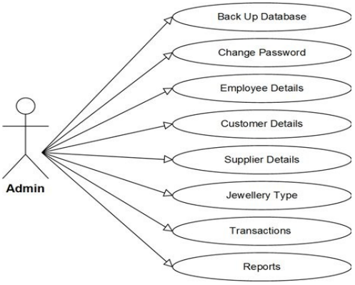
Block Diagram

Slide 9
MODULES
ADMIN
Customer details
We provided input details like First name, Last name, User name, Password, Address, Email, Contact No. This details are registration details of customer and it will per stored in database.
Product details
We provided input details like Product name, Rate, GST. It will per stored in database.

Slide 10
Sales
This module stores sales record by entering Order number, purchase date, customer details, Jewellery item details, rate, quantity, Total amount, etc. The system generates bill after the sale.
USER
My account
Here we show user profile details like First name, Last name, User name, Password, Address, Email, Contact No. This details are registration details of customer and it will per stored in database.
Installment payment details
Here we show user installment payment details of when they paid and how much they paid everything will be showned here from database.

Slide 11
SOFTWARE REQUIREMENTS:
Operating System : Windows 10
Platform : DOT NET TECHNOLOGY
Front End : ASP.Net 4.0
Back End : SQL SERVER 2014

Slide 12
HARDWARE REQUIREMENTS:
Keyboard
Mouse
Hard disk 500GB
Ram 4 Gb

Slide 13
CONCLUSION
The system “Jewellary Management system” deals with purchase and sales processing of a Jewellary shop. This system has been developed to satisfy all the proposed requirements.
The process of recording details about supplier, item, Billing an dcustomers is more simple and easy.
The system reduces the possibility of errors to a great extent and maintains the data in an efficient manner. User friendliness is the uniquefeature of this system.

Slide 14
The system generates the reports as and when required. The system is highly interactive and flexible for further enhancement.
The coding is done in a simplified and easy to understandable manner so that other team trying to enhance the project can do so without facing much difficulty.
The documentation will also assist in the process as it has also been carried out in a simplified and concise way.

Slide 15
REFERENCE
1. Visual Basic 6.0 from the Ground up, Gary Cornell, Tata McGraw Hill Edition
2. The Complete Reference Visual Basic 6.0 , Noel Jerke, Tata Mcgraw HillEdition
3. Visual Basic 6.0 Programming Black Book, Sten Holzner, Dream tech Press,Dreamtech Press, New Delhi-2004
4. MS-Office 2000, Michael Busy and Rossell a Stultz, BPB Publication, NewDelhi.

Slide 16
5. Microsoft Office Access Bible by G r oh
6. Software Engineering a practioner’s approach- Roger S. Pressman, Tata Mc Graw Hill Edition
7. Working with Access by RON Mansfield, Tata McGraw Hill Publication

