Slide 1
IRIS TUMOR DETECTION USING CNN

Slide 2
Abstract
Iris tumors, so called intraocular tumors are kind of tumors that start in the iris; the colored part of the eye that surrounds the pupil.
There is a need for an accurate and cost-effective iris tumor detection system since the available techniques used currently are still not efficient.
The combination of the image processing different techniques has a great efficiency for the diagnosis and detection of the iris tumor. Image processing techniques improve the diagnosis of the tumor by enhancing the quality of the images, so the physicians diagnose properly.

Slide 3
Moreover, using some techniques such as edge detection and image fusion helps in detecting and segmenting the tumor, located in the iris.
This paper aims to develop a detection system that automatically detects the presence of abnormalities or tumors in the iris.
The suggested system combines different image processing techniques such as image filtering, images adding, canny edge detection, and image fusion.

Slide 4
These methods are used in order to analyze and segment the tumor into the iris, and then mark this abnormal region onto the original grayscale image.
The iris images are obtained from a public database available on the internet, “Miles Research”.
The computer experimental results proved that the proposed detection system can successfully segment an iris tumor, and mark it to be then superimposed on the original image using image fusion.

Slide 5
Existing System
The survey of various existing techniques provides a platform for the development of the novel techniques in this area as future work.
Existing iris recognition systems are heavily dependent on specific conditions, such as the distance of image acquisition and the stop-and-stare environment, which require significant user cooperation.
Most existing iris recognition algorithms are designed for highly controlled cooperative environments, which is the cause of their failure in non-cooperative environments, i.e., those that include noise, off-angles, motion blurs, glasses, hairs, specular reflection (SR), eyelids and eyelashes incorporation, and partially open eyes.

Slide 6
Disadvantage of Existing System
Iris DenseNet is an end-to-end segmentation network that uses the complete image without prior pre-processing or other conventional image processing techniques with the best information gradient flow, which prevents the network from overfitting and vanishing gradient problem.
To address the issues of accurate segmentation without prior pre-processing and to develop a robust scheme for all types of environments, this study presents a densely connected fully convolutional network (IrisDenseNet)-based approach to detect an accurate iris boundary with better information gradient flow due to dense connectivity.

Slide 7
PROPOSED SYSTEM :
Our proposed iris segmentation scheme can be used with inferior quality noisy images even in visible light environment.
The proposed method accurately identified the true boundary even in intense scenarios, such as glasses, off-angle eyes, rotated eyes, side view, and partially opened eyes.
We proposed a CNN-based segmentation method of the iris region based on the ROI defined by the rough iris boundary.
Our proposed method can correctly segment the iris region irrespective of various noises in eye image.

Slide 8
ADVANTAGE
The major challenge here is to achieve high performance on a mobile platform because of limitation of space, power, and cost of the system.
IrisDenseNet is a densely connected fully convolutional network that proceeds in the feed-forward fashion with dense features for better performance.
This connectivity enhances the capability of the network and enables the feature reuse for better performance.
Biometrics in both physiological and behavioral forms are delivering an efficient platform for security metrics.

Slide 9
TITLE | AUTHOR | DESCRIPTION
Congenital iris cysts | Richard D Grutzmacher, Thomas D Lindquist, Mark E Chittum, Ann H Bunt-Milam, And Robert E Kalina, | Unilateral, spontaneous, non-pigmented iris cysts appeared before the age of 2 years in four patients. Histopathological specimens obtained in three cases showed stratified to cuboidal, non-pigmented, epithelial lined cysts.
A Spatial Median Filter for Noise Removal in Digital Images | James Church, Dr. Yixin Chen, and Dr. Stephen Rice, | The purpose of these algorithms is to remove noise from a signal that might occur through the transmission of an image.

Slide 10
TITLE | AUTHOR | DESCRIPTION
Retinal Image Analysis Using Morphological Process and Clustering Technique | R.Radha and Bijee Lakshman, | This paper proposes a method for the Retinal image analysis through efficient detection of exudates an d recognizes the retina to be normal or abnormal.
Image Segmentation of Blood Cells in Leukemia Patients | Khashman, A., Al-Zgoul, E., | We propose the use of morphological analysis of microscopic images of leukemic blood cells for the identification purpose.

Slide 11
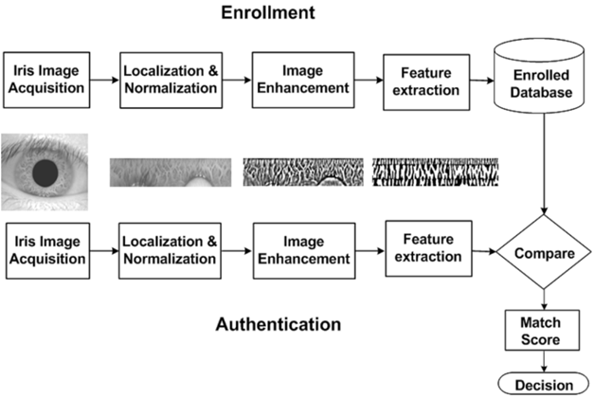
Block Diagram

Slide 12
SOFTWARE REQUIREMENTS:
Operating System : Windows 10
Platform : DOT NET TECHNOLOGY
Front End : ASP.Net 4.0
Back End : SQL SERVER 2014

Slide 13
HARDWARE REQUIREMENTS:
Keyboard
Mouse
Hard disk 500GB
Ram 4 Gb

Slide 14
CONCLUSION
This paper presented a novel approach for the detection of the iris tumor using segmentation and image fusion.
The developed system reads the tumorous iris image, processes it, and marks the regions of interest (tumorous regions) including pupil for the affected images.
However, for the normal images, only pupils are marked since there are no tumors into the iris. The system has been tested for normal and abnormal images obtained from Miles Research and the experimental results were successful which proves that our effective system can be implemented into real life applications.

Slide 15
REFERENCE
[1] Heath grades, “Eye Cancer”, available: http://www.healthgrades.com/conditions/eye-cancer.
[2] Richard D Grutzmacher, Thomas D Lindquist, Mark E Chittum, Ann H Bunt-Milam, And Robert E Kalina,” Congenital iris cysts”. British Journal of Ophthalmology, 1987, 71, p.p. 227-234H.
[3] Cancer Research UK, available: http://www.cancerresearchuk.org/about-cancer/type/eyecancer/about/types-of-eye-cancer#mel
[4] The Eye Cancer Foundation Eye Cancer Network Education and Support for Eye Tumor Patients and Their Families, available: http://www.eyecancer.com/conditions/34/irismelanoma
[5] Miles Research, available: http://www.milesresearch.com/main/links.htm.

Slide 16
[6] Digital image processing, available: http://www.tutorialspoint.com/dip/Grayscale_to_RGB_Conversio n.html.
[7] James Church, Dr. Yixin Chen, and Dr. Stephen Rice, “A Spatial Median Filter for Noise Removal in Digital Images”. Southeastcon, 2008. IEEE, p.p.618 – 623.
[8] R.Radha and Bijee Lakshman, “Retinal Image Analysis Using Morphological Process and Clustering Technique”. Signal & Image Processing: An International Journal (SIPIJ) Vol.4, No.6, December 2013.
[9] Lijun Ding, Ardeshir Goshtasby, “On the Canny edge detector”. Pattern Recognition Society, 2001. p.p.721-725.
[10] Gonzalez and Woods, Digital Image Processing, Second Edition, PrenticeHall, pp. 108-120, 2002

