Slide 1
IOT BASED UNDERGROUND FAULT DETECTOR

Slide 2
Abstract
Cables are put underground to stay away from pointless obstruction. These force cables convey electrical force and when these cables are put underground it is extremely hard to decide the specific area of the deficiency happened.
There are numerous elements or purposes behind a deficiency to happen as, for example, burrowing, tremor, development work and so forth.
As it don't have a clue about the specific area of the issue happened to the cable the fixing procedure identified with that cable is troublesome.

Slide 3
Underground cable framework is a most basic practice followed in the urban zones.
This paper is expected to find the flaw in an underground cable lines from the base station to a precise area in kilometres.
The framework identifies flaw with the assistance of potential divider organize laid over the cable.
When a defect is found in a cable line, a voltage gets produced according to the resistors organize blend. This voltage is detected by the microcontroller and is refreshed to the client.

Slide 4
Existing System
The IoT allows objects to be sensed and controlled remotely across existing network infrastructure, creating opportunities for more direct integration of the physical world into computer-based systems, and resulting in improved efficiency, accuracy and economic benefit.
When IoT is augmented with sensors and actuators, the technology becomes an instance of the more general class of cyber-physical systems, which also encompasses technologies such as smart grids, homes, intelligent and smart cities.
Each thing is uniquely identifiable through its embedded computing system but is able to interoperate within the existing Internet infrastructure.

Slide 5
Disadvantage of Existing System
When the area has been recognized we start to transmit high voltage over the broken cable to locate the specific area of the issue.
The wavelet peculiarity identification hypothesis is utilized as an amazing sign handling device to appraise the area of the issue in multiend-matured cable frameworks.
The deficiencies are handily recognized in this technique however the issue in this strategy is that in some overpopulated urban areas we cannot utilize this technique.

Slide 6
PROPOSED SYSTEM :
The system proposed in this paper is used to find out the exact location of the fault and display it to the dedicated website over internet using wi-fi module, giving prior information to the authorized person at other end.
The proposed system uses the simple concept of OHMs law where a low DC voltage is applied at the feeder end through a series resistor.
This paper proposes fault location model for underground power cable using microcontroller and the thing which is based on the internet means the information will transfer through the internet access.

Slide 7
ADVANTAGE
In order to reduce the sensitivity of distribution networks to environmental influences underground voltage cables are highly used .
Current sensing part of cable represented as set of resistors & switches are used as fault creators to indicate the fault at each location. In this system, a bridge rectifier is used because of its added advantage like good stability.
Underground cables have been widely used in power distribution networks due to the advantages of underground connection, more enhanced security than overhead lines in adverse weather condition, less liable to damage by storms or lightning.

Slide 8
TITLE | AUTHOR | DESCRIPTION
Fault location for underground power cable using distributed parameter approach | Yang, Xia, | This paper proposes an extensive fault location model for underground power cable in distribution system using voltage and current measurements at the sending-end.
Improved GPS travelling wave fault locator for power cables by using wavelet analysis | Zhao, W., Y. H. Song, and W. R. Chen. | The paper proposes an improved approach to cable-fault location, which is essentially based on synchronised sampling technique, wavelet analysis and travelling wave principle.

Slide 9
TITLE | AUTHOR | DESCRIPTION
Underground Cable Fault Locator | Manish Paul, Raj Kamal Kakoti, | The fault occurring at a particular distance and the respective phase is displayed on a LCD interfaced to the microcontroller.
Two Terminal Fault Location on Unsymmetrical Transmission Lines | Schulze, Member, IEEE and Peter Schegner, | Due to the availability of highly accurate GPS based time references the investigation of two-terminal methods combined with signal analysis tools makes sense in the first place.

Slide 10
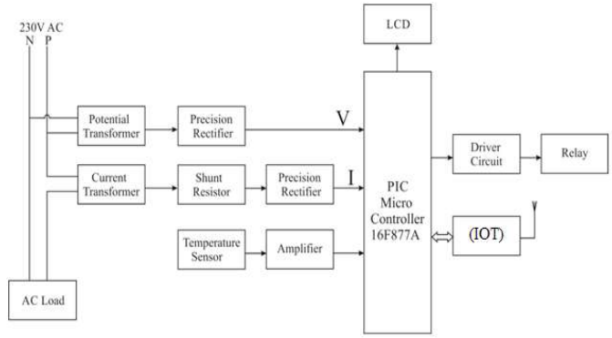
Block Diagram

Slide 11
SOFTWARE REQUIREMENTS:
Operating System : Windows 10
Platform : DOT NET TECHNOLOGY
Front End : ASP.Net 4.0
Back End : SQL SERVER 2014

Slide 12
HARDWARE REQUIREMENTS:
Keyboard
Mouse
Hard disk 500GB
Ram 4 Gb

Slide 13
CONCLUSION
The paper IOT based underground fault detector is used for detecting any flaws in an underground cable system.
This system can clearly choose the region where the fault has occurred and can send the co-ordinates to the user as well as displays in the LCD display screen.
Henceforth the strategy used in this paper works in a consecutive way and ends up being helpful in discovery and area of deficiencies in underground cables.

Slide 14
REFERENCE
1. Yang, Xia, “Fault location for underground power cable using distributed parameter approach" ,Power Systems, IEEE Transactions on 23.4 (2008): 1809-1816.
2. Westrom, Arthur C., and James W. Larsen, "Fault distance locator for underground cable circuits" , U.S. Patent No. 5,600,248. 4 Feb. 1997.
3. Zhao, W., Y. H. Song, and W. R. Chen. "Improved GPS travelling wave fault locator for power cables by using wavelet analysis. 23.5 (2001): 403-411.
4.Ms Pradnya , A. Hukeri, Mr. P. B. Ghewari, “Paper On IOT Based technology” in IRJET, Vol 4 , Issue: 01,pp 1580-1582, Jan 2017.

Slide 15
5. ZHANG Chao, KANG Xiaoning, MA Xiuda, JIANG Shuai, QU Xiaoyun Shaanxi Key Laboratory of Smart Grid “On-line Incipient Faults Detection in Underground Cables Based on Single-end Sheath Currents” IEEE PES Asia-Pacific Power and Energy Conference,2016
6. Schulze, Member, IEEE and Peter Schegner, ”Two Terminal Fault Location on Unsymmetrical Transmission Lines”,IEEE,2010
7. Xu Sun, Wing Kin Lee1, Yunhe Hou1, and Philip W. T. Pong1 “Underground Power Cable Detection and Inspection Technology Based on Magnetic Field Sensing at Ground Surface Level” ,IEEE ,2014

Slide 16
8. Manish Paul, Raj Kamal Kakoti, “Underground Cable Fault Locator”, IARJSET, Vol.3, Issue 9, September 2016.
9. Md. Fakhrul Islam, Amanullah M T Oo, Salahuddin. A. Azadl, “Locating Underground Cable Fault: A Review and Guideline for New Development”, 2013, IEEE.
10. Gilany, Mahmoud, Doaa Khalil Ibrahim, and El Sayed Tag Eldin. "Traveling-wave-based fault location scheme for multi-end-aged underground cable system." Power Delivery, IEEE Transactions on 22.1 (2007): 82-89.

