Slide 1
IOT BASED AIR POLLUTION MONITORING SYSTEM USING ARDUINO

Slide 2
Abstract
Air pollution is a growing issue these days. It is necessary to monitor air quality and keep it under control for a better future and healthy living for all.
Here we propose an air quality monitoring system that allows us to monitor and check live air quality in a particular area through IOT.
System uses air sensors to sense presence of harmful gases/compounds in the air and constantly transmit this data to microcontroller.

Slide 3
Also system keeps measuring sound level and reports it to the online server over IOT.
The sensors interact with microcontroller which processes this data and transmits it over internet.
This allows authorities to monitor air pollution in different areas and take action against it.

Slide 4
Existing System
Many emission management frameworks are designed today by dreaming about different natural borders. The the current structure model uses the spatial and natural environments for a wide range of technologies in different fields to track remote sensor organisations.
The sensor hubs talked comfortably with the moving hubs sent to the subject-matter of interest that prohibited the use of complicated steering calculations, but neighbourhood calculations are extremely minor.
RFID is a way to send and retrieve information via electromagnetic transmission to a viable integrated RF circuit.

Slide 5
Disadvantage of Existing System
Need of manual labor, cost of operation is high, has the risk of human error and data can easily altered.
For both gases and particulate matter, if several identical low cost systems are co-located, the user should expect a high level of repeatability (R2 > 0.9) and should expect to be able to adjust accuracy by ‘calibrating’ – adjusting slope and offset – against a co-located reference/equivalent station.
Ozone is monitored daily, but mostly during the ozone season (the warmer months, approximately April through October).

Slide 6
PROPOSED SYSTEM :
The structure suggested includes the accompanying biological thresholds, so as to measure air pollution concentrations: gases, Other constraints are calculated including temperature, mugginess and light power and tone.
The basic information sensed is transformed by ADC into advanced qualities.
The ADC output is passed to the microcontroller that is treated and shipped off of the IoT stage. Our cloud knowledge base with IoT support reveals the constant values. The LCD display also shows the intentional consistency.

Slide 7
ADVANTAGE
The measurements of pollution concentrations are the best characterization of the concentration of a given pollutant at a given time and location. The data are supported by a comprehensive quality assurance program, ensuring good data of known quality.
Easy to Install
Updates On mobile phone directly
Accurate Pollution monitoring
Remote location monitoring.

Slide 8
TITLE | AUTHOR | DESCRIPTION
Case Study: Monitoring Of Air Quality In King Faisal University Using A Microcontroller And Wsn | Al-haija, Q. A., Al-qadeeb, H., & Al-lwaimi, A., | In this paper, a WSN based microcontroller equipped with gas sensors have been actively used for air quality monitoring.
Real-time Air Quality Monitoring Through Mobile Sensing In Metropolitan Areas | Devarakonda, S., Sevusu, P., Liu, H., Liu, R., Iftode, L., &Nath, B., | In particular, we found that a personal sensing device conveniently mounted inside a vehicle in front of the vent can measure carbon monoxide levels that correlate well with outdoor values.

Slide 9
TITLE | AUTHOR | DESCRIPTION
Smart Air Pollution Detection And Monitoring Using Iot | D.Arunkumar, K.Ajaykanth, M.Ajithkannan, M.Sivasubramanian, | Due to the air pollution not only affect the human health and also damage the environment and eco system so reduce the aging of living things.
Air and Sound Pollution Monitoring System using IoT | Ms. Sarika Deshmukh, Mr.Saurabh surendran and Prof.M.P. Sardey, | The air & sound monitoring system overcomes the problem of the highly-polluted areas which is a major issue. It supports the new technology and effectively supports the healthy life concept.

Slide 10
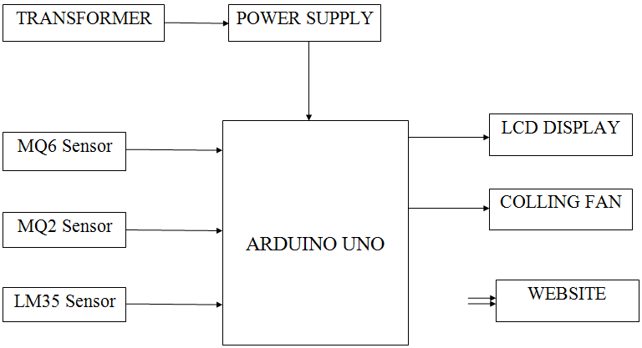
Block Diagram

Slide 11
SOFTWARE REQUIREMENTS:
Operating System : Windows 10
Platform : DOT NET TECHNOLOGY
Front End : ASP.Net 4.0
Back End : SQL SERVER 2014

Slide 12
HARDWARE REQUIREMENTS:
Keyboard
Mouse
Hard disk 500GB
Ram 4 Gb

Slide 13
CONCLUSION
This system includes the sensors that detect the parameters causing pollution. The sensors are carbon dioxide sensor.
Whenever there is an increase in the level of these parameters the sensor senses the situation and an alarm or indication is given.
The message is displayed in the LCD display. If the authority of the industry does not take any actions to minimize the emissions then the system takes certain actions to this.

Slide 14
If carbon-dioxide rises above the threshold value then machines are terminated from working.
Similarly if fire is detected then exhaust fans are turned on, if LPG and color change in liquids is detected the suitable actions are taken to overcome them.
The system is operated through wireless system using the concept of IOT.
The status of sensors of particular industry can be accessed anywhere from anyplace.

Slide 15
REFERENCE
[1] Dias, M. J. et al., (2010). “Indoor Air Quality Evaluation in School Buildings Ventilated by Natural and Mechanical Systems”. Clima pp. R6-TS62-0P02, Turkey: REHVA. ISBN Code of the CD 978-975-6907- 14-6, 2010.
[2] Al-Haija, Q. A., Al-Qadeeb, H., & Al-Lwaimi, A.,“Case study: Monitoring of air quality in king Faisal University using a microcontroller and WSN”, Procedia Computer Science, volume 21, pp. 517–521, 31 Dec 2013.
[3] Devarakonda, S., Sevusu, P., Liu, H., Liu, R., Iftode, L., &Nath, B., “Real-time Air Quality Monitoring Through Mobile Sensing in Metropolitan Areas”, in Proceedings of the 2nd ACM SIGKDD International Workshop on Urban Computing, pp. 15, Aug 2013

Slide 16
[4] Ch.V.Saikumar, M.Reji, P.C.Kishoreraja, “IOT Based Air Quality Monitoring System”, International Journal on Information Theory (IJIT), Vol-117, No.-9, 2017;
[5] Riteeka Nayak, Malaya Ranjan Panigrahy , Vivek Kumar Rai and T Appa Rao “IOT based air pollution monitoring system”, International Journal on Information Theory (IJIT) Vol-3, Issue-4, 2017;
[6] Poonam Pal, Ritik Gupta, Sanjana Tiwari, Ashutosh Sharma, “Air Pollution System Using Arduino”, International Journal on Information Theory (IJIT), Vol-04, Issue-10, 2017;
[7] D.Arunkumar, K.Ajaykanth, M.Ajithkannan, M.Sivasubramanian, “Smart Air Pollution Detection And Monitoring Using IoT”, International Journal on Information Theory (IJIT) Vol-119, No.-15, 2018;

Slide 17
[8] Shanzhi Chen, Hui Xu, Dake Liu, Bo Hu, and Hucheng Wang, “A Vision of IoT: Applications, Challenges, and Opportunities with China Perspective”, IEEE INTERNET OF THINGS JOURNAL, VOL.-1, NO.-4, August 2014;
[9] S. Chen, H. Xu, D. Liu, B. Hu and H. Wang, "A Vision of IoT: Applications, Challenges, and Opportunities with China Perspective," in IEEE Internet of Things Journal, Vol-1, No.-4, 2014;
[10] Ms. Sarika Deshmukh, Mr.Saurabh surendran and Prof.M.P. Sardey, “Air and Sound Pollution Monitoring System using IoT” International Journal on Information Theory (IJIT), Vol-5, Issue-6, 2017;

