Slide 1
Environmental surveillance Monitoring System for the Industries

Slide 2
Abstract
One of the alarming threats to mankind and other living organisms is environmental pollution. Worldwide, textile industry is one of the main air and water pollutants. Its environmental effect is critical because it consumes considerable water for processing and discharges major polluted water. If the quality of those discharged water exceeds the prescribed limit set by the authorities, it will cause serious threat to the living organism. This demands the suitable monitoring system even from a remote location. Innovation in technology could serve as the best solution to the above problem. The chemical properties are measured of the textile effluent and an announcement will be made for proactive measures if it exceeds the prescribed limit. The quality parameters of the effluent are continually monitored and information recorded in the cloud by means of different sensors. The parameters such as pH, and dissolved oxygen of the effluent can be measured and surrounding air quality also measured. The information stored can be tracked by the competent authority via the Web page. The threshold value for the cloud information is automated to make an automatic comparison with the detection system and send an alert to the authorities involved.

Slide 3
Existing System
There exist extensive activities causing pollution in industrial manufacturing factory.
RFID is a promising technology which has existed for years in the construction industry and has the potential to become ubiquitous in the coming years for a variety of applications.
Due to the BIM database structure that enables this querying which can be done for an entire building simply that doesn`t exist with traditional 3D CAD softwares.
However, more research needs to be conducted in order to make system interoperable with existing sensor systems by reducing its cost of deployment and simplifying the system user interfaces.

Slide 4
Disadvantage of Existing System
The focus has been on controlling emerging problems of dangerous air pollutants, which are mainly exposed in our homes or workplaces where most of our lives is spent.
The big issue occurs when these products are discharged straight into water bodies, which pollute water.
This water pollution does not only affect people and households but also impacts aquatic animals.
The environmental impact of textile effluents is evaluated by many researchers and scientists.
Many researchers and scientists are analyzed the impact of textile effluent to the environment.

Slide 5
PROPOSED SYSTEM :
The proposed framework does not accommodate user centric approach of visualization, since every user (building occupant, facility manager or owner) has role specific requirements for deploying sensor network, which needs to be explored.
In order to detect environmental hazards in buildings, there are various potential technologies that can be used for monitoring purpose.
RFID tags when attached to objects give unique e-coding for counting and identification purposes.
The developed prototype system uses BIM for visualization purpose and TelosB motes for sensor data acquisition.

Slide 6
ADVANTAGE
The nature of the pollution control requirements and the efficiency of pollution controls are assessed by water quality and air quality surveillance.
Although various protocols and rules for efficient effluent disposal have been drawn up by the Government, there always are violations for the business interests of the sector.
Each time the production method differs based on the customer’s need, the waste produced varies based on the type of chemicals and raw materials used.
The textile industry used natural dyes that did not damage living humans and the environment, but have disappeared these days, when science and technology lagged behind.

Slide 7
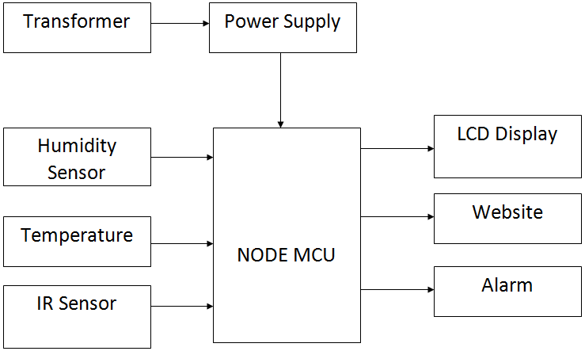
Block Diagram

Slide 8
Humidity sensor
A humidity sensor is a device that detects and measures water vapor.
TE Connectivity (TE) manufactures a complete range of calibrated and amplified RH sensor products to measure relative humidity.
Based on our robust capacitive technology, these humidity detectors provide accurate measurement of dew point and absolute humidity by combining relative humidity (RH) and temperature (T) measurements.

Slide 9
Temperature sensor
LM35 is an integrated analog temperature sensor whose electrical output is proportional to Degree Centigrade.
LM35 Sensor does not require any external calibration or trimming to provide typical accuracies.
The LM35’s low output impedance, linear output, and precise inherent calibration make interfacing to readout or control circuitry especially easy.

Slide 10
IR Sensor
An infrared (IR) sensor is an electronic device that measures and detects infrared radiation in its surrounding environment.
While measuring the temperature of each color of light (separated by a prism), he noticed that the temperature just beyond the red light was highest.
IR is invisible to the human eye, as its wavelength is longer than that of visible light (though it is still on the same electromagnetic spectrum).

Slide 11
Node MCU
NodeMCU is a low-cost open source IoT platform.
It initially included firmware which runs on the ESP8266 Wi-Fi SoC from Espressif Systems, and hardware which was based on the ESP-12 module. Later, support for the ESP32 32-bit MCU was added.
The prototyping hardware typically used is a circuit board functioning as a dual in-line package (DIP) which integrates a USB controller with a smaller surface-mounted board containing the MCU and antenna.

Slide 12
LCD Display
LCD (Liquid Crystal Display) is a type of flat panel display which uses liquid crystals in its primary form of operation.
LEDs have a large and varying set of use cases for consumers and businesses, as they can be commonly found in smartphones, televisions, computer monitors and instrument panels.
LCDs were a big leap in terms of the technology they replaced, which include light-emitting diode (LED) and gas-plasma displays.

Slide 13
SOFTWARE REQUIREMENTS:
Operating System : Windows 10
Platform : DOT NET TECHNOLOGY
Front End : ASP.Net 4.0
Back End : SQL SERVER 2014

Slide 14
HARDWARE REQUIREMENTS:
Keyboard
Mouse
Hard disk 500GB
Ram 4 Gb

Slide 15
CONCLUSION
Each organization should regularly monitor effluents and documents related to the environmental safety regulations in order to protect the environment. The system is developed which can remotely monitor the release by the textile processing industry of toxic gases and water effluent. The level of pollution is emitted by industry is monitored using Rpi and IBM Watson IoT platform which can prevent environmental pollution and safety to the living beings. Air Quality (MQ135) sensors detect the poisonous gases. The turbidity and pH sensors monitor the quality of water effluent from the textile industry and alert can be given to save the life of people and for the environment. Remote monitoring is enabled by using IBM Watson IoT platform. The application on Cloud shows data collected from the sensors.

Slide 16
REFERENCE
1. U. Nations, The sustainable development goals report 2016, 2019.
2. I. United Nations Environment Programme. Division of Technology, Economics, E. Programme, and United Nations Environment Programme [UNEP], “UNEP Year Book 2014: Emerging Issues in Our Global Environment,” Emerging issues in our global environment, 2014.
3. K. Saravanan, E. Anusuya, R. Kumar, and Others, “Real-time water quality monitoring using Internet of Things in SCADA,” Environmental monitoring and assessment, vol. 190, no. 9, p. 556, 2018.
4. M. S. Islam, “An Intelligent System on Environment Quality Remote Monitoring and Cloud Data Logging Using Internet of Things (IoT),” International Conference on Computer, Communication, Chemical, Material and Electronic Engineering, IC4ME2 2018, pp. 1–4, 2018.
5. V. Jaganathan, P. Cherurveettil, A. Chellasamy, and M. S. Premapriya, “Environmental pollution risk analysis and management in textile industry: A preventive mechanism,” European Scientific Journal, ESJ, vol. 10, no. 10, 2014

Slide 17
6. R. Kant, “Textile dyeing industry an environmental hazard,” Natural science, vol. 4, no. 1, pp. 22–26, 2012.
7. F. Ezbakhe, “Addressing Water Pollution as a Means to Achieving the Sustainable Development Goals,” Journal of Water Pollution and Control, vol. 1, no. 1:6, pp. 1–9, 2018.
8. M. Shirode, M. Adaling, J. Biradar, and T. Mate, “IOT Based Water Quality Monitoring System,” International Journal of Computer Sciences and Engineering, vol. 12, pp. 5447–5454, 2018.
9. N. A. Cloete, R. Malekian, and L. Nair, “Design of smart sensors for real-time water quality monitoring,” IEEE Access, vol. 4, pp. 3975–3990, 2016.
10. S. Kavi Priya, G. Shenbagalakshmi, and T. Revathi, “Design of smart sensors for real time drinking water quality monitoring and contamination detection in water distributed mains,” International Journal of Engineering & Technology, vol. 7, no. 1.1, p. 47, 2017.

