Slide 1
ENVIRONMENT MONITORING SYSTEM IN INDUSTRY USING IOT

Slide 2
Abstract
Environmental monitoring is must for all industries as its conditions majorly affect our prosperity, solace and efficiency.
Because it is such an essential aspect that have an immense effect on health of operating personnel & other parameters like fire, smoke, dust and intruder detection along with weather forecasting in industries.
But the systems that are in current use are complex, expensive, lack of reliability and unable to provide real time results on timely basis.

Slide 3
Hence there is a need of a monitoring & alerting system which is cost effective and efficient.
Proposed system is not only a reliable solution for the environment surveillance but also an inexpensive and efficient one with effective visualization, which can be implemented in industries for real time analysis.
Industrial Internet of Things (IIoT) is one best technology for this kind of application where there is a need of monitoring and alerting mechanism with the communication between devices using with unique identifiers (UID’s) over a network

Slide 4
Existing System
There exist extensive activities causing pollution in industrial manufacturing factory.
A system is used through which the level of sound and the existence of the harmful gases in the surroundings area can be detected.
Industry should take on new class of materials including oxide materials and their composites that can rival existing innovation regarding great strength and work for significant time frames without need for any re-alignment.

Slide 5
Disadvantage of Existing System
An optical sensor is coordinated to the framework so it can empower the client to assess the thickness level of particulate issues progressively.
In such large scale sensor deployment, there are data collection, data management, connection, and power consumption issues.
Air quality is a major concern nowadays that requires monitoring of several parameters responsible for this problem. Beside industry's positive effects, industries have negative impacts; one of it is the industrial harmful pollution outputs that affect both the world climate and the local production environments.

Slide 6
PROPOSED SYSTEM :
A solution for monitoring the noise and air pollution levels in industrial environment or particular area of interest using embedded computing system is proposed.
When the gas concentration reaches the threshold values used in the program then it will send an sms alert to the user, so the user will be aware of the situation and takes necessary action to prevent the damage.
The toxic gases are forming in chemical industries, drainage, food wastes, and unused wells, vehicles etc.

Slide 7
ADVANTAGE
All these parameters of environment are essential to monitor so that efficiency of industries will be increased.
This work is focused on, utilizing the interdisciplinary advances in different engineering fields, to suggest a new design form with modified capabilities of an efficient, real time, reliable and realizable, at low cost, industrial environment monitoring system.
An efficient environmental monitoring system is required to monitor and assess the conditions just in case of exceeding the prescribed level of parameters (e.g., noise, CO and radiation levels).

Slide 8
TITLE | AUTHOR | DESCRIPTION
Optimizing sensor deployment and maintenance costs for large-scale environmental monitoring | Xiaofan Yu; Kazim Ergun; Ludmila Cherkasova; Tajana Šimunić Rosing | In this article, we formulate a sensor deployment problem to preventively minimize maintenance costs while ensuring tolerable sensing quality and complete connectivity.
Industry 4.0: Industrial internet of things (IIOT) | Munirathinam, Sathyan. | An explosion of smart devices and technologies has allowed mankind to be in constant communication anywhere.

Slide 9
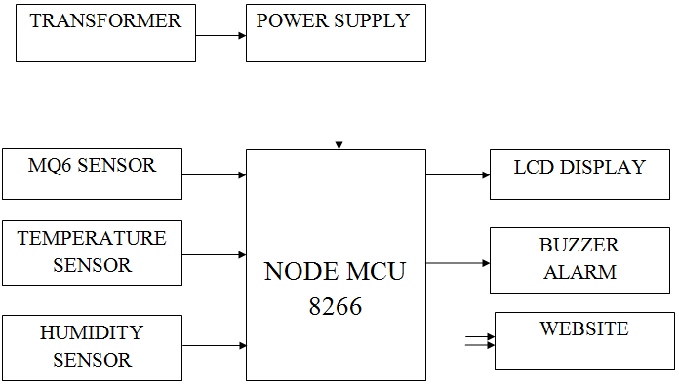
Block Diagram

Slide 10
CONCLUSION
Environment monitoring with alerting system for an industry is designed, which is a low power, low cost, efficient model for real-time surveillance purpose.
This system completely avoids the manual intervention by facilitating monitoring and alerting action in order to fulfill environmental surveillance.
This system can be implemented to various industries based on application.

Slide 11
It has many functionalities like detection of fire, dust, smoke and intruders along with gas detection facility and weather forecasting.
This system is very handy and reliable solution to user by which it is avoiding complexity in installing and maintaining.
Data can be visualized at any time through the app and cloud storage.
Implementation of this system to industries will improve the environmental surveillance in an exponential manner.

Slide 12
REFERENCE
[1] He, Y., Guo, J., & Zheng, X. (2018). From surveillance to digital twin: Challenges and recent advances of signal processing for industrial internet of things. IEEE Signal Processing Magazine, 35(5), 120-129.
[2] Munirathinam, Sathyan. "Industry 4.0: Industrial internet of things (IIOT)." Advances in computers. Vol. 117. No. 1. Elsevier, 2020. 129-164.
[3] Shilpa R. Khodve, A. N. Kulkarni,”Web Based Air Pollution Monitoring System” International Journal of Science and Research (IJSR),2014.
[4] Internet of Things Platform” ,International Conference on Intelligent Computing and Control Systems (ICCS),IEEE,2019.

