Slide 1
Enhancing Remembrance of Password as an Image

Slide 2
Abstract
This paper focuses on changing the system of having ‘text’ as password as people tend to often forget their passwords and have to recover it.
Proposing the system of having picture as a password which is kept encrypted in a database and decrypted and matched to check for authorization of user.
It has been scientifically proven that it’s easier for a human mind to remember a picture, something they can see rather than text.

Slide 3
Existing System
We argue that this is because existing password schemes do not fully leverage humans’ cognitive strengths, and we thus examine techniques to enhance password memorability that incorporate scientific understanding of long-term memory.
All of these were significantly higher than the control conditions representing existing graphical password schemes.
In existing cognometric graphical password schemes, mouse input is used to select an image, where the images in a portfolio remain the same but are positioned randomly each time that a portfolio is loaded to compensate for shoulder surfing risk during login.

Slide 4
Disadvantage of Existing System
Traditional user-chosen textual passwords suffer from security problems because of password reuse and predictable patterns.
The usability and security problems of using cognitive questions for authentication, and several other studies point out the vulnerability of this approach to targeted guessing attacks.
We made a deeper investigation of this issue through a direct comparison between schemes offering different combinations of cues, and we found that spatial cues did not significantly contribute to enhance memorability, while verbal cues made a significant contribution in this regard.

Slide 5
PROPOSED SYSTEM :
A new graphical password authentication technique is proposed which is resistant to shoulder surfing and also other types of possible attacks to some extent.
Our proposed technique is resistant to shoulder surfing to some extent and also to other possible attacks. It is a combination of recognition and recall based approach.
A proposed system provides a strong security against brute force and guessing attacks as it has a good combination of two types of graphical passwords.

Slide 6
ADVANTAGE
The top performance of the system-generated mnemonic and picture condition was due, at least in part, to picture creation.
This encoding helps people to remember and retrieve the processed information efficiently over an extended period of time.
JPEG compression uses DCT to transform successive sub-image blocks (8x8 pixels) into 64 DCT coefficients.
Data is inserted into these coefficients‘ insignificant bits. However, altering any single coefficient would affect the entire 64 block pixels.

Slide 7
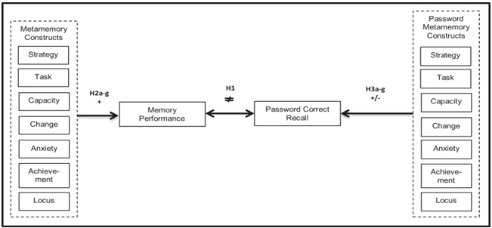
Block Diagram

Slide 8
SOFTWARE REQUIREMENTS:
Operating System : Windows 10
Platform : DOT NET TECHNOLOGY
Front End : ASP.Net 4.0
Back End : SQL SERVER 2014

Slide 9
HARDWARE REQUIREMENTS:
Keyboard
Mouse
Hard disk 500GB
Ram 4 Gb

Slide 10
CONCLUSION
This paper is tried to improve the remembrance of password as a picture. It is prove that human being is more convenient to remember a picture than a text.
This is an attempt to improve the process of normal password system to some other manners. We are try to develop a software to implement this process of remembrance password as a picture.
In the future enhancement we will implement this system where we can encrypt the whole data in the image and also the image can also be encrypted so in this way there will be implementation of the double protection of the data.

Slide 11
REFERENCE
[1] Ross J. Anderson and Fabien A. P. Petitcolas, (1998), ‘On The Limits Of Steganography’, IEEE Journal On Selected Areas In Communication, ISSN: 0733-8716, Vol: 16, Issue: 4, Pg. 474- 481, May
[2] Jing-Ming Guo, Thanh-Nam Le, (2010), ‘Secret Communication Using JPEG Double Compression’, IEEE Signal Processing Letters, ISSN: 1558-2361, Vol: 17, Issue: 10, pg. 879-882, 23 August
[3] Qian Mao, KarunanithiBharanitharan, Chin-Chen Chang, (2015), ‘Multi-round dynamic swap optimization for tablebased steganography’, IET Image Processing, ISSN: 1751- 9667, Vol: 9, Issue: 12, pg. 1073-1082, 23 November
[4] Weiming Zhang, Hui Wang, DongdongHou, and Nenghai Yu, (2016), ‘Reversible Data Hiding in Encrypted Images by Reversible Image Transformation’, IEEE Transactions On Multimedia, ISSN: 1941-0077, Vol: 18, Issue: 8, Pg. 1469- 1479, 17 May
[5] Yu-Chi Chen, GwoboaHorng, and Du-Shiau Tsai, (2012), ‘Cheating Prevention in Visual Cryptography’, IEEE TRANSACTIONS ON IMAGE PROCESSING, ISSN: 1941- 0042, Vol: 21, Issue: 7, Pg. 3319-3323, 6 March

Slide 12
[6] Deepak Kumar, Shailendra Singh, (2011), ‘Secret Data Writing Using DNA Sequences’, International Conference On Emerging Trends In Networks And Computer Communications(ETNCC), ISSN : 978-1-4577-0240-2, 22 April, Udaipur, India
[7] Mrs.G.Prema, S.Natarajan, ‘Steganography using Genetic Algorithm along with Visual Cryptography for Wireless Network Application’, International Conference On Information Communication And Embedded Systems(ICICES), 21-23 Feb, Chennai, India
[8] SoodehAhani, ShahrokhGhaemmaghami, (2015), ‘Colour image steganography method based on sparse representation’, IET Image Processing, ISSN: 1751-9659, Vol: 9, Issue: 6, pg. 596-505, 1 June
[9] Feng Wang , Wan-Li Lyu, Jeng-Shyang Pan, (2016), ‘Robust image authentication scheme with self-repair capability for greyscale source document images via PNG format’, IET Image Processing, ISSN 1751-9659, Vol: 10, Issue: 12, pg. 971-978, December
[10] AlsharifAbuadbba, Ibrahim Khalil, (2017). ‘Walsh–HadamardBased 3-D Steganography for Protecting Sensitive Information in Point-of-Care’, IEEE TRANSACTIONS ON BIOMEDICAL ENGINEERING, ISSN: 0018-9294, VOL. 64, NO. 9, pg. 2186- 2195, 29 November

