Slide 1
EMPLOYEE ATTENDANCE SYSTEM

Slide 2
Abstract
This study aims at establishing an attendance system which can facilitate the administration data collection related to employee attendance effectively and efficiently.
The method used descriptive scheme, interview and document analysis related to employee attendance to create an effective and efficient attendance system.
The results obtained from this study is the establishment of an attendance system that has a function not only for absenteeism but also have the function of saving the status of employee position, working hours of employees, and employment reports of daily and monthly employees.

Slide 3
This attendance system serves to assist the secretary to fill employee data, then give the employee daily reports to the vice manager and assist the vice manager in giving the monthly report of employee work to the main manager, so as to make it easier to give an assessment of the performance of company employee for company progress.

Slide 4
Existing System
The biometrics of the user is captured again and the extracted features are compared with the ones already existing in the database to determine a match.
The developed fingerprint-based attendance management system was compared with the existing manual attendance system (use of paper sheet/attendance register) and the time of taking both attendance was recorded.
The manual attendance system average execution time for one hundred and seventeen (117) attendees is approximately 18.48 seconds as against 4.29 seconds for the fingerprint-based attendance management.

Slide 5
Disadvantage of Existing System
To overcome this problem we can use fingerprint recognition by which we can easily recognize any person, because human fingerprints are unique to each person and can be regarded as some sort of signature, certifying the person's identity.
The company can use these data to identify problems and to find solutions that are related to the employees.
This is an issue that we have identified in this system regarding the reliability of the data contain in the system on the attendance.

Slide 6
PROPOSED SYSTEM :
We are proposed to implement a system with graphical user interface (GUI) and also a mobile app to make this task easier for the client.
The proposed system is consisted with a web application and a mobile application. In this system users are categorized as non-managerial employees, Managers and HR admin.
This proposed system allow each and every employee to view his/her attendance for a desired time period. In this paper we propose a method for fingerprint matching based on minutiae matching.

Slide 7
ADVANTAGE
To build a system which facilitates the administration of attendance and the attendance of logging employees effectively and efficiently, using the descriptive scheme method, interviews, and analysis of documents related to the attendance employees.
It can build a RFID-based attendance system, which can help facilitate the attendance logging so that it can provide an assessment of the performance of the employees of the company for the progress of the company.
Attendance management plays an important role in the determination of the performance of an organization.

Slide 8
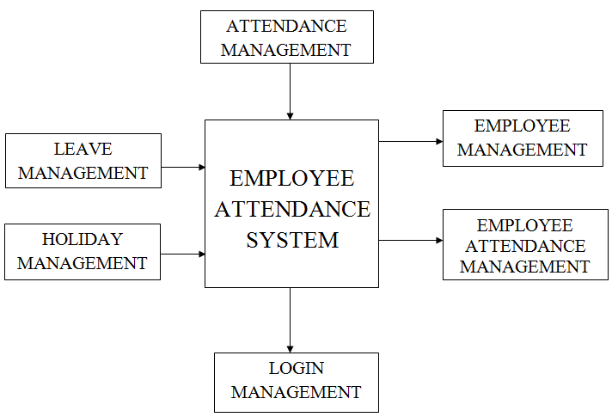
Block Diagram

Slide 9
SOFTWARE REQUIREMENTS:
Operating System : Windows 10
Platform : DOT NET TECHNOLOGY
Front End : ASP.Net 4.0
Back End : SQL SERVER 2014

Slide 10
HARDWARE REQUIREMENTS:
Keyboard
Mouse
Hard disk 500GB
Ram 4 Gb

Slide 11
CONCLUSION
Attendance system is needed by the company to see how big the responsibilities of employees to their work seen from the attendance of employees in the company, so the company can provide the straightforward assessment of employee performance, making employee attendance report and employee salary through attendance data that has stored in database company.

Slide 12
REFERENCE
[1] Kosinski M, Bachrach Y, Kohli P, Stillwell D, & Graepel T 2014 Manifestations of user personality in website choice and behaviour on online social networks. Machine learning, International Journal of Science 95(3) pp. 357-3.
[2] Singhal, Z, & Gujral, R K 2012 Anytime anywhere-remote monitoring of attendance system based on RFID using GSM network. International Journal of Computer Applications 39(3) pp. 37-41.
[3] Arulogun O T, Olatunbosun A, Fakolujo O A, & Olaniyi O M 2013 RFID-based students attendance management system. International Journal of Scientific & Engineering Research 4(2) pp. 1-9.
[4] Sandilya D K, & Nandi S K 2017 RFID based Attendance System. Journal of Innovation in Electronics and Communication Engineering 7(2) pp. 56-60.

Slide 13
[5] Zulkifli C Z, Hassan H N, Zalay A A, KamisS M, & Hassan N H A 2018 Integrated Rfid Technology And Wireless Mesh Network Platform For Boarding School Management. Journal of Fundamental and Applied Sciences 10(6S) pp. 681-691.
[6] Shukla, S 2013 RFID Based attendance management system. International Journal of Electrical and Computer Engineering 3(6) pp. 784-790.
[7] Anjum R, & Kamble V 2016 RFID Student Navigation System Int J Sci Res Sci Technol. International Journal of Science 2(6) pp. 463-467.

Slide 14
[8] Nainan S Parekh R& Shah T 2013 RFID technology based attendance management system. arXiv preprint arXiv:1306.5381. International Journal of Science 13, 11-17.
[9] Mishra Y Marwah, G K, & Verma S 2015 Arduino Based Smart RFID Security and Attendance System with Audio Acknowledgement. International Journal of Engineering Research and Technology 4(1) pp. 1-5.
[10] Maramis G D P& Rompas P T D 2018 Radio Frequency Identification (RFID) Based Employee Attendance Management System. In IOP Conference Series: Materials Science and Engineering IOP Publishing. International Journal of Science 306(1) p. 012045.

