Slide 1
Driver Drowsiness Detection using Machine Learning Image Processing

Slide 2
Abstract
Drowsiness of drivers is one of the significant cause of road accidents. Every year, there is an increase in the amount of deaths and fatal injuries globally. By detecting the driver’s drowsiness, road accidents can be reduced.
This paper describes a machine learning approach for drowsiness detection. Face detection is employed to locate the regions of the driver’s eyes, which are used as the templates for eye tracking in subsequent frames.
Finally, the tracked eye’s images are used for drowsiness detection in order to generate warning alarms.

Slide 3
This proposed approach has three stages: detecting Face, detecting Eyes and detecting drowsiness.
Image processing is used to recognize the face of the driver and then its extracts the image of the eyes of the driver for detection of drowsiness.
The HAAR face detection algorithm takes as captured frames of image and then the detected face is considered as output. Next, CHT is used for tracking eyes from the detected face.

Slide 4
Using EAR (Eye Aspect Ratio) the eye state is detected. The proposed system was tested by implementing the proposed approach on a Raspberry pi 3 Model B with 1GB RAM with use of Logitech HD Webcam C270.
The system uses frames for face and eye tracking, and the average correct rate for eye location and tracking could achieve 95.0% based on some test videos.
Thus, the proposed approach for a real-time of driver drowsiness detection is a low cost and effective solution method.

Slide 5
Existing System
Drowsiness or lack of attention of the driver is considered the primary cause for such mishaps. Driver drowsiness monitoring research can help minimize accidents.
After gone through the research papers and the existing methods, this project proposed that eyes and yawning detection method will be used.
A thorough observation was done on the existing method to detect the drowsiness. Different parameters have been used by previous researches.

Slide 6
Disadvantage of Existing System
The deep learning approaches, especially the Convolutional Neural Networks (CNNs) methods, has gained prominence in resolving challenging classifications problems.
The movement of the camera shows a great impact as it varies at certain points (Speed brakers) on the roads.
This problem will increase day by day. So, there is a requirement of designing detection systems for the driver drowsiness or inattention and can produce some warning alarms to alert the driver and the further people in the vehicle.

Slide 7
PROPOSED SYSTEM :
This paper proposes a drowsiness detection system based on multilayers perceptron classifiers.
The open eye is detected using the proposed iris–sclera pattern analysis(ISPA) method.
In the proposed system a nonintrusive driver drowsiness monitoring system has been developed using computer vision techniques.
In this paper, they propose a DriCare, approach whereby drivers are identified with video images without using devices like yawning, blinking, and closure of the eyes.

Slide 8
ADVANTAGE
Convolutional Neural Networks (CNNs) methods have largely produced an outlandish performance in the drowsiness detecting area and are also a powerful aid to various classification tasks.
The use of these new technologies and methodologies can be an effective way to not only increase the efficiencies of the existing real-time driver drowsiness detection system but also provide a tool that can be widely used by drivers.
Moreover, it has been established that the efficiency of the model drops in the cases of wearing sunglasses because the algorithm is not able to detect the driver's eyes.

Slide 9
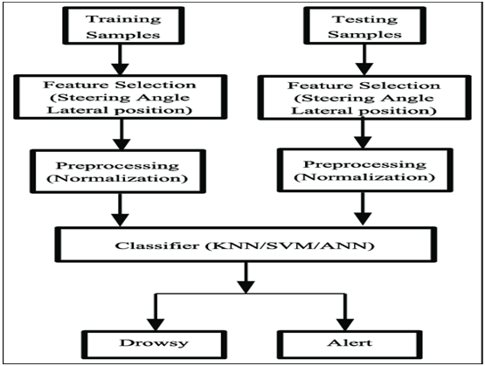
Block Diagram

Slide 10
SOFTWARE REQUIREMENTS:
Operating System : Windows 10
Platform : DOT NET TECHNOLOGY
Front End : ASP.Net 4.0
Back End : SQL SERVER 2014

Slide 11
HARDWARE REQUIREMENTS:
Keyboard
Mouse
Hard disk 500GB
Ram 4 Gb

Slide 12
CONCLUSION
Driver Drowsiness Detection was built to help a driver stay awake while driving in order to reduce car accidents caused by drowsiness.
This paper experimented in a bright room with constant light. In addition, there were several limitations including light conditions and the darkness of the skin.
The embedded device can calculate a drowsiness level from the driver using a combination of Raspberry Pi 3 Model B and Raspberry Pi Camera. Raspberry Pi 3 Model B is a processor to calculate whether or not a driver is drowsy.

Slide 13
REFERENCE
[1] Tejasweeni Musaleand Pansambal, Driver Drowsiness Detection Technique Using Raspberry Pi , B.H. Bhivarabai Sawant College Of Engineering And Research, Narhe, Pune, India Article.
[2] Oraan Khunpisuth, Taweechai Chotchinasri, “Driver Drowsiness Detection Using Eye-Closeness Detection”, Varakorn Koschakosai Mahidol University International College, Department Of Computer Engineering, Faculty Of Engineering, Mahidol University, Nakhonpathom, Thailand Narit Hnoohom Image, Information And Intelligence Laboratory, Department Of Computer Engineering, Faculty Of Engineering, Mahidol University, Nakhon Pathom, Thailand
[3] Marco Javier Flores, José María Armingol And Arturo De La Escalera, “Real-Time Drowsiness Detection System For An Intelligent Vehicle” Member, Ieee

Slide 14
[4] Belal Alshaqaqi; Abdullah Salem Baquhaizel, Mohamed El Amine Ouis, Meriem Boumehed; Abdelaziz Ouamri, “Driver Drowsiness Detection System”, Mokhtar Keche, Laboratory Signals And Images (Lsi) University Of Sciences And Technology Of Oran Mohamed Boudiaf (Usto-Mb) Oran, Algeria {Alshaqaqi@Ieee.Org;
[5] Li Cuimei, Qi Zhiliang, Jia Nan, Wu Jianhua “Human Face Detection Algorithm Via Haar Cascade Classifiers Combined Withthree Additional Classifiers” @ Ieee 13th International Conference 1.School Of Communication And Electronics, Jiangxi Science & Technology Normal University Nanchang 330013, China2. School Of Information Engineering Nanchang University Nanchang 330031, China

Slide 15
[6] T.D’orazio, M. Leo, G.Cicirelli, “An Algorithm For Real Time Eye Detection In Face Images” A. Distante[Dorazio, Leo, Cicirelli, Distante] @Ba.Issia.Cnr.It Institute Of Intelligent Systems For Automation.
[7] Voila P, Jones M J., “Rapid Object Detection Using A Boosted Cascade Of Simple Features”, Proceedings Of The 2001 Ieee Computer Society Conference On Computer Vision And Pattern Recognition (Iccvpr 2001), Vol. 1, Pp. I-511- I-518, 8-14 Dec. 2001, Kauai, Usa.

