Slide 1
DRIVER DROWSINESS AND ALCOHOL DETECTION WITH CAR TRACKING SYSTEM USING IOT

Slide 2
Abstract
The Internet of Things is most useful in communicating devices (things) with each other by using the internet nowadays. Most of sensor device is connected with IoT is more popular in recent times.
In this paper a model based in IoT is proposed with aim to prevent accidents due to drink-driving and drowsiness of driver.
It includes analysis of alcohol concentration, eye-blinking rate, coordinates of car, alert system at which the car is made to detect a drunken or drowsy state and hence undertake protective measures include ignition off, triggering an alarm, alert to family members etc.

Slide 3
Existing System
The existing system which is utilized is also very costly and is implemented only in high class and very expensive vehicles.
The conduct of the driver, including yawning, eye conclusion, eye squinting, head present, and so forth., was observed through a camera and the driver was cautioned if any of these laziness side effects are recognized.
A driver nods off, at that point the driver loses power over the vehicle, an activity which regularly brings about an accident with either another vehicle or any article.

Slide 4
Disadvantage of Existing System
It is compulsory to wear eyeglasses for drowsiness detection.
Wearing the sensors can be annoying for the driver and may cause distraction while driving; therefore effective implementation is challenge.
It is very risky to ignition off while driving.
In case of server load, it is difficult to response.
It is completely sensor based system, sensors may work inefficiently.

Slide 5
PROPOSED SYSTEM :
This paper approaches a system towards automobile safety with autonomous region based automatic car system.
We propose three distinct concepts namely, a Drowsy Driver Detection system, a traffic detection system with external vehicle intrusion avoidance based concept and alcohol consumption detection system.
The proposed system is used to avoid various road accidents caused by drowsy driving, using mobile while driving and alcohol consumption during driving also this system used for security purpose of a driver to caution the driver if any of these state occurs.

Slide 6
ADVANTAGE
It is cheap and easy to implement.
IR sensor is cheap and widely available.
The car ignition system off if the sensor detects drowsiness.
NFC tags are cheap and easy to implement.
No external monitoring is required for this system to work.

Slide 7
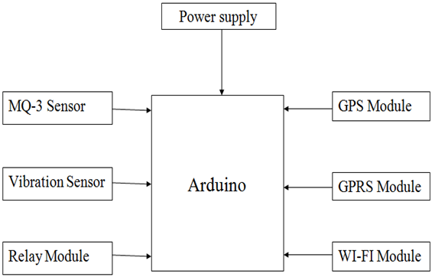
Block Diagram

Slide 8
SOFTWARE REQUIREMENTS:
Operating System : Windows 10
Platform : DOT NET TECHNOLOGY
Front End : ASP.Net 4.0
Back End : SQL SERVER 2014

Slide 9
HARDWARE REQUIREMENTS:
Keyboard
Mouse
Hard disk 500GB
Ram 4 Gb

Slide 10
CONCLUSION
In this paper, we proposed and implemented an IoT system which is very useful to preventing accidents. An effective solution is provided to develop a system for vehicles will sense the alcohol present in the breath of the driver and take action immediately ignition off and send alert to family members.
Another problem is solved is sleeping on wheel a driver who feels sleepy while driving then system turn on buzzer and prevent dangerous accidents.
System also detects accidents and send alert to driver’s family members so they can track the vehicle location and try to help them.

Slide 11
The communication with family members system is designed with GPRS and GPS module. For alcohol detection MQ-3 sensor is used and for accident detection vibration sensor is used. Ignition off module is important module which is done by putting relay. The whole control system has the benefit of small volume and high reliability.
Future scope of this system is to decrease accidents numbers and providing useful emergency solutions as fast as possible. We will try to get accurate measurements of sensors and their response time. This system brings modernization to the existing technology in the current vehicles and also improves safety features.

Slide 12
REFERENCE
[1] K.Srijayathi and M.Vedachary, “Implementation of the Driver Drowsiness Detection System,” International Journal of science,Engineering and Technology Research(IJSETR), vol. 2, pp. 1751-1754, September 2013.
[2] Elie Nasr, Elie Kfoury and David Khoury, “An IoT Approach to Vehicle Accident Detection, Reporting and Navigation,” IEEE International Multidisciplinary Conference on Engineering Technology (IMCET), 978-1- 5090-0996-1, 2016.
[3] Pragyaditya Das and S.Pragadeesh, “A Microcontroller based Car-Safety System: Implementing Drowsiness Detection And Vehicle-Vehicle Distance Detection In Parallel,” International journal of Scientific & Technology Research , vol. 4, issue 12 , pp. 161-163, December 2015.

Slide 13
[4] Swaleh Owais, “Eye Blink Detection Algorithms”, https://hackaday.io/project/27552- blinktotext/log/68360-eye-blink-detection-algorithms.
[5] Dr. Pradip Ashok Saymote,Mr.Abhijeet Patil, “Application Of Google API with Java Script for Web mapping of Shivaji University Campus(MS),” International Journal of Current Trands in Engineering & Research(IJCTER), vol. 2, issue 9, pp. 18-26, September 2016.
[6] Patole Gitanjali, Shinde Jyoti, Dalve Satish, Prof. Vipul Ranjan, Prof. Suri S.B, “IOT based Vehical Tracking & Vehicular Emergy System – A case Study and Review,”International Journal of Advanced Research in Electrical,Electronics and Instrumentation Engineering, vol. 6, issue 10 pp. 8001–8012, October 2017.

