Slide 1
BLOCK CHAIN BASED SECURED DATA TRANSFER IN MOBILE CLOUD COMPUTING

Slide 2
Abstract
Offloading computation-intensive tasks (e.g., blockchain consensus processes and data processing tasks) to the edge/cloud is a promising solution for blockchain-empowered mobile edge computing.
However, the traditional offloading approaches (e.g., auction-based and game-theory approaches) fail to adjust the policy according to the changing environment and cannot achieve long-term performance.
Moreover, the existing deep reinforcement learning-based offloading approaches suffer from the slow convergence caused by high-dimensional action space.

Slide 3
In this paper, we propose a new model-free deep reinforcement learning-based online computation offloading approach for blockchain-empowered mobile edge computing in which both mining tasks and data processing tasks are considered.
First, we formulate the online offloading problem as a Markov decision process by considering both the blockchain mining tasks and data processing tasks.
Then, to maximize longterm offloading performance, we leverage deep reinforcement learning to accommodate highly dynamic environments and address the computational complexity.

Slide 4
Furthermore, we introduce an adaptive genetic algorithm into the exploration of deep reinforcement learning to effectively avoid useless exploration and speed up the convergence without reducing performance.
Lastly, our experimental results demonstrate that our algorithm can converge quickly and outperform three benchmark policies.

Slide 5
INTRODUCTION
On rapid development of information technology in security, blockchain leads the major role in which it undergoes decentralized peer-peer system.
Data in the blockchain undergoes immutability features in which once the data is updated into the block, it cannot be changeable so data changes will not occur.
Blocks are open access to the user connected to the blockchain network in which the user data is not open. Blockchain maintains consensus algorithms such as proof of work and proof of stake to store sensitive data.

Slide 6
Big data and cloud undergo some issues in security, storage, sharing and authenticating the data.
In this paper we have contributed the analysis of the blockchain network in perspective of big data storage and cloud security where SWOT analysis is also taken to know benefits and loss of credits.
This paper is organized as the detailed description of blockchain network evolution, needs and features SWOT analysis to understand the working of blockchain and blockchain based big data storage using cloud computing and addresses the challenges in blockchain.

Slide 7
Block chain
Blockchain is mostly known as the technology underlying the virtual cryptocurrency Bitcoin which was invented in 2008 by a person known as Satoshi Nakamoto.
In a nutshell, the blockchain is briefly explained as public, trusted and shared ledger based on a peer-to-peer network.
This emerging technology has also recently become a hot topic for researchers and been argued to innovate blockchain-based applications beyond Bitcoin. The core idea of the blockchain network is decentralization which means blockchain is distributed over a network of nodes.

Slide 8
Ethereum Account
Ethereum has two different accounts: externally owned accounts (EOAs) and contract accounts.
Every account is indexed by a 20-byte address and defined by a pair of keys, a private key and a public key.
To interact with Ethereum blockchain, each user needs to create an account to become an entity in the network.

Slide 9
Smart contract
A smart contract is a kind of self-operating computer program, which can be executed automatically when specific conditions are met.
In the Ethereum blockchain, a smart contract is a special account, which contains data and code with multiple programmable functions. Users can use their Ethereum account to interact with smart contracts via application binary interfaces (ABI).
Functions defined in smart contracts can be triggered by a new transaction sent from an account. This property allows entities to implement their job functionalities such as data transmission, request handling or access management.

Slide 10
Transaction
An Ethereum transaction is a data packet to transfer ether (Ethereum native token) from an account to another.
A typical structure of transaction is as follow {Account Nonce, address of recipient, Gas price, Gas limit, Ether value, sender’s signature, data field}. Below is an example of a transaction. Transaction Tx = new Transaction( getFromAddress(), gasPrice, gasLimit, to, value, data).
In our model, we use the data field to declare request IDs to smart contracts for data request on cloud storage.

Slide 11
Existing System
Most of these existing works show how RL has been effectively applied to MEC based networks due to network dynamics.
Random task generation and arrival exist for a mobile device since independent tasks are possibly sensed, collected, and generated by multiple types of applications stochastically.
The existing DRL algorithms in terms of convergence, stability, and robustness, proposed a multiagent DRL-based cooperative computation offloading policy in the NOMA enabled MEC system with the aid of expert strategies, scatter networks, and hierarchical agents.

Slide 12
Disadvantage of Existing System
The slow convergence caused by high-dimensional action space remains an urgent and challenging problem.
In this paper, we study the computation offloading problem for both mining tasks and data processing tasks in multi-hop multi-user blockchain-empowered MEC.
In our performance optimization problem, it is important to note that costs such as energy consumption and purchasing VMs should be paid immediately.

Slide 13
PROPOSED SYSTEM :
To minimize the expected long-term cost of task delay and dropping penalty, the optimal offloading decision making strategy was proposed in with the aid of long short-term memory (LSTM), dueling DQN, and double DQN algorithms.
In, a low-complexity DRL-based task execution time and energy consumption optimization is proposed to avoid frequent offloading decisions and resource allocation recalculations, considering time-varying wireless channels and dynamic edge computational resources.
A context-aware attention mechanism is proposed for the online weight adjustment of each action value.

Slide 14
ADVANTAGE
The performance of the algorithm is greatly affected by the convergence and accuracy of the deep Q-network (DQN).
In this way, we can make the most of the evaluating role of critic network in exploration, avoiding useless exploration to a great extent without reducing the performance.
A resource allocation algorithm based on deep Qlearning is proposed into optimize the performance of computation offloading in MEC.
All these algorithms are constrained by the trade-off between efficiency and optimality.

Slide 15
TITLE | AUTHOR | DESCRIPTION
Qos-aware cooperative computation offloading for robot swarms in cloud robotics | Z. Hong, H. Huang, S. Guo, W. Chen, and Z. Zheng. | In this paper, we propose a quality of service (QoS)-aware cooperative computation-offloading scheme for robot swarms using game theory.
Blockchain for secure and efficient data sharing in vehicular edge computing and networks | J. Kang, R. Yu, X. Huang, M. Wu, S. Maharjan, S. Xie, and Y. Zhang. | We exploit consortium blockchain and smart contract technologies to achieve secure data storage and sharing in vehicular edge networks.

Slide 16
TITLE | AUTHOR | DESCRIPTION
Mobile-edge computation offloading for ultradense iot networks | H. Guo, J. Liu, J. Zhang, W. Sun, and N. Kato. | In order to meet the diverse quality-of-service and quality of experience demands from the ever-increasing IoT applications, the ultradense IoT networks face unprecedented challenges.
Credit-based payments for fast computing resource trading in edge-assisted internet of things | Z. Li, Z. Yang, S. Xie, W. Chen, and K. Liu. | In our resource-coin loan problem, we propose an iterative double-auction-based algorithm, where a broker is introduced to solve the loan allocation problem and to determine the size of the loan each lender would provide to each borrower.

Slide 17
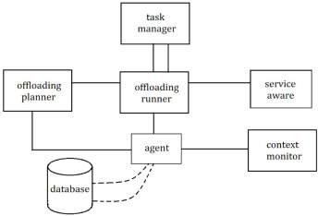
Block Diagram

Slide 18
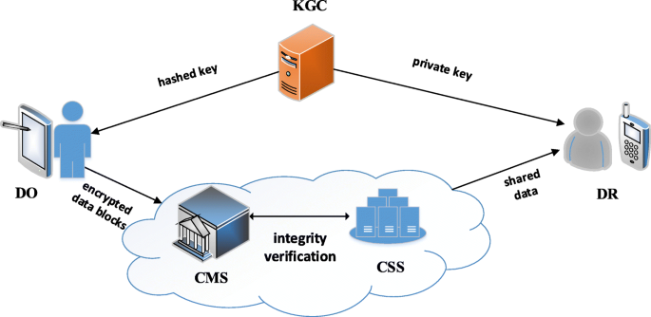
SYSTEM ARCHITECTURE

Slide 19
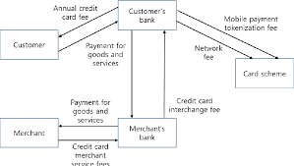
USECASE DIAGRAM

Slide 20
SOFTWARE REQUIREMENTS:
Operating System : Windows 10
Platform : DOT NET TECHNOLOGY
Front End : ASP.Net 4.0
Back End : SQL SERVER 2014

Slide 21
HARDWARE REQUIREMENTS:
Keyboard
Mouse
Hard disk 500GB
Ram 4 Gb

Slide 22
CONCLUSION
In this paper, we propose a deep reinforcement learning based online computation offloading approach for blockchain empowered MEC, in which both mining tasks and data processing tasks are considered.
To achieve long-term offloading performance, our DRGO algorithm uses model-free deep reinforcement learning to adapt to highly dynamic environments and maximize the long-term reward.
In particular, to overcome the slow convergence caused by the high-dimensional action space, the DRGO algorithm takes advantage of the genetic algorithms into deep reinforcement learning during the exploration process, survives the curse of high-dimensional action space, and converges at a acceptable speed.

Slide 23
Simulation results have shown that the DRGO algorithm achieves better performance compared with three representative benchmark policies and shows strong robustness under various environments.
In future work, we plan to study the exploration mechanism to further improve the efficiency of the exploration, which is the key to solve the convergence problem of deep reinforcement learning.

Slide 24
REFERENCE
[1] Z. Hong, H. Huang, S. Guo, W. Chen, and Z. Zheng. Qos-aware cooperative computation offloading for robot swarms in cloud robotics. IEEE Transactions on Vehicular Technology, 68(4):4027–4041, April 2019.
[2] J. Kang, R. Yu, X. Huang, M. Wu, S. Maharjan, S. Xie, and Y. Zhang. Blockchain for secure and efficient data sharing in vehicular edge computing and networks. IEEE Internet of Things Journal, pages 1– 1, 2019.
[3] J. Kang, Z. Xiong, D. Niyato, P. Wang, D. Ye, and D. I. Kim. Incentivizing consensus propagation in proof-of-stake based consortium blockchain networks. IEEE Wireless Communications Letters, 8(1):157– 160, Feb 2019.

Slide 25
[4] Z. Li, Z. Yang, S. Xie, W. Chen, and K. Liu. Credit-based payments for fast computing resource trading in edge-assisted internet of things. IEEE Internet of Things Journal, pages 1–1, 2019.
[5] Z. Li, Z. Yang, and S. Xie. Computing resource trading for edge-cloudassisted internet of things. IEEE Transactions on Industrial Informatics, pages 1–1, 2019.
[6] W. Chen, B. Liu, H. Huang, S. Guo, and Z. Zheng. When uav swarm meets edge-cloud computing: The qos perspective. IEEE Network, 33(2):36–43, March 2019.
[7] H. Guo, J. Liu, J. Zhang, W. Sun, and N. Kato. Mobile-edge computation offloading for ultradense iot networks. IEEE Internet of Things Journal, 5(6):4977–4988, Dec 2018.

Slide 26
[8] Z. Xiong, S. Feng, W. Wang, D. Niyato, P. Wang, and Z. Han. Cloud/fog computing resource management and pricing for blockchain networks. IEEE Internet of Things Journal, pages 1–1, 2019.
[9] Y. Wang, K. Wang, H. Huang, T. Miyazaki, and S. Guo. Traffic and computation co-offloading with reinforcement learning in fog computing for industrial applications. IEEE Transactions on Industrial Informatics, 15(2):976–986, Feb 2019.
[10] V. Mnih, K. Kavukcuoglu, D. Silver, A. Rusu, J. Veness, M. Bellemare, A. Graves, M. Riedmiller, A. Fidjeland, G. Ostrovski, S. Petersen, C. Beattie, A. Sadik, I. Antonoglou, H. King, D. Kumaran, D. Wierstra, S. Legg, and D. Hassabis. Human-level control through deep reinforcement learning. Nature, 518(7540):529–533, February 2015.

