Slide 1
AN END-TO-END EARLY WARNING SYSTEM BASED ON WIRELESS SENSOR NETWORK FOR GAS LEAKAGE DETECTION IN INDUSTRIAL FACILITIES

Slide 2
Abstract
Existing liquefied petroleum gas (LPG) detection systems are ad hoc and designed as stand-alone nodes.
This article, however, presents an integrated end-to-end wireless sensor network (WSN) system that integrates hardware and software for early warning gas leakage detection and monitoring applications, fully utilizing the Internet of Things (IoT) functionalities and capabilities in WSNs at the network level such that network performance is improved.
The proposed system can operate in single- and multihop modes depending on the surrounding radio frequency environment and network topology.

Slide 3
Specifically, we design a per-deployed WSN system for LPG detection/monitoring in residential areas and factories that collects, analyzes, and forwards the collected information over a wireless channel to the monitoring center to take the appropriate action.
To achieve a reliable communication and data delivery, we implement an efficient communication protocol that organizes the data exchange between different nodes in the network.
The proposed WSN system is deployed and experimentally tested.

Slide 4
The data acquired from the various experiments are used to examine the reliable operation of the implemented system in terms of robustness and data delivery reliability.
Robust and reliable performance is demonstrated with packet loss rate as low as 5%.
The experimental results also indicate that the proposed system can promptly detect gas leakage within 50 ms and provide accurate gas concentration measurements with 97% accuracy.

Slide 5
Existing System
Existing fire prevention measures in public places are mostly based on the emergency treatments after the fire, which have limited protection capability when the fire spreads rapidly, especially for the flammable liquid explosion accident.
Based on the gas sensor network, this paper proposes a detection framework as well as detail technologies to detect flammable liquid existing in small spaces.
If there is repeated abnormal fluctuation in the measurement node of a single measurement node, we judge that there is a combustible gas diffusion source exists near the sensor node.

Slide 6
Disadvantage of Existing System
Most of the theoretical efforts attempted to solve a subset of the design problem such as providing communication protocols for WSNs, clustering mechanism, routing, etc.
Acquiring data from a closed area in fire is a challenging problem for fire fighters.

Slide 7
PROPOSED SYSTEM :
We propose to use sensor network to detect the flammable liquids through monitoring the concentrations of the target liquid vapor diffused in the air.
In order to meet the fire prevention requirements for small public places, this paper proposes detection mechanism for flammable and explosive liquids detection.
This paper proposes the fire detection mechanism in small space based on sensor network, which has low implementation cost as well as high scalability.In, a WSN system for preventing fire accident on the running train was proposed.

Slide 8
ADVANTAGE
The proposed system features reliable sensing and data processing algorithms as well as efficient distributed communication mechanisms.
The adopted communication protocol provides reliable data delivery while being energy efficient.

Slide 9
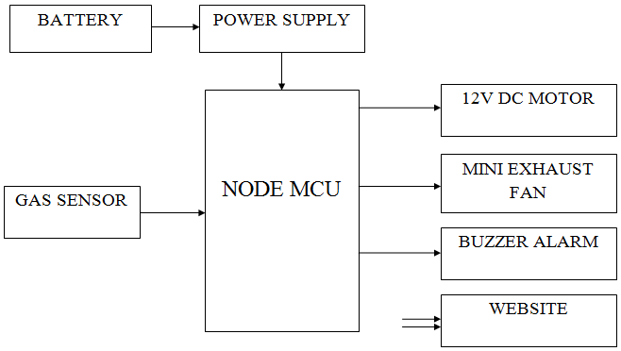
Block Diagram

Slide 10
SOFTWARE REQUIREMENTS:
Operating System : Windows 10
Platform : DOT NET TECHNOLOGY
Front End : ASP.Net 4.0
Back End : SQL SERVER 2014

Slide 11
HARDWARE REQUIREMENTS:
Keyboard
Mouse
Hard disk 500GB
Ram 4 Gb

Slide 12
CONCLUSION
While a recently published survey paper confirms that existing LPG detection systems are ad hoc and designed as stand-alone nodes, this article presents an integrated end-to-end WSN system that integrates hardware and software for early warning gas leakage detection and monitoring applications, fully utilizing the IoT functionalities and capabilities in WSNs at the network level such that the network performance is improved. This article presented the hardware and software components of the designed system, discussed the design of the circuit and PCB layouts for various sensor nodes in the system, and demonstrated the operation of the various developed software and communication protocols and algorithms by experimental testing.

Slide 13
We have manufactured and assembled various nodes in the end-to-end WSN system and evaluated their performance under realistic scenarios. Specifically, WSN prototypes are experimentally tested in order to demonstrate the effectiveness of the proposed hardware and software design components in realistic environment. The results showed that the proposed end-to-end WSN system can provide reliable, timely, and efficient early warning event-detection system. Robust and reliable communication was demonstrated, in which the proposed end-to-end system depicted a packet loss rate as low as 5%. It is worth mentioning that the proposed system can be used in other applications to monitor and report different physical conditions (e.g., temperature, humidity, and intrusion detection) by replacing the gas sensor with the appropriate sensing unit that can measure the physical conditions of interest.

