Slide 1
Water logging in almost all major cities despite having drainage system in place

Slide 2
Abstract
It is a common phenomenon in cities that waterlogging affects people’s normal life.
It is of great significance for targeted transformation and upgrading to identify the risk factors of urban waterlogging.
This paper collected the waterlogging data of Tianjin in China, analyzed the coupling mechanism among waterlogging risk factors of urban drainage systems, and then selected the system dynamics theory and the Vensim software as the analysis tools due to the mixing characteristic and the limited availability of data.

Slide 3
After that, the sensitive factors were identified by model simulation and sensitivity analysis, and the prominent impact of urban expansion on waterlogging risk was discussed.
Then, through the comparison of the three simulation scenarios, it was found that, compared with the urban development focus shifting strategy, the strategies of sponge city reconstruction and management optimization could achieve the risk control goal within a shorter time.
On this basis, two kinds of governance schemes with strong operability were put forward, which were the data governance strategy and the sponge city reconstruction strategy of giving priority to old urban areas.

Slide 4
Existing System
Cleaning and removal of blockage from existing drains and repair and rehabilitation of existing primary, secondary and tertiary drains and protection of the water quality at outfall.
There exist few lined and unlined drains within the urban area. These can drain some local areas of the urban area. The capacity and outfalls of existing drainage system is not planned with well defined consideration of drainage areas/zones for the whole urban area.
The existing drains and also those will be constructed shall have to cleaned at regular interval.

Slide 5
Disadvantage of Existing System
The system dynamics provide the possibility of quantitative analysis on a qualitative basis and are especially suitable for complex system problems that evolve over time.
To study and establish water sensitive urban design (WSUD) to deal with multiple water problems such as storm flood risks, shortage of fresh water resources, and water deterioration.
When the urban waterlogging problem is increasingly prominent, we must pay attention to the disadvantages of urban repeated development and consider balancing urban and rural development and optimizing urban and rural structures in further urban planning.

Slide 6
PROPOSED SYSTEM :
Drainage system of an urban area is assessed through a sequence of analytical processes and it finally results in a proposed drainage system.
These water logged areas have been considered and brought under proposed drainage network.
A strategic move towards renewable energy generation on salt-affected soils and possibly with saline water resources could consider the establishment of plantations consisting of multipurpose tree and shrub species.

Slide 7
ADVANTAGE
The advantages of the method are the development of limit and the debacle production hazards the board perspectives, conduct and a more substantial knowledge into the networks empowering better outcomes.
However, although the effect is minor compared with strategy one, efficient hazard management can prevent dangerous events developing into disasters or reduce disaster losses, reflecting the level of waterlogging risk management.
Many of the irrigation systems have become dilapidated due to silting of canal system, weed growth, damages to the canal sections and regulatory structures leading to low performance.

Slide 8
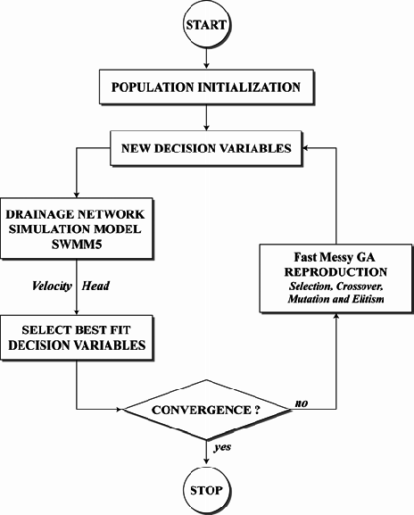
Block Diagram

Slide 9
SOFTWARE REQUIREMENTS:
Operating System : Windows 10
Platform : DOT NET TECHNOLOGY
Front End : ASP.Net 4.0
Back End : SQL SERVER 2014

Slide 10
HARDWARE REQUIREMENTS:
Keyboard
Mouse
Hard disk 500GB
Ram 4 Gb

Slide 11
CONCLUSION
It was concluded that sponge city construction needs the cooperation of more departments and requires a great deal of time.
Correspondingly, the management optimization strategy may be a more direct and effective way to improve the overall level of waterlogging management, while the transformation of the overall development strategy of the city is a higher and further consideration.

Slide 12
REFERENCE
1. Zhang, Q.; Wu, Z.; Zhang, H.; Fontana, G.D.; Tarolli, P. Identifying Dominant Factors of Waterlogging Events in Metropolitan Coastal Cities: The Case Study of Guangzhou, China. J. Environ. Manag. 2020, 271, 110951.
2. Tang, X.; Shu, Y.; Lian, Y.; Zhao, Y.; Fu, Y. A Spatial Assessment of Urban Waterlogging Risk based on a Weighted Naïve Bayes Classifier. Sci. Total Environ. 2018, 630, 264–274.
3. Zhang, H.; Cheng, J.; Wu, Z.; Li, C.; Qin, J.; Liu, T. Effects of Impervious Surface on the Spatial Distribution of Urban Waterlogging Risk Spots at Multiple Scales in Guangzhou, South China. Sustainability 2018, 10, 1589.
4. IPCC. Intergovernmental Panel on Climate Change Special Report on Managing the Risks of Extreme Events and Disasters to Advance Climate Change Adaptation; Cambridge University Press: Cambridge, UK, 2011.
5. Hallegatte, S.; Green, C.; Nicholls, R.J.; Corfee-Morlot, J. Future Flood Losses in Major Coastal Cities. Nat. Clim. Chang. 2013, 3, 802–806.

Slide 13
6. UNISDR (United Nations International Strategy for Disaster Reduction). GAR 2015 Making Development Sustainable: The Future of Disaster Risk Management; UNISDR: Geneva, Switzerland, 2015.
7. Woodruff, J.; Irish, J.; Camargo, S. Coastal Flooding by Tropical Cyclones and Sea-level Rise. Nature 2013, 504, 44–52.
8. Shi, P.; Wei, X.; Wang, J.B. Natural Disaster System in China, 1st ed.; Springer: Berlin/Heidelberg, Germany, 2016; pp. 1–36.
9. Chen, Q.; Zhong, P.; Zhang, X.; Liu, J.; Jia, L. Establishment of an Innovative System of Natural Disaster Prevention. Hydrogeol. Eng. Geol. 2020, 47, 1–4. (In Chinese)
10. Radcliffe, J.C. Approaches to Water Sensitive Urban Design; Woodhead Publishing: Sawston, UK, 2019.

