Slide 1
Development of business models for collection and utilization of single use plastics and various other industrial wastes

Slide 2
Abstract
This study reviews the scientific literature for business models contributing to sustainable plastic management and suggests avenues for future research.
We define sustainable plastic management (SPM) as any technique along the waste hierarchy seeking to minimize the environmental damage of plastic material.
Limited cases were found during the literature review, whereas many more SPM business models exist in practice, signaling a research gap.

Slide 3
Forty-four scientifically documented business models were identified and analyzed on the basis of business model component, sustainability, level of waste hierarchy and sustainable business model archetype.
Our results suggest that business models focus on recycling and creating value from waste, as well as the development of bioplastic.
Few cases qualified as triple bottom line businesses, as many reported environmental and economic, but not social, benefits. Circular economy business models were found in a quarter of all cases.

Slide 4
Finally, we present a synthesis of the barriers and opportunities for sustainable plastic management by the private sector.
Drivers include maintaining competitive advantage, accessing green customers, collaboration with stakeholders, and achieving efficiency improvements.
Barriers frequently mentioned were high costs, complexity of new systems, supply chain lock-in and low customer buy-in. Further research should expand the scale of SPM research, identify the enabling conditions for sustainable plastic management, and determine environmental impact.

Slide 5
Existing System
This highlights the urgent need to restructure existing recycling systems and policies on the production of plastic and its disposal.
A variety of regulatory and legislative tools exists, aimed at controlling, reducing and managing the use of plastics, with a particular emphasis on single-use plastics.
Existing legislation consists mainly of levies, bans, and voluntary efforts through the 3R rule: reduce, reuse and recycle. The features that are essential to biota are identical, as many organisms thrive in small bodies of water that exist at or just below the surface, rendering them essentially aquatic organisms.

Slide 6
Disadvantage of Existing System
The problem of plastics is situated in the global challenge of waste management which now confronts humanity.
This development has since motivated greater global efforts into examining and exploring new technologies and innovative solutions to the problem.
It is useful to noted that these same application advantages which have lend to the generation of massive waste and pollution issues at the global level .

Slide 7
PROPOSED SYSTEM :
The proposed approach aims mostly at educating the public to the dangers posed by plastic debris, especially in aquatic systems.
In the proposed scenario, the use of intentionally added microplastics in consumer or professional products of any kind would be severely restricted.
Multiple technologies exist for this purpose, such as thermochemical and catalytic conversion approaches. The non-profit company was closed but no other dedicated purpose was identified for the levy’s revenues.

Slide 8
ADVANTAGE
The recovered plastic is made into goods with similar performance to those from virgin plastics. However, the quality of the scrap reintroduced has a bearing on the performance of the resulting product.
Plastic recycling processes are largely focused on primary and secondary recycling methods thereby calling for growth in adoption of other recycling processes to improve the recycling capacity and efficiency.
There are several techniques that can be applied to separate and sort plastic solid waste and these should be applied in the most efficient way during a short period of time so as to be cost effective.

Slide 9
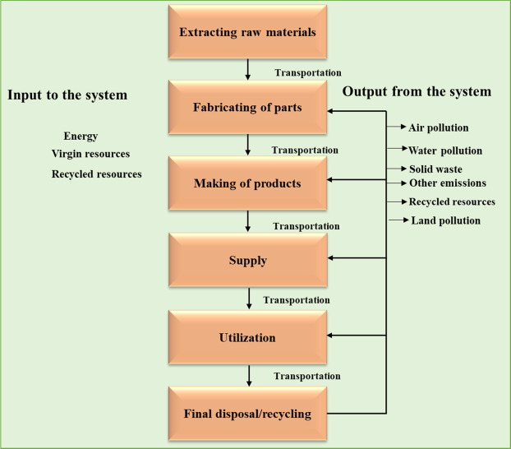
Block Diagram

Slide 10
SOFTWARE REQUIREMENTS:
Operating System : Windows 10
Platform : DOT NET TECHNOLOGY
Front End : ASP.Net 4.0
Back End : SQL SERVER 2014

Slide 11
HARDWARE REQUIREMENTS:
Keyboard
Mouse
Hard disk 500GB
Ram 4 Gb

Slide 12
CONCLUSION
This study has synthesized the current scientific literature regarding business models for sustainable plastic management, or SPM, which we defined as an activity that minimizes the environmental damage of plastic material. The review found 20 academic articles referencing 44 unique SPM business models.
The business models were coded and analyzed on the basis of the business model components, sustainability indicators, their position in the waste hierarchy, and categorized into sustainable archetypes.
Additionally, drivers and barriers were identified and larger trends were addressed that promote or hinder SPM.

Slide 13
REFERENCE
Abdelkafi, N., Hansen, E.G., 2018. Ecopreneurs’ creation of user business models for green tech: an exploratory study in e-mobility. Int. J. Entrepreneurial Ventur. 10, 32e55.
Alaerts, L., Augustinus, M., Van Acker, K., Alaerts, L., Augustinus, M., Van Acker, K., 2018. Impact of bio-based plastics on current recycling of plastics. Sustainability 10, 1487.
Bergmann, M., Klages, M., Bergmann, M., Klages, M., 2015. Marine anthropogenic litter. https://doi.org/10.1007/978-3-319-16510-3.
Betts, K., 2008. Why small plastic particles may pose a big problem in the oceans. Environ. Sci. Technol. 42.
Chesbrough, H., 2010. Business model innovation: opportunities and barriers. Long. Range Plan. 43, 354e363.

Slide 14
Engler, R.E., 2012. The complex interaction between marine debris and toxic chemicals in the ocean. Environ. Sci. Technol. 46, 12302e12315.
Galloway, T.S., Cole, M., Lewis, C., 2017. Interactions of microplastic debris throughout the marine ecosystem. Nat. Ecol. Evol. 1 https://doi.org/10.1038/ s41559-017-0116, 0116.
Geissdoerfer, M., Vladimirova, D., Evans, S., 2018. Sustainable business model innovation: a review. J. Clean. Prod. 198, 401e416.
Høgevold, N.M., 2011. A corporate effort towards a sustainable business model. Eur. Bus. Rev. 23, 392e400.
Hoon, C., 2013. Meta-synthesis of qualitative case studies: an approach to theory building. Organ. Res. Methods 16, 522e556.

