Slide 1
App-Based Solution to provide market access to micro & small enterprises

Slide 2
Abstract
Finance for micro, small, and medium-sized enterprises (MSMEs) has been a concern for all stakeholders including entrepreneurs, financial institutions, and government organizations.
The key objective of the study was to identify various challenges faced by MSMEs in sourcing of finance during different stages of their life cycle. This study is a first-of-its-kind attempt to focus on these aspects.
The study further explores whether the financial awareness of MSME entrepreneurs is a major limitation in the identification and utilization of sources of finance.

Slide 3
Data was collected through personal interviews using a structured questionnaire from a sample of 85 MSMEs.
The survey was conducted mainly in the city of Bangalore covering a wide spectrum of sectors like precision tools, weavers, jewelers, food retailers, metal works, textiles, and book shops.
The results reinforce the findings of other studies that utilization of formal sources like banks is significantly small compared with informal sources like personal and family wealth.

Slide 4
The study found that the main challenges faced in underutilization of formal sources were inadequacy of collateral assets and lack of financial awareness of entrepreneurs.
Based on the conclusion that requirement of finance differs with the life-cycle stage of the MSME, recommendations have been proposed for entrepreneurs, financial institutions, and policy makers.

Slide 5
Existing System
Most of the time, delay in realisation of such receivables increases their operating cycle and reduces their ability to procure new orders or fulfil the existing ones.
It would also help in removing the bias towards manufacturing enterprises in the existing definition and would improve the ease of doing business.
However, a large number of MSEs exist in the informal sector and are not registered with any statutory authority. To explore existing and emerging technologies suitable for MSMEs.

Slide 6
Disadvantage of Existing System
MSMEs also need to deal with the issue of protection of their intellectual property and with the scarcity of skilled workers.
These issues pose inherent challenges to financing of MSMEs due to lack of awareness of funding schemes among MSME entrepreneurs and the limited role of venture capitalists, nonbanking financial companies (NBFCs), foreign banks, angel investors, and initial public offerings in financing MSMEs.
A delay in payment affects cash flow to the MSME and also negatively impacts its ability to process other orders.

Slide 7
PROPOSED SYSTEM :
We propose to run a regulatory sandbox for cohorts focussed on lending.
It has been proposed to establish Enterprise Development Centres (EDCs) within District Industries Centres (DICs) in each district.
To propose measures for leveraging technology in accelerating growth of the sector.
The proposed definition has been considered progressive and suitable because of introduction of Goods and Services Tax (GST).

Slide 8
ADVANTAGE
They are also unable to take advantage of most of the Government schemes which are mostly based on digital infrastructure and require beneficiaries to have some form of digital identify and presence.
Some lenders are collaborating with FinTech companies to take advantage of such surrogate data for speedier credit underwriting for extending loans to MSME sector.
This requires the corporates, both in the public and private sector, to join the TReDS platform and make the system more efficient.

Slide 9
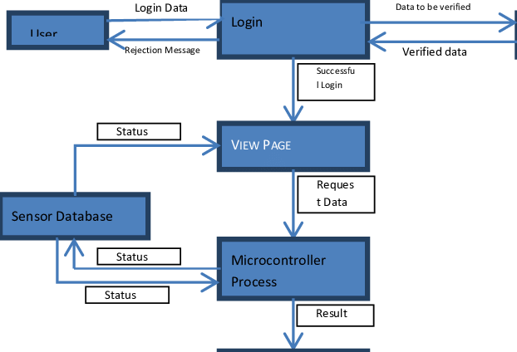
Block Diagram

Slide 10
SOFTWARE REQUIREMENTS:
Operating System : Windows 10
Platform : DOT NET TECHNOLOGY
Front End : ASP.Net 4.0
Back End : SQL SERVER 2014

Slide 11
HARDWARE REQUIREMENTS:
Keyboard
Mouse
Hard disk 500GB
Ram 4 Gb

Slide 12
CONCLUSION
The major challenges are the difficulty in providing collateral or a guarantee, procedural complications, lack of knowledge about available schemes, and lengthy processing times for loan applications.
A lack of knowledge of available MSME finance schemes, together with collateral requirements for loans, were common challenges in this stage, as in the other stages.
It was interesting to find that financial institutions would insist on collateral from enterprises that have established themselves in the market over a period of time, and that goodwill was not considered sufficient.

Slide 13
REFERENCE
Ambrose, J. 2012. Venture Capital (VC): The All Important MSMEs Financing Strategy under Neglect in Kenya. International Journal of Business and Social Science. 3(21). pp. 234–240.
Asian Development Bank. 2014. ADB–OECD Study on Enhancing Financial Accessibility for MSMEs: Lessons from Recent Crises. Manila.
Banerjee, A. A. 2006. Capital Market Access to SMEs in India. Paper presented at the 10th Indian Institute of Capital Markets (IICM) Conference, 18–19 December, Mumbai, India.
Government of India. 2015a. MSME at a Glance. Ministry of Micro, Small and Medium Enterprises. New Delhi.
Irwin, D., and J. M. Scott. 2010. Barriers Faced by SMEs in Raising Bank Finance. International Journal of Entrepreneurial Behavior and Research. 16(3). pp. 245–259.

Slide 14
Grant Thornton India and FICCI. 2011. Vision 2020: Implications for MSMEs. New Delhi.International Finance Corporation. 2012. Micro, Small and Medium Enterprise Finance in India. New Delhi.
Mallick, S. K., A. Sarkar, K. Roy, T. Duttachaudhuri, and A. Chakrabarti. 2010. Dynamics of Emerging India's Banking Sector Assets: A Simple Model. Journal of Asset Management. 11(1). pp. 62–70.
Prasad, C. S. 2006. Micro, Small and Medium Enterprises Financing in India—Issues and Concerns. CAB Calling. July–Sept, 35–40.
Reserve Bank of India. 2005. Policy Package for Stepping Up Credit to Small and Medium Enterprises. Mumbai.
Reynolds, P. D., and R. T. Curtin. 2009. New Firm Creation in the United States: Initial Explorations II Data Set. International Studies in Entrepreneurship. 23. pp. 2–5.

