Slide 1
Using food waste as consumable organic resource

Slide 2
Abstract
Food wastage and its accumulation are becoming a critical problem around the globe due to continuous increase of the world population. The exponential growth in food waste is imposing serious threats to our society like environmental pollution, health risk, and scarcity of dumping land. There is an urgent need to take appropriate measures to reduce food waste burden by adopting standard management practices. Currently, various kinds of approaches are investigated in waste food processing and management for societal benefits and applications. Anaerobic digestion approach has appeared as one of the most ecofriendly and promising solutions for food wastes management, energy, and nutrient production, which can contribute to world’s ever-increasing energy requirements. Here, we have briefly described and explored the different aspects of anaerobic biodegrading approaches for food waste, effects of cosubstrates, effect of environmental factors, contribution of microbial population, and available computational resources for food waste management researches.

Slide 3
Existing System
In contrast, interventions designed to prevent waste focus on the utility of existing goods as a way to improve resource efficiency.
Waste management-exempt activities would impose the obligation on a smaller number of businesses, and could be introduced as par t of the existing regulatory framework.
It must promote the uptake of existing mainstream technologies and best practices, but also harness and guide the resource saving potential of disruptive innovations.

Slide 4
Disadvantage of Existing System
Incineration of food waste consisting high moisture content results in the release of dioxins which may further lead to several environmental problems.
This food waste, which is a component of municipal solid waste, is incinerated or dumped in open area which may cause severe health and environmental issues.
It would be useful to pay more attention to recovery processes for new and emerging materials and technologies, and there is a continued need to support research on problematic legacy wastes, especially from the nuclear industry.

Slide 5
PROPOSED SYSTEM :
We received showed a widespread concern about the proposed absence of planning at a level between the national and the local.
The proposed actions were based on local resources, skills and infrastructure, the analysis produced a bespoke, sustainable solution that was grounded in the local context.
This too will influence the balance of system maps because a failure to acknowledge the views of citizens can compromise the effectiveness of proposed interventions.

Slide 6
ADVANTAGE
It was reported that the use of goat rumen fluid as inoculum at the rate of 8% (v/v) is very efficient for biogas production.
The pH of bioreactor affects the microbial activity in anaerobic digestion and its efficiency.
It has been reported that two-stage anaerobic digestion is providing more efficient operation as compared to single stage.
Microbial community analysis, investigating the composition and behaviour of microbial communities, can be helpful to optimize stable and efficient process operation.

Slide 7
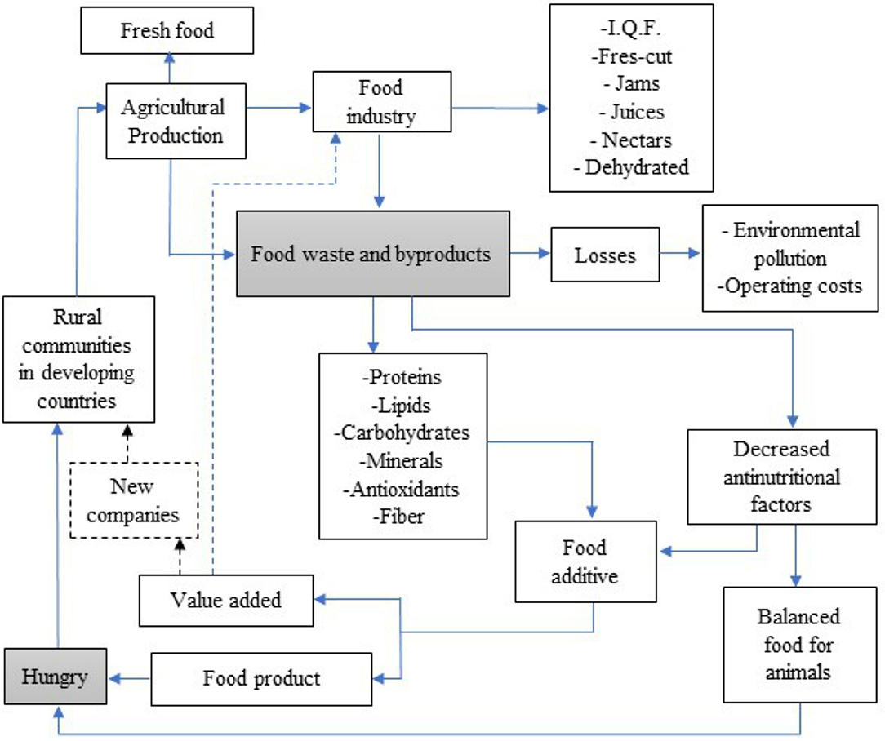
Block Diagram

Slide 8
SOFTWARE REQUIREMENTS:
Operating System : Windows 10
Platform : DOT NET TECHNOLOGY
Front End : ASP.Net 4.0
Back End : SQL SERVER 2014

Slide 9
HARDWARE REQUIREMENTS:
Keyboard
Mouse
Hard disk 500GB
Ram 4 Gb

Slide 10
CONCLUSION
Proper disposal of food waste has posed a stern pecuniary and environmental concern. It appears that conversion of food waste into energy via anaerobic processes in terms of methane is economically viable. However, difficulties accompanying the collection as well as transportation of food waste should also be considered. Nevertheless, the stumpy or no cost of food waste along with the environmental aids considering the waste discarding would balance the initial high investment costs of the biorefineries. Moreover, the efficacy and cost base of the generation could be upgraded by intensifying research and optimization studies on assimilating different value-added product manufacturing processes.

Slide 11
REFERENCE
[1] FAO, Towards the Future we Want: End Hunger and Make the Transition to Sustainable Agricultural and Food Systems, Food and Agriculture Organization of the United Nations Rome, 2012.
[2] M. Melikoglu, C. S. K. Lin, and C. Webb, “Analysing global food waste problem: pinpointing the facts and estimating the energy content,” Central European Journal of Engineering, vol. 3, no. 2, pp. 157–164, 2013.
[3] A. Agarwal, A. Singhmar, M. Kulshrestha, and A. K. Mittal, “Municipal solid waste recycling and associated markets in Delhi, India,” Resources, Conservation and Recycling, vol. 44, no. 1, pp. 73–90, 2005.
[4] FAO, FAOSTAT: World Food and Agriculture Statistical Yearbook, FAO-Food & Agriculture Organization of the United Nation, Rome, Italy, 2013.
[5] I. M. Nasir, T. I. M. Ghazi, and R. Omar, “Production of biogas from solid organic wastes through anaerobic digestion: a review,” Applied Microbiology and Biotechnology, vol. 95, no. 2, pp. 321–329, 2012.

Slide 12
[6] S. Pattnaik and M. V. Reddy, “Assessment of municipal solid waste management in Puducherry (Pondicherry), India,” Resources, Conservation and Recycling, vol. 54, no. 8, pp. 512– 520, 2010.
[7] V. Talyan, R. P. Dahiya, and T. R. Sreekrishnan, “State of municipal solid waste management in Delhi, the capital of India,” Waste Management, vol. 28, no. 7, pp. 1276–1287, 2008.
[8] T. Katami, A. Yasuhara, and T. Shibamoto, “Formation of dioxins from incineration of foods found in domestic garbage,” Environmental Science and Technology, vol. 38, no. 4, pp. 1062– 1065, 2004.
[9] H. Ma, Q. Wang, D. Qian, L. Gong, and W. Zhang, “The utilization of acid-tolerant bacteria on ethanol production from kitchen garbage,” Renewable Energy, vol. 34, no. 6, pp. 1466– 1470, 2009.
[10] T. N. B. Dung, B. Sen, C. C. Chen, G. Kumar, and C. Y. Lin, “Food waste to bioenergy via anaerobic processes,” Energy Procedia, vol. 61, pp. 307–312, 2014

