Slide 1
Tracking, reducing and reusing of plastic waste

Slide 2
Abstract
The quantities of plastic wastes discarded and the fate of various plastics in the environment.
Our Interactive Qualifying Project was concerned with researching the possible alternatives to plastics, mainly biodegradable plastics that have been claimed to biodegrade and help environment.
Moreover, it was also required to evaluate the best methods to deal with our plastic wastes that are environmentally, economically, and energy wise viable.

Slide 3
Existing System
Within a game-like context, pupils can experience in-person in the simulation of certain existing systems.
Waste collection systems are seemingly failing to deal with waste resulting from this culture. Poor waste management systems also compound to this problem or nonexistence of enforcements or absence of substitute materials.
To achieve the closed-loop use of resources of a circular economy in plastic waste management, there should exist genuine cooperation between all sectors of a society.

Slide 4
Disadvantage of Existing System
Their recycling is a challenge in itself, and the fact that used plastics tossed into land never degrade adds to the problem.
Long-term lead poisoning has many severe health impacts like a decrease in bone growth and muscle development, damaged nervous system, speech and language problems, unconsciousness etc.
It has the potential to cause reproductive and developmental problems in women, nervous system disorders.

Slide 5
PROPOSED SYSTEM :
Recycling is the process of converting the old and used materials/components/items/parts for a new use, for the same purpose or for some other purpose.
After plastic packaging materials have served their purpose, the bulk of them are disposed and become post-consumer waste. A wholistic approach to waste management will need to involve all stakeholders working to achieve a circular economy.
Food packaging has evolved to be a key aspect to successful food industries serving fast foods, ready meals, on-the-go beverages and snacks among others.

Slide 6
ADVANTAGE
These plastics can be programmed to degrade in the desired amount of time while being manufactured which gives them advantage from conventional plastics.
A major advantage that can result from this would be that the food wasted in these areas can be directly diverted to commercial composting facilities.
It has been involved in raising awareness in people about adverse effects of traditional plastics and advantages of biodegradable plastics.

Slide 7
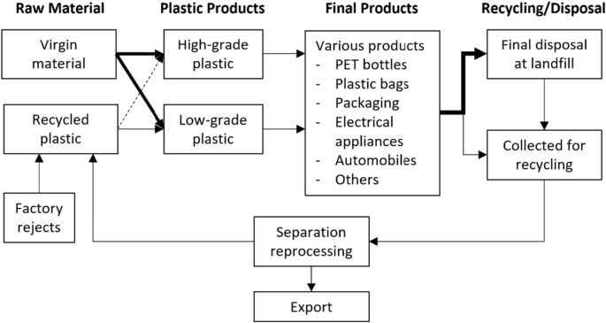
Block Diagram

Slide 8
SOFTWARE REQUIREMENTS:
Operating System : Windows 10
Platform : DOT NET TECHNOLOGY
Front End : ASP.Net 4.0
Back End : SQL SERVER 2014

Slide 9
HARDWARE REQUIREMENTS:
Keyboard
Mouse
Hard disk 500GB
Ram 4 Gb

Slide 10
CONCLUSION
Plastic takes up large part of society, from plastics used for furniture, electronics, to small households needs like containers and grocery bags.
Since plastic first became available to consumers, it became widely used, due to the advantages it provides, such as lightweight, durability and its ability to mold into any products with chemicals and additives.
However, there are also a number of disadvantages that plastic poses, including health problems starting from manufacturing to consumption and negative environmental impacts created by accumulation of plastic wastes.

Slide 11
REFERENCE
AggRegain. Terminology. 2009. http://www.aggregain.org.uk/terminology/recyclate.html (accessed April 2009).
Bottle Bill Resource Guide. 2007. http://www.bottlebill.org/ (accessed September 9, 2008).
Burns, Loree Griffin. Tracking Trash: Flotsam, Jetsam, and the Science of Ocean Motion. Boston: Houghton Mifflin Company, 2007.
Callister and David G. Rethwisch, 553. Hoboken, NJ: John Wiley & Sons, 2008.
Choi, Charles Q. "New Biodegradable Plastics Could Be Tossed into the Sea." LIVESCIENCE. march 27, 2007.

Slide 12
Environmental Protection Agency. "Municipal Solid Waste in the United States." 2007 Facts and Figures. November 2008.
EPA. 2006 MSW Characterization Data Tables. Washington, DC, November 2007.
Kissell, Joe. Biodegradable Plastic-The Quest of Impermanence. Paris, May 5, 2005. Marshall, Jessica. Discovery. August 21, 2008.
Nolan-ITU Pty Ltd. Biodegradable Plastics - Developments and Environmental Impacts. october 2002.
Szabo, Liz. Heat causes chemical to leach from plastic. Virginia: USA Today, 2008.

