Slide 1
Suggest an improvised way of tackling the issue of creating a consistent supply chain to augment the use of Bio fuels

Slide 2
Abstract
The rapidly growing biofuel industry poses considerable challenges to its supply chain network design and operations. In this chapter, we introduce key characteristics of the biofuel supply chain that comprises of feedstock production, biomass logistics, biofuel production and distribution. We then discuss the recent literature on biofuel supply chain models.
Using an illustrative biofuel supply chain model to facilitate the understanding of the core trade-offs in this context, we discuss various issues including logistics network optimization, transportation and inventory management, uncertainty management, land use competition, governmental policies, and the resulting environmental and social impacts.

Slide 3
Existing System
In addition, first generation biofuels require changes in the existing transportation infrastructure such as modifications to vehicle engines and fuel pipelines.
Environmentally conscious development of emerging biofuel pathways requires addressing alternatives that exist at each step along the life cycle with the possibility of a multitude of useful coproducts and waste streams.
Several existing modeling approaches for sustainable chemical production and their applications at multiple scales ranging from metabolism, to the life cycle, to ecosystems, and proposed a multi-scale approach integrating these models into a single cohesive framework.

Slide 4
Disadvantage of Existing System
The farmland use competition in the context of biofuel supply chains is typically captured by formulation into a bi-level optimization problem, or one with equilibrium constraints.
A multi-objective problem can be transformed into one with a single objective by aggregating multiple objectives with proper weights based on the decision maker’s utility.
In a similar vein, also consider the supply chain design problems with different model features, the former incorporating the carbon trading effect and the latter focusing on a specific feedstock from hybrid poplar.

Slide 5
PROPOSED SYSTEM :
The proposed framework synthesizes results obtained from models/methods across disciplines and scales to inform process design and decision-making.
The proposed framework considers multi-objective optimization over the broader superstructure to identify supply chain configurations that optimize ecological and economic performance while simultaneous achieving minimum threshold sustainability criteria.
Their proposed integrated catalytic system eliminates the need for an external source of hydrogen.

Slide 6
ADVANTAGE
A biofuel supply chain involves various distinct stages with different ownership entities such as farmers, biorefineries, distributors, and oil companies, and its performance highly depends on the network design, planning, and operations.
However, regardless of their sources, ethanol at this stage must satisfy all specific fuel criteria to offer the same performance as a regular fuel.
While technological and engineering advancements are key to the success of biofuel industry, providing an efficient and reliable supply chain network design and operations is another critical component to its success.

Slide 7
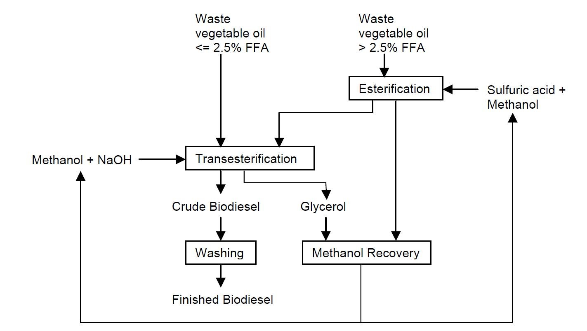
Block Diagram

Slide 8
SOFTWARE REQUIREMENTS:
Operating System : Windows 10
Platform : DOT NET TECHNOLOGY
Front End : ASP.Net 4.0
Back End : SQL SERVER 2014

Slide 9
HARDWARE REQUIREMENTS:
Keyboard
Mouse
Hard disk 500GB
Ram 4 Gb

Slide 10
CONCLUSION
Biofuel is an alternative energy fuel that is converted from naturally grown renewable resources.
With compelling benefits and potential over the economic, environmental, and social dimensions, it is deemed as one of the most promising and ideal alternatives for transportation fuel.
To this end, governments around the world, including the U.S., are strongly supporting the development of biofuel production with various policies and regulations including mandate and subsidy programs. .

Slide 11
While technological and engineering advancements are key to the success of biofuel industry, providing an efficient and reliable supply chain network design and operations is another critical component to its success.
This chapter provides an introduction to the nascent biofuel production industry and key features and issues of its biofuel supply chain.
Starting from a basic supply chain design model, we review fundamental trade-offs and the main design and operational issues that rise in a biofuel supply chain and the related economic, social, and environmental contexts.

Slide 12
REFERENCE
1. U.S. Department of Energy (2005) Biomass as feedstock for a bioenergy and bioproducts industry: The technical feasibility of a billion-ton annual supply. Oak Ridge National Laboratory. http://www1.eere.energy.gov/bioenergy/pdfs/final billionton vision report2.pdf
2. U.S. Department of Energy (2011) U.S. Billion-ton update. Oak Ridge National Laboratory. http://www1.eere.energy.gov/bioenergy/pdfs/billion ton update.pdf
3. National Research Council of the National Academies (2011) Renewable fuel standard: potential economic and environmental effects of U.S. biofuel policy. National Academies Press, Washington, D.C.
4. Environmental Protection Agency (2014) Renewable Fuels: Regulations and Standards. http://www.epa.gov/otaq/fuels/renewablefuels/index.htm
5. Shastri Y, Hansen A, Rodriquez L, Ting KC (2014) Engineering and Science of Biomass Feedstock Production and Provision. Springer, New York.

Slide 13
6. U.S. Energy Information Administration (2014) Data for petroleum and other liquids. http://www.eia.gov/petroleum/data.cfm
7. Energy Independence and Security Act (2007) Public Law. 110–140 http://www.gpo.gov/fdsys/pkg/PLAW-110publ140/html/PLAW-110publ140.htm
8. USDA Farm Service Agency (2014) Biomass Crop Assistance Program. http://www.fsa.usda.gov/FSA/webapp?area=home&subject=ener&topic=bcap
9. Wakeley HL, Hendrickson CT, Griffin WM, Matthews HS (2009) Economic and environmental transportation effects of large-scale ethanol production and distribution in the United States. Environ Sci Technol 43(7): 2228–2233
10. Papapostolou C, Kondili E, Kaldellis JK (2011) Development and implementation of an optimisation model for biofuels supply chain. Energy 36(10):6019–6026

