Slide 1
Solution to establish a zero waste society with proper waste disposal management

Slide 2
Abstract
This study aims to find out how far the implementation of the concept of Zero Waste in waste management in Banda Aceh City. The problem of increasingly complex garbage due to the increasing amount of waste along with population growth. During this time generally waste is transported and disposed to the Final Processing Place (TPA) so that all garbage piled up in the landfill. Most of the waste handling is done after the garbage appears so it is difficult to manage it. Handling of garbage from scratch is still minimal so the TPA becomes full fast. The concept of Zero Waste is to minimize waste generation so that less waste is wasted to the landfill. This is so as not to waste resources and prevent environmental damage.

Slide 3
Handling of waste from the beginning of waste avoidance, waste sorting, producer responsibility, waste levies according to the amount of disposal, waste management by the community and the provision of incentives and disincentives is the implementation parameter of Zero Waste. This concept should be integrated into local policy so it becomes an obligation for the government and the community to implement it. A number of cities around the world have implemented Zero Waste policies and set a target to reduce waste disposal to TPA as small as possible. Banda Aceh as a medium-sized city in Indonesia has integrated a number of Zero Waste concepts in its local regulations. Some of these concepts are difficult to implement due to a number of socio-political factors.

Slide 4
Existing System
Existing landfills may help address growing global resource scarcity, serving as a resource reservoir available to be mined.
At the same time, the e-waste recycling processes exist the potential environmental and human health effects.
Many zero practices and zero waste approaches have existed in the current world, zero waste management includes socio-economic, political, environmental, and technological aspects and has many stakeholders.

Slide 5
Disadvantage of Existing System
Problems encountered at every stage of solid waste management such as temporary disposal, collection, transportation and final disposal where these problems tend to increase in the end point of landfill.
Many cities face landfill problems due to limited availability of land and open dumping sites with no sanitation systems, such as soil cover, leachate collection and environmental pollution treatment systems through CH4 emissions and leach intrusion into groundwater and surface.
The issue of global warming and climate change and its impacts on humans has led people to think about sustainable natural resources.

Slide 6
PROPOSED SYSTEM :
The purpose of this paper is to gain knowledge about various initiatives in both countries and locate the scope for improvement in the management of waste.
The other purpose is to provide some suggestions and recommendations to improve the waste management practices in Indian towns.
These zones are further divided into different sanitary wards for the purpose of solid waste collection and transport operations.

Slide 7
ADVANTAGE
Preliminary assessment and evaluation is very important to know the performance of municipal solid waste management.
After implementing the ZW work plan, ZW performance evaluation is done to know the extent of its success.
One of the key goals of this 2030 vision is to transform Stockholm city into a resource-efficient area.
The existing waste management laws were inadequate, leading to inefficient waste management in Indonesia.

Slide 8
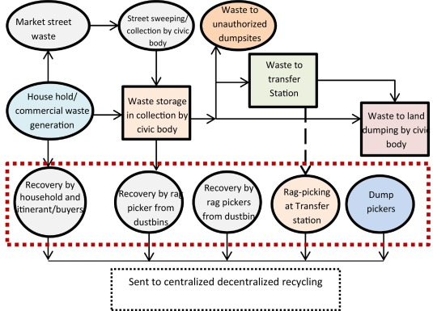
Block Diagram

Slide 9
SOFTWARE REQUIREMENTS:
Operating System : Windows 10
Platform : DOT NET TECHNOLOGY
Front End : ASP.Net 4.0
Back End : SQL SERVER 2014

Slide 10
HARDWARE REQUIREMENTS:
Keyboard
Mouse
Hard disk 500GB
Ram 4 Gb

Slide 11
CONCLUSION
Zero Waste can be an alternative concept in waste management in Indonesia because Zero Waste is a concept that starts from, prevents waste in "upstream" to "downstream", not just handling waste by dumping it to landfil. Require the involvement of all parties in implementing the concept of Zero Waste, ranging from private parties, governments and communities in the implementation of this concept. Policy support from the national government in the form of a firmer regulation is required for ZW to be implemented properly. The Municipal Government of Banda Aceh has included a number of ZW principles and implemented some of them. The implementation of ZW still needs to be improved again in order to really reduce waste.

Slide 12
REFERENCE
[1] Africa PS 2010 Solid Waste Management in the World’s Cities in Solid Waste Management in the World’s Cities: Water and Sanitation in the World’s Cities 2010 p 30
[2] Chalmin P and Gaillochet C 2009 From Waste to Resource: An Abstract of World Waste Survey 2009
[3] Connett, P 2007 Zero Waste: A Key Move Towards A Sustainable Society, American Environmental Health Studies Project (USA: Canton)
[4] DLHK3 Banda Aceh (2017) Profil DLHK3 Kota Banda Aceh. Edisi I. Banda Aceh, Indonesia.
[5] Irwansyah, Syahputra I, Nadir M and Bakri G 2017 Indepth interview on Waste Community. Banda Aceh

Slide 13
[6] Lehmann S 2011 Sustainable Development Law & Policy 11
[7] Meidiana C and Gamse T 2010 European Journal of Scientific Research 40 199
[8] Morlok J, Schoenberger H and Styles D 2017 The Impact of Pay-As-You-Throw Schemes in the Management of Municipal Solid Waste : The Case of the County of Aschaffenburg , Germany pp 1–16 doi: 10.3390/resources6010008.
[9] Munawar E and Fellner J 2013 Guidelines for Design and Operation of Municipal Solid Waste Landfills in Tropical Climates [Report] ISWA–the International Solid Waste Association.
[10] Palmer P 2004 Getting to Zero Waste (California: Purple Sky Press)

