Slide 1
IOT BASED PATIENT MONITORING SYSTEM IN ICU

Slide 2
Abstract
Monitoring various parameters of the patient using internet of things. In the patient monitoring system based on Internet of things project, the real-time parameters of patient’s health are sent to cloud using Internet connectivity.
These parameters are sent to a remote Internet location so that user can view these details from anywhere in the world.
There is a major difference between SMS based patient health monitoring and IOT based patient monitoring system.

Slide 3
In IOT based system, details of the patient health can be seen by many users. The reason behind this is that the data needs to be monitored by visiting a website or URL.
This is one of the Latest Electronics Project Ideas related to Medical applications. One more benefit of using IOT is that, this data can be seen using a desktop computer, laptop, using an Android smart phone comma using a tab or Tablet.
The user just needs a working Internet connection to view this data. There are various cloud service providers which can be used to view this data over Internet.

Slide 4
Existing System
The main aim of the planned system is to design a patient monitoring system, which overcomes the existing problem which requires doctor’s attention over the patient continuously by interfacing all the biological parameters through Lab VIEW.
The current existing system monitors only the ECG signals and remaining parameters are not available.
The major problem faced by the patients in the Intensive Care Unit is that they can’t be monitored continuously using IoT.

Slide 5
Disadvantage of Existing System
It is clear that chronic diseases such as diabetes, heart and pressure among others, are remarkable in the world economic and social level problem.
All these systems although quite complete is your scenario, include individual problems with regard to the treatment of some diseases that affect human being in the economic and social.
The increased use of mobile technologies and smart devices in the area of health has caused great impact on the world.

Slide 6
PROPOSED SYSTEM :
The main objectives of this proposed system is to transmitting the patients health monitoring parameters through wireless communication.
By continuous monitoring the patient problem can be detected as they occur and remedies taken before this problem get out of hand.
In this proposed system the patients information includes numeric signal data, text data and real time waveform data can be extracted by remote information server and it can be changed into the recognizable pattern for Java jiglet application on the mobile phone, with the help of PHP web application.

Slide 7
ADVANTAGE
Its excellent features include the cost efficiency, low power dissipation programming lock for security purposes, real timer counter.
These smart devices are used to collect temperature, Heart rate, Respiration, Sweat etc., which are used to evaluate the health condition of the patient.
There are several process such as smart home, smart city, health monitoring systems are monitor using Internet of Things. Internet of Things is used for monitor all patients in any level.

Slide 8
TITLE | AUTHOR | DESCRIPTION
IOT Based Patient Health Monitoring Using ESP8266 & Arduino | Mr Alam | The IoT platform used in this project is Thing Speak. Thing Speak is an open-source Internet of Things (IoT) application and API to store and retrieve data from things using the HTTP protocol over the Internet or via a Local Area Network.
IOT Based Patient Monitoring System Using ESP8266,Arduino &Android Bluetooth App | Engr Fadhad | This IoT device could read the pulse rate and measure the surrounding temperature. It continuously monitors the pulse rate and surrounding temperature and updates them to an IoT platform.

Slide 9
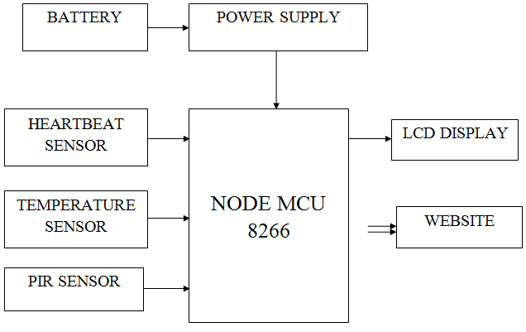
Block Diagram

Slide 10
SOFTWARE REQUIREMENTS:
Operating System : Windows 10
Platform : DOT NET TECHNOLOGY
Front End : ASP.Net 4.0
Back End : SQL SERVER 2014

Slide 11
HARDWARE REQUIREMENTS:
Keyboard
Mouse
Hard disk 500GB
Ram 4 Gb

Slide 12
CONCLUSION
For such critical conditions the doctors need to have an all time update patient’s health related parameters like their blood pressure, heart pulse and temperature.
In this way IOT Based ICU Patient Monitoring System that helps in monitoring ICU Patients without any manual intervention. The output from sensor and amplifier circuit was connected to the arduino .
The observed output signal was periodic ac signal with amplitude varying from peak to peak according to person. A sinusoidal signal and the output from sensor were fed to arduino and the counted pulse rate was successfully sent via Wi-Fi module.

Slide 13
REFERENCE
[1] Mr Alam “IOT Based Patient Health Monitoring Using ESP8266 & Arduino”[June 11,2019]
[2] Engr Fadhad”IOT Based Patient Monitoring System Using ESP8266,Arduino &Android Bluetooth App”[August 31,2019]
[3] https://www.engineersgarage.com/what-is-gsm-gprs- module
[4] https://tkkrlab.nl/wiki/Arduino_37_sensors [Oct 20, 2017]
[5] https://www. deepdyve.com/lp/institute-of-electrical- and-electronics-engineers/ubiquitous-data-accessing- methodin-iot-based-information-system-for- YCZzyY5W9g [Sept 6, 2017]
[6]https://scholar.google.com/citations?user=Y4opLB8A AAAJ&hl=en [Sept. 7, 2017]Cloud to Database Wi-fi Module Doctor Finish

