Slide 1
HAZARDOUS GAS AND TEMPERATURE DETECTION IN MINING USING IOT

Slide 2
Abstract
Eventually a day's a consequence of a general temperature alteration and atmosphere changes there are attempting conditions in field of coal mine.
To decrease the cost and improve the productivity close by thing quality the atomization in the field of coal mine is irrefutably essential, which will in addition reduce the mine laborers endeavors.
This paper proposes a structure of a WSN with the assistance of Raspberry pi processor which can screen the temperature, diligence, gas and status of smoke in an underground mine.

Slide 3
This structure in addition controls the ventilation requesting to mine laborers relying upon present atmosphere conditions inside the mine field.
This structure uses low force, practical Raspberry pi, and a temperature sensor LM35, clamminess sensor, and smoke sensor, gas sensor for recognizing the mine atmosphere parameters and Wi-Fi for remote logging of information at focal locale to control the air state with the assistance of engine and valve control hardware.
Standard coal mine watching structures will all things considered be wired structure frameworks, which anticipate an enormous action in coal mine guaranteed creation.

Slide 4
Existing System
We are working on modifies the existing safety model installed in the industrial areas and this system can also be used in houses and offices.
We are working on a project in which we are using new technology which is being used to make every existing digital system more smart, internet of things (iot).
When the target combustible gas exist, the sensors conductivity is higher along with the gas concentration rising.

Slide 5
Disadvantage of Existing System
The use of Air Conditioner (A/C) in the cars is more often this is dangerous to outer environment causing Global Warming like problems but as well as it affects the inner environment of a car.
It causes problems like decrease in the oxygen level around 15% and increase in the level of harmful gases like Carbon mono oxide.
Health Safety is a major issue in current era and good safety systems are needed to be implemented in places which are related to work, education and living.

Slide 6
PROPOSED SYSTEM :
They proposed prototype depicts a mini mobile robot which is capable to detect gas leakage in hazardous places.
The gas leakage detection system was proposed, designed and successfully implemented in this paper for home safety and industrial applications.
In this they proposed the use of MOS (Metal oxide Semiconductor) Gas Sensor. This information that is send over the server created on the internet and a Smartphone application can be used to notify.

Slide 7
ADVANTAGE
This proposed system proves that this is efficient system than existing one. Used for public water quality maintain.
This proposed framework used to screen the coal mineshaft boundary and alarm the treat alert for making sure about people.
With gas leakage detection, this system gives a fully automated approach towards the gas booking.
Real time weight measurement of the gas and its display on LCD makes it an efficient home system and also can be used in industries and other places to detect gas leaks.

Slide 8
TITLE | AUTHOR | DESCRIPTION
Spatial direct reuse in remote sensor network | Toby Berger. | The most efficient channel reuse configuration for WSN has been determined and the worst-interference scenario has been identified.
Design of Monitoring System for Coal Mine Safety Based on MSP430 | Dange, K.M., Patil, R.T. (2013), | This system also controls the ventelation demand to mine workers depending upon present climate conditions within the mine field.

Slide 9
TITLE | AUTHOR | DESCRIPTION
A smart and intuitive machine condition monitoring in the Industry 4.0 scenario | G. Dinardo, L. Fabbiano, and G. Vacca, | The proposed procedure is based on the continuous monitoring of the energetic features of the vibration signals acquired from the equipment under analysis.
A survey on wearable sensor-based systems for health monitoring and prognosis | A. Pantelopoulos and N. G. Bourbakis, | A variety of system implementations are compared in an approach to identify the technological shortcomings of the current state-of-the-art in wearable biosensor solutions.

Slide 10
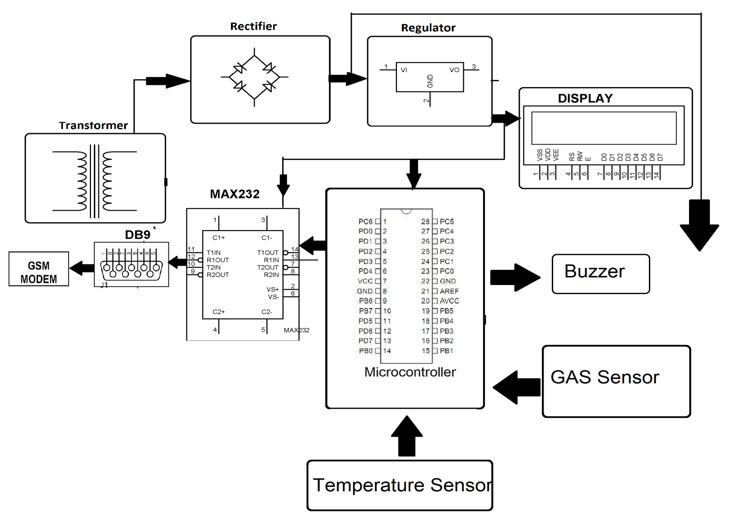
Block Diagram

Slide 11
SOFTWARE REQUIREMENTS:
Operating System : Windows 10
Platform : DOT NET TECHNOLOGY
Front End : ASP.Net 4.0
Back End : SQL SERVER 2014

Slide 12
HARDWARE REQUIREMENTS:
Keyboard
Mouse
Hard disk 500GB
Ram 4 Gb

Slide 13
CONCLUSION
We implemented and constructed IOT coal mine system with monitoring in internet done successfully in this proposed system we integrated all input modules and output modules to the Raspberry Pi Micro processor. We obtained results accurately.
This proposed system proves that this is efficient system than existing one. Used for public water quality maintain.

Slide 14
REFERENCE
[1] Dange, K.M., Patil, R.T. (2013), Design of Monitoring System for Coal Mine Safety Based on MSP430.
[2] Toby Berger. Spatial direct reuse in remote sensor network[j]. Remote Network, 2008,14(2):133-146.
[3] Dheeraj "IoT in burrowing for distinguishing, Monitoring and desire for underground mines Roof support", assembling on progressing information and progress development 2018
[4] Dong "Coal Mine prosperity Monitoring system subject to Zigbee and GPRS ", Applied Mechanics and Material Volume 422,2013.
[5] Tao Zhiyong, Li Xin. "Remote Temperature System Design Based on nRF905", Journal of Zhongguo Technology I mformation, 2007.22, p.53.

Slide 15
[6] G. Dinardo, L. Fabbiano, and G. Vacca, “A smart and intuitive machine condition monitoring in the Industry 4.0 scenario,” Meas. J. Int. Meas. Confed., 2018, doi: 10.1016/j.measurement.2018.05.041.
[7] A. Pantelopoulos and N. G. Bourbakis, “A survey on wearable sensor-based systems for health monitoring and prognosis,” IEEE Transactions on Systems, Man and Cybernetics Part C: Applications and Reviews. 2010, doi: 10.1109/TSMCC.2009.2032660.
[8] A. Schütze, N. Helwig, and T. Schneider, “Sensors 4.0 - Smart sensors and measurement technology enable Industry 4.0,” J. Sensors Sens. Syst., 2018, doi: 10.5194/jsss-7-359-2018.

