Slide 1
Technology demonstration of digital stamping of electronic communication/message to know its origin, date, time and spread

Slide 2
Abstract
A new method is discussed to enhance the security of communications over Internet. The method is based on utilization of electronic graphic images being sent as part of messages that require secure communication and certification. At the core of the proposed method are Electronic Virtual Stamps implemented as familiar and easily recognizable electronic images of postal stamps, letterheads, financial documents, etc. EV-Stamps carry embedded and hidden message certificates and information concerning events associated with the transmitted objects. Each transmission is monitored by a certifying Web server that maintains the records of all issued EV-stamps, subscribed users, involved financial transactions, and registered assets. In this paper, we present the principles of the system’s architecture and different scenarios of its utilization.

Slide 3
Existing System
One of the techniques is the Digital Time Stamping, whose objective is to assure the existence of any electronic document at one certain moment.
The Digital Time-Stamping nobody could trust documents which were only signed, because there is no way to prove the existence of the document before the allegation that the private key or signature algorithm were compromised.
This can be solved by executing periodically searches in the tree to verify if such branches exist.

Slide 4
Disadvantage of Existing System
Many users of STAMPIT reported serious problems concerning the situations when the printer jams, or when multiple copies are printed instead of just one which jeopardizes the consistency and integrity of the system.
It can become easier to reduce occurrences of identity, cut down on junk e-mail, and resolve some other problems that Internet users have to deal with all the time.
The EV-stamp system issues a specified number of banknotes covered by the funds deposited by Bob on his EV-stamp account.

Slide 5
PROPOSED SYSTEM :
In the proposed method, we use the steganography technique to create a user friendly environment for dealing with electronic messaging and, at the same time, to guard the user’s confidential information.
Visual style of EV-stamps is an important property of the proposed method.
The idea of secure physical postage can be brought into the realm of electronic mail and Web services with the same purpose – to identify the corresponding parties, certify the messages and enclosures, and secure the delivery of the mail.

Slide 6
ADVANTAGE
This work contemplates these requirements presenting a reliable and high performance digital time-stamp method, through the use of relative authentication and the flexible rounds.
A new efficient linking scheme can be assembled, to reduce the fetching time of a individual stamp. The growing use of digital time-stamp services creates a demand for reliable and efficient methods.
The use of electronic documents is becoming more and more frequent, presenting a series of advantages, amongst them, safer and faster communication, optimal use of resources and physical space, not to mention that they speed up the process.

Slide 7
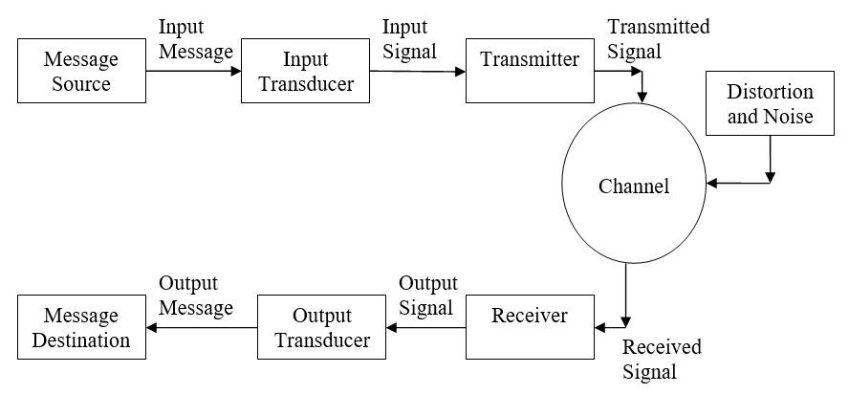
Block Diagram

Slide 8
SOFTWARE REQUIREMENTS:
Operating System : Windows 10
Platform : DOT NET TECHNOLOGY
Front End : ASP.Net 4.0
Back End : SQL SERVER 2014

Slide 9
HARDWARE REQUIREMENTS:
Keyboard
Mouse
Hard disk 500GB
Ram 4 Gb

Slide 10
CONCLUSION
The method of Internet communication described here is based on use of graphic images, with embedded and hidden information, which enhances the ability of mail and Web services to provide secure and reliable communication. The EV-stamp system is work in progress. The prototype of the system is under development as a multi-language project to be launched in 2008. The authors would like to acknowledge the contribution of the developers from Data Storage Research, LLC working on this project in both US and Russia.

Slide 11
REFERENCE
[1] W. Stallings, L. Brown. Computer Security: Principles and Practice. Prentice Hall, 2007.
[2] S. Katzenbeisser (Editor), Information Hiding Techniques for Steganography and Digital Watermarking, Artech House Inc., 2000.
[3] W. Ford, M. Baum. Secure Electronic Commerce: Building the Infrastructure for Digital Signatures and Encryption. Addison-Wesley, 2001.
[4] Stampit - die Lizenz zum Portodrucken, http://www.deutschepost.de/dpag?xmlFile=912.
[5] P. Astakhov, R. Tankelevich, A. Klimov. A system and method for electronic certification, identification and communication by using encrypted graphic images, U.S. Provisional Patent No. 61/021,919, 2008.

