Slide 1
SMART TRAFFIC MANAGEMENT USING CLOUD COMPUTING

Slide 2
Abstract
Traffic big data has brought many opportunities for traffic management applications. However several challenges like heterogeneity, storage, management, processing and analysis of traffic big data may hinder their efficient and real-time applications.
All these challenges call for well-adapted distributed framework for smart traffic management that can efficiently handle big traffic data integration, indexing, query processing, mining and analysis.
In this paper, we present a novel, distributed, scalable and efficient framework for traffic management applications.

Slide 3
The proposed cloud computing based framework can answer technical challenges for efficient and real-time storage, management, process and analyse of traffic big data. For evaluation of the framework, we have used Open Street Map (OSM) real trajectories and road network on a distributed environment.
Our evaluation results indicate that speed of data importing to this framework exceeds 8000 records per second when the size of datasets is near to 5 million.
We also evaluate performance of data retrieval in our proposed framework.

Slide 4
The data retrieval speed exceeds 15000 records per second when the size of datasets is near to 5 million.
We have also evaluated scalability and performance of our proposed framework using parallelisation of a critical pre-analysis in transportation applications.
The results show that proposed framework achieves considerable performance and efficiency in traffic management applications.

Slide 5
Existing System
A new approach to service allocation, derived from the existing cloud and grid computing approaches, was created to address the unique needs of ITS traffic management.
Intelligent Transportation Systems (ITSs) aim to improve existing road networks capacity, reduce travel times, fuel consumption, increase safety of all traffic participants and deliver traffic relevant information to the drivers.
Design an improved traffic management scheme to address the identified weaknesses of existing methods.

Slide 6
Disadvantage of Existing System
All these problems call for well-adapted distributed framework for TMS that can efficiently handle big traffic data integration, indexing, query processing, mining and analysis.
To face this issue, an important traffic analysis named map matching has been developed.
The main drawback of this platform is using central server and lack of fault tolerance, elasticity and high availability. The main goal of the framework is answering to traditional TMS drawbacks that has discussed earlier.

Slide 7
PROPOSED SYSTEM :
In architecture of the proposed model, to reduce the load on cloud computing servers, processing and storage sources are placed on mid-layer between cloud computing servers and final user.
The genetic algorithm is used for optimal distribution of load between local servers and cloud servers in proposed model as a meta-heuristic algorithm.
This purpose can be realized only with an appropriate architecture and effective use of all components of traffic management system.

Slide 8
ADVANTAGE
Low-latency data storage and access: the framework should contain an efficient and flexible tool for data gathering and management for massive traffic data with high performance and low latency.
However like every other high level abstraction, using hive needs additional computation which leads to lower performance of the system.
Data processing and analysis: with this tremendous valuable big data, real-time query processing, analysis and data mining in traditional frameworks is a time consuming inefficient task.

Slide 9
TITLE | AUTHOR | DESCRIPTION
Hadoop GIS: a high performance spatial data warehousing system over mapreduce | Aji, A., Wang, F., Vo, H., Lee, R., Liu, Q., Zhang, X., Saltz, J., 2013 | Hadoop-GIS utilizes global partition indexing and customizable on demand local spatial indexing to achieve efficient query processing.
A communications-oriented perspective on traffic management systems for smart cities: challenges and innovative approaches | Djahel, S., Doolan, R., Muntean, G.-M., Murphy, J., 2015. | In this survey, we present an up-to-date review of the different technologies used in the different phases involved in a TMS and discuss the potential use of smart cars and social media to enable fast and more accurate traffic congestion detection and mitigation.

Slide 10
TITLE | AUTHOR | DESCRIPTION
Spatial hadoop: A mapreduce framework for spatial data | Eldawy, A., Mokbel, M.F., 2015. | In the language layer, Spatial Hadoop adds a simple and expressive high level language for spatial data types and operations.
Sipresk: A Big Data Analytic Platform for Smart Transportation | Khazaei, H., Zareian, S., Veleda, R., Litoiu, M., 2015. | In this paper, we propose a platform for performing analyt- ics on urban transportation data to gain insights into traffic patterns.

Slide 11
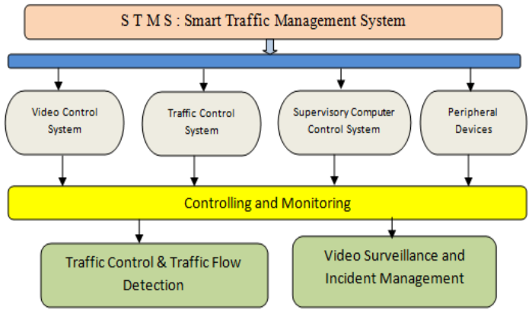
Block Diagram

Slide 12
SOFTWARE REQUIREMENTS:
Operating System : Windows 10
Platform : DOT NET TECHNOLOGY
Front End : ASP.Net 4.0
Back End : SQL SERVER 2014

Slide 13
HARDWARE REQUIREMENTS:
Keyboard
Mouse
Hard disk 500GB
Ram 4 Gb

Slide 14
CONCLUSION
Traffic Big data has initiated great opportunities for traffic management applications. Beside such opportunity, several technical challenges have appeared.
This paper takes a major step towards development of an efficient and real-time traffic management system using cloud computing technologies.
The proposed distributed three layer framework contains several open-source components and libraries for supporting traffic management applications.

Slide 15
Our evaluation results show that the proposed framework has efficiently stored, managed and analysed traffic big data.
Using Hadoop ecosystem and Map Reduce paradigm, proposed approach provides high availability and scalability along with fault tolerance for real time traffic management applications.

Slide 16
REFERENCE
Aji, A., Wang, F., Vo, H., Lee, R., Liu, Q., Zhang, X., Saltz, J., 2013. Hadoop GIS: a high performance spatial data warehousing system over mapreduce. Proceedings of the VLDB Endowment 6, 1009-1020.
Djahel, S., Doolan, R., Muntean, G.-M., Murphy, J., 2015. A communications-oriented perspective on traffic management systems for smart cities: challenges and innovative approaches. IEEE Communications Surveys & Tutorials 17, 125-151.
Eldawy, A., Mokbel, M.F., 2015. Spatialhadoop: A mapreduce framework for spatial data, 2015 IEEE 31st International Conference on Data Engineering. IEEE, pp. 1352-1363.

Slide 17
Thusoo, A., Sarma, J.S., Jain, N., Shao, Z., Chakka, P., Anthony, S., Liu, H., Wyckoff, P., Murthy, R., 2009. Hive: a warehousing solution over a map-reduce framework. Proceedings of the VLDB Endowment 2, 1626-1629.
Khazaei, H., Zareian, S., Veleda, R., Litoiu, M., 2015. Sipresk: A Big Data Analytic Platform for Smart Transportation, EAI International Conference on Big Data and Analytics for Smart Cities.
Liu, S., Liu, C., Luo, Q., Ni, L.M., Krishnan, R., 2012. Calibrating large scale vehicle trajectory data, 2012 IEEE 13th International Conference on Mobile Data Management. IEEE, pp. 222-231.

Slide 18
Finkel, R.A., Bentley, J.L., 1974. Quad trees a data structure for retrieval on composite keys. Acta informatica 4, 1-9.
Guttman, A., 1984. R-trees: a dynamic index structure for spatial searching. ACM.
Sekar, E.V., Anuradha, J., Arya, A., Balusamy, B., Chang, V., 2017. A framework for smart traffic management using hybrid clustering techniques. Cluster Computing, 1-16.
STATISTICS, B.O.T., 2015. Transportation Statistics Annual Report, in: Transportation, U.S.D.o. (Ed.).

