Slide 1
VOICE CONTROLLED VEHICLE

Slide 2
Abstract
This project was developed in a way that the robot is controlled by voice commands. An android application with a microcontroller is used for required tasks.
The connection between the android app and the vehicle is facilitated with Bluetooth technology.
The robot is controlled by buttons on the application or by spoken commands of the user.
The movement of the robot is facilitated by the two dc servo motors connected with microcontroller at the receiver side.

Slide 3
The commands from the application is converted in to digital signals by the Bluetooth RF transmitter for an appropriate range (about 100 meters) to the robot.
At the receiver end the data gets decoded by the receiver and is fed to the microcontroller which drives the DC motors for the necessary work. The aim of Voice Controlled Robotic Vehicle is to perform the required task by listening to the commands of the user.
A prior preparatory session is needed for the smooth operation the robot by the user. For the same a code is used for giving instruction to the controller.

Slide 4
Existing System
The Existing system is a speech recognizing system. Speech recognition is the process of capturing spoken words using a microphone or telephone and converting them into a digitally stored set of words.
The quality of a speech recognition systems are assessed according to two factors: its accuracy (error rate in converting spoken words to digital data) and speed (how well the software can keep up with a human speaker).
If you have ever paid a bill over the phone using an automated system, you have probably benefited from speech recognition software.

Slide 5
Disadvantage of Existing System
Even the best speech recognition systems sometimes make errors. If there is noise or some other sound in the room (e.g. the television or a kettle boiling), the number of errors will increase.
Speech Recognition works best if the microphone is close to the user (e.g. in a phone, or if the user is wearing a microphone). More distant microphones (e.g. on a table or wall) will tend to increase the number of errors.
In Speech recognition system, there is a possibility of unauthorized usage. Since this doesn’t depends upon which person is speaking. No password protection.

Slide 6
PROPOSED SYSTEM :
The proposed system is basically based on Voice Controlled Robotic Vehicle helps to control robot through voice commands received via android application.
While speech recognition is the process of converting speech to digital data, voice recognition is aimed toward identifying the person who is speaking.
Voice recognition works by analyzing the features of speech that differ between individuals.

Slide 7
ADVANTAGE
It can be developed into a real-world vehicle tor transportation purposes.
The robotic vehicle can be used where humans find difficult to reach but human voice reaches like in a small pipeline, in fire situations, in highly toxic areas Etc.
It can be integrated with wheelchairs for assisting disabled persons.
It can be used to bring and place small objects. In military applications such as observation of enemy camp using cameras

Slide 8
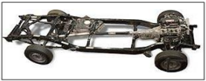
Chassis
A chassis is the internal framework of the artificial object which support in its construction and use Direct inclusion in abstracting services.

Slide 9
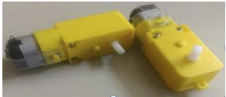
Gear Motor
A DC motor is a class of rotary electrical machine that converts t\direct current into mechanical energy.
All types of DC motors have some kind of internal mechanism either electronic or electro mechanical, so it can change the direction of flow of current in path of motor periodically.

Slide 10
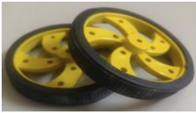
Wheels
A wheel is circular block of durable and hard material which is placed in axil about which the wheel rotates when a moment is applied by torque or gravity, thereby making one of the simple machines.
When placed under a load baring platform, the wheel turning on the horizontal axil makes it possible to transport heavy loads.

Slide 11
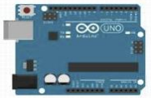
Arduino UNO Board
Arduino UNO is an open source micro controller board placed on the micro chip ATmega328p micro controller and developed by Adruino.cc.
The board has 6 Analog pins, 14 digital pins programmable with Arduino IDE via a Type B USB cable. It can power by external main volt battery.

Slide 12
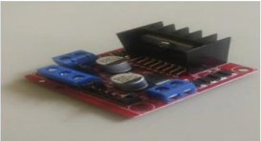
L298D Motor Driver
The L298 Driver is a high voltage high current dual bridge driver designed to accept standard TTL Logic levels and drive inductive loads.
The emitter of the lower level transistors of each bridge are connected together to the corresponding external terminal can be used for the connection of an external sensing resistor

Slide 13
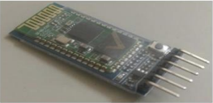
HC05 Bluetooth module
HC05 module is a simple Bluetooth module is a simple Bluetooth serial port protocol module designed for wireless serial connection setup.
It has a footprint as small as 12.7mm X 27mm. It will simplify the overall design cycle.

Slide 14
TITLE | AUTHOR | DESCRIPTION
Hand gesture recognition and voice controlled robot | M. Meghana et al,2020, | In the technology era, the space between the physical and the digital world is brought closer by the introduction of gesture concept.
Voice Controlled Human Assistence Robot | M.Bhanu chandu, Kirupa Ganapathy,2020, | The robot can perform various developments, turns, start/stop activities and migrate an article starting with one spot then onto the next and offering things to the matured individuals in the home.

Slide 15
TITLE | AUTHOR | DESCRIPTION
Intuitive Voice Controlled Robot for Obstacle, Smoke and Fire Detection for Physically Challenged People | P. Mahesh Reddy, Suram Pavan Kalyan Reddy, G R Sai Karthik, Priya B.K,2020, | Voice-controlled robots will be a huge boon for physically challenged people who cannot use their limbs properly.
Design And Development Of Dual Axis Control Robot For Writing Robot Through Speech Recognition | Ms. M. Ramjan Begum, Mr. S. Chandramouli, Mr. T. Gowtham,2020, | The hardware part consists of the mechanical design of the robot, the adequate choice of the motors, and the electronic devices to properly drive the robot joints.

Slide 16
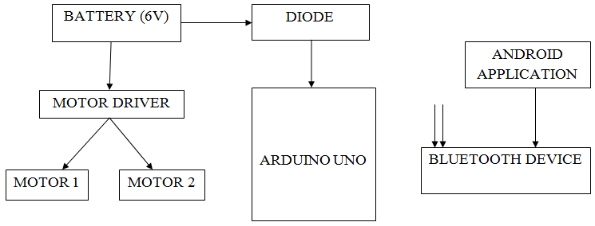
Block Diagram

Slide 17
SOFTWARE REQUIREMENTS:
Operating System : Windows 10
Platform : DOT NET TECHNOLOGY
Front End : ASP.Net 4.0
Back End : SQL SERVER 2014

Slide 18
HARDWARE REQUIREMENTS:
Keyboard
Mouse
Hard disk 500GB
Ram 4 Gb

Slide 19
CONCLUSION
The “Voice Controlled Robotic Vehicle” project has many applications and in present and future. The project can be made more effective by adding features to it in the future.
The project has applications in wide variety of areas such as military, home security, rescue missions, industries, medical assistance etc.
We were successful in implementing a simple model of voice controlled robotic vehicle using the available resources.

Slide 20
The implementation of this project is easy, so this robot is beneficial for human life. The Voice Control Robot is useful for disable people and monitoring purpose.
It works on simple voice command, so it is easy to use. It is useful for those areas where humans can’t reach. The size of this robot is small, so we can use this robot for spying purpose.
It can be used for surveillance. We can implement web cam in this robot for security purpose. The voice recognition software has an accuracy and for identify a voice command and it is also highly sensitive to the surrounding noise.

Slide 21
REFERENCE
[1] M. Meghana et al,2020, Hand gesture recognition and voice controlled robot, Materials Today: Proceedings, 2214-7853.
[2] M.Bhanu chandu, Kirupa Ganapathy,2020, Voice Controlled Human Assistence Robot, International Conference on Advanced Computing & Communication Systems (ICACCS), 978-1- 7281-5197-7/20.
[3] P. Mahesh Reddy, Suram Pavan Kalyan Reddy, G R Sai Karthik, Priya B.K,2020, Intuitive Voice Controlled Robot for Obstacle, Smoke and Fire Detection for Physically Challenged People, International Conference on Trends in Electronics and Informatics (ICOEI ), ISBN: 978-1-7281- 5518-0.

Slide 22
[4] Ms. M. Ramjan Begum, Mr. S. Chandramouli, Mr. T. Gowtham,2020, Design And Development Of Dual Axis Control Robot For Writing Robot Through Speech Recognition, International Research Journal of Modernization in Engineering Technology and Science, e- ISSN: 2582-5208.
[5] Linda John et al,2020, Voice Control Human Assistance Robot, National Conference on Technical Advancements for Social Upliftment, Proceedings of the 2 nd VNC; VNC-2020;
[6] Anurag Mishra, Pooja Makula, Akshay Kumar, Krit karan, and V.K. Mittal, 2015, A voicecontrolled personal assistant robot, International Conference on Industrial Instrumentation and Control (ICIC).

Slide 23
[7] Dyah Ayu Anggreini Tuasikal, Hanif Fakhrurroja, Carmadi Machbub,2018, Voice Activation Using Speaker Recognition for Controlling Humanoid Robot”, International Conference on System Engineering and Technology (ICSET).
[8] T. Thivagar, A. Sriram,2020, Hand Gesture ,2020,Voice Controlled Smart Vehicle, International Journal of Modern Science and Technology, ISSN: 2456-0235.
[9] Ass. Prof. Emad S. Othman, Senior Member IEEE - Region 8, 2017, Voice Controlled Personal Assistant Using Raspberry Pi, International Journal of Scientific & Engineering Research Vol 8, Issue 11, 1611, ISSN 2229-5518,pp1611-1615.

