Slide 1
Stress Detection using Galvanic Skin Response An Android Application

Slide 2
Abstract
Stress is one of the factors that affect human health in many aspects. It is considered as one of the culprits in increasing the risk of getting sick that could probably lead to critical physical or mental illnesses. Stress can be experienced everywhere and in different circumstances. Hence, stress should be controlled and managed by monitoring its progress or regress. Physiological information can be used to determine stress levels. One of these is the Galvanic Skin Response (GSR) that utilizes skin conductance which is known to be directly involved in the emotional behavioural regulation in humans. In this study, a method on how to determine stress when a person is engaged in mobile communication is proposed. An Android application was developed that is capable of determining the stress level of a person while doing SMS composition. GSR data were utilized and the performance of the proposed method was found of no significant difference with a commercially available device. Factors like phone size and period of texting was investigated and were found out that these only contribute an extremely low level of stress. The developed App could be used to determine stress levels especially if emotional conversations are considered.

Slide 3
Existing System
We aimed to identify and exploit the frequency patterns that relate to the existence of stressful conditions in a participant’s recording.
The existing repository1 was ported to Tensorflow 2.0 and Keras framework in order to work on latest standards and export compatible TensorFlow Lite (an optimized FlatBuffer format) models for the Android platform.
By relying on an objective proxy for stress (GSR) and a robust statistical framework (PSM), this study strengthens substantially the existing literature on mental health benefits of active travel.
Heart rate and GSR can currently be reliably sensed passively in existing wristworn wearables, this paper focuses on using these sensors from a commercially available smartwatch.

Slide 4
PROPOSED SYSTEM :
The preprocessing step is taking as input the raw ECG and EDA and extracts several statistical features for stress detection that have been proposed for physiological signal analysis.
Due to differences in the incorporated datasets, they indicate that the proposed CNN classifier based only on ECG can achieve better or similar performance with the multi-sensor features classified by standard ML techniques (evaluated by 10CV).
The problem of stress identification and categorization from the sensor data stream mining perspective, consider a reductionist approach for arousal identification as a drift detection task, highlight the foremost problems of managing with GSR data, and propose simple approaches the way to them.

Slide 5
TITLE | AUTHOR | DESCRIPTION
STRESS, TEXTING, AND BEING SOCIAL | VITELLI R | While text messaging by itself does not automatically lead to problems, students already dealing with high levels of interpersonal stress are already more vulnerable to the problems linked to greater text messaging.
THE ASSOCIATION BETWEEN SMARTPHONE USE, STRESS, AND ANXIETY: A META-ANALYTIC REVIEW | VAHEDI Z AND SAIPHOO A. | The multitasking capability of these devices results in users spending more time using them than they would a traditional telephone or cellphone.

Slide 6
TITLE | AUTHOR | DESCRIPTION
ACTIVITY AWARENESS CAN IMPROVE CONTINUOUS STRESS DETECTION IN GALVANIC SKIN RESPONSE | TANG T B, YEO L W AND LAU D J H, | One economical way to detect stress is to measure galvanic skin response (GSR) as the electrical conductance of skin varies with physiological arousal.
DETERMINATION OF STRESS USING BLOOD PRESSURE AND GALVANIC SKIN RESPONSE | FERNANDES A, HELAWAR R, LOKESH R, TARI T, AND SHAHAPURKAR A V, | The BP level of volunteer was examined by inflating a cuff in line with the heart, around the fore-arm which is again fed to the microcontroller.

Slide 7
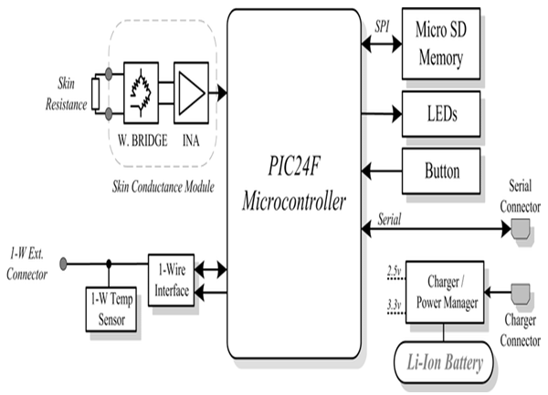
Block Diagram

Slide 8
SOFTWARE REQUIREMENTS:
Operating System : Windows 10
Platform : DOT NET TECHNOLOGY
Front End : ASP.Net 4.0
Back End : SQL SERVER 2014

Slide 9
HARDWARE REQUIREMENTS:
Keyboard
Mouse
Hard disk 500GB
Ram 4 Gb

Slide 10
CONCLUSION
The developed Android application (GSR App) can simulate the performance of the commercial Galvanic Skin Response (eSense) application. The GSR App can record skin conductance and systematically determine the stress level of a person during a texting task. The GSR App was able to display the stress levels of an individual on the smartphone. The stress level was based on the value of skin conductance of the person while doing a texting task. The skin conductance recorded by the eSense and GSR App was compared and results show that there is no significant difference between the results given by the two apps. The texting task provides an extremely low level of stress though there are evidences that task increased some of the participants’ skin conductance values. However, it is not enough to elevate the low stress levels to higher level.

Slide 11
REFERENCE
[1] Worldometers 2019 Global Smartphone Penetration Data https://www.bankmycell. com/blog/how-many-phones-are-in-the-world.
[2] Vitelli R 2019 Stress, Texting, and Being Social Psychology Today https://www.psychologytoday.com/us/blog/media-spotlight/201312/stress-texting-and-beingsocial.
[3] Vahedi Z and Saiphoo A 2018 The association between smartphone use, stress, and anxiety: A meta-analytic review, Stress Heath Vol. 34, 3 347–358
[4] Tang T B, Yeo L W and Lau D J H 2014 Activity awareness can improve continuous stress detection in galvanic skin response Proceedings of IEEE Sensors 1980–1983.

Slide 12
[5] Subramanya K, Bhat V V, and Kamath S 2013 A wearable device for monitoring galvanic skin response to accurately predict changes in blood pressure indexes and cardiovascular dynamics Annual IEEE India Conference 2 1–4.
[6] Fernandes A, Helawar R, Lokesh R, Tari T, and Shahapurkar A V 2015 Determination of stress using Blood Pressure and Galvanic Skin Response International Conference on Communication and Network Technologies 165–168
[7] BrainSigns 2018 Galvanic Skin response (GSR) https://www.brainsigns.com/en/ science/s2/technologies/gsr.
[8] Mancha A 2015 Mobile Phone Size Evolution https://www.dailyinfographic.com/mobile-phonesize-evolution
[9] WorldWorks 1996 eSense GSR Skin Response http://www.lifematters.com/esense-gsr.asp.

