Slide 1
SENTIMENTAL ANALYSIS USING A CODE-MIX DATASET OF TAMIL-ENGLISH

Slide 2
Abstract
This paper describes the development of a multilingual, manually annotated dataset for three under-resourced Dravidian languages generated from social media comments. The dataset was annotated for sentiment analysis and offensive language identification for a total of more than 60,000 YouTube comments. The dataset consists of around 44,000 comments in Tamil-English, around 7,000 comments in Kannada-English, and around 20,000 comments in Malayalam-English. The data was manually annotated by volunteer annotators and has a high inter-annotator agreement in Krippendorff’s alpha. The dataset contains all types of code-mixing phenomena since it comprises user-generated content from a multilingual country. We also present baseline experiments to establish benchmarks on the dataset using machine learning methods. The dataset is available on Github and Zenodo.

Slide 3
Existing System
It exists in two forms, the continuous Bag-of-Words model (cBoW) and the Skip-Gram model.
In the work of Named Entity Recognition in Tweets , it has been seen that the performance of the existing named extraction systems is not so good.
A low-resource perspective, exploring data augmentation strategies and trying to take advantage of existing multilingual pretrained models to cope with data scarcity in low-resource scenarios.

Slide 4
Disadvantage of Existing System
To facilitate the researchers working on these problems, there have been shared tasks conducted on aggression identification in social media and offensive language identification by providing necessary datasets.
The problems include the comparison of the movie with movies of same or other industries, expression of opinion of different aspects of the movie in the same sentence.
While speaking about its cons, they are vulnerable to mistakes in classification problems having many classes and a comparatively limited number of training examples.
We expect this resource will enable the researchers to address new and exciting problems in code-mixed research.

Slide 5
PROPOSED SYSTEM :
Propose a statistical method for opinion lexicon extraction based on a few seed words, which can be easily transplanted to almost any language and does not need to refer to synonyms and antonyms dictionaries;
On the basis of the extracted opinion lexicon, propose a key sentence extraction method for capturing the overall opinion of reviews, which solves the problem of conflictive sentiments;
Propose a Self-Supervised Learning (SSL) method for sentiment classification, which combines unsupervised and supervised techniques together by virtue of the above extracted opinion lexicon and key sentences; Finally, extensive experiments on multilingual datasets in different domains well demonstrate the effectiveness of the proposed methods.

Slide 6
ADVANTAGE
Cost-efficient framework for multilingual sentiment analysis.
Improve the performance of sentiment classification.
The concept of key sentences is reasonable and key sentences are useful for dealing with conflictive sentiments.
The key sentence extraction method is effective and language-independent Abbreviations and Acronyms

Slide 7
TITLE | AUTHOR | DESCRIPTION
SENTIMENTAL ANALYSIS OF TWITTER DATA | AGARWAL A, XIE B, VOVSHA I, RAMBOW O, PASSONNEAU R. | In this paper, we look at one such popular microblog called Twitter and build models for classifying “tweets” into positive, negative and neutral sentiment.
CODE MIXING: A CHALLENGE FOR LANGUAGE IDENTIFICATION IN THE LANGUAGE OF SOCIAL MEDIA | BARMAN U, DAS A, WAGNER J, FOSTER J. | This tag was introduced to capture intra-word code mixing and denotes cases where code mixing has occurred within a single word.

Slide 8
TITLE | AUTHOR | DESCRIPTION
RANDOM FORESTS | BREIMAN L | The nodes that are not split are called “terminal nodes” and form the final partition of the predictor space.
AN EMPIRICAL COMPARISON OF SUPERVISED LEARNING ALGORITHMS | CARUANA R, NICULESCU-MIZIL A. | The different performance metrics measure different tradeoffs in the predictions made by a classifier, and it is possible for learning methods to perform well on one metric, but be suboptimal on other metrics.

Slide 9
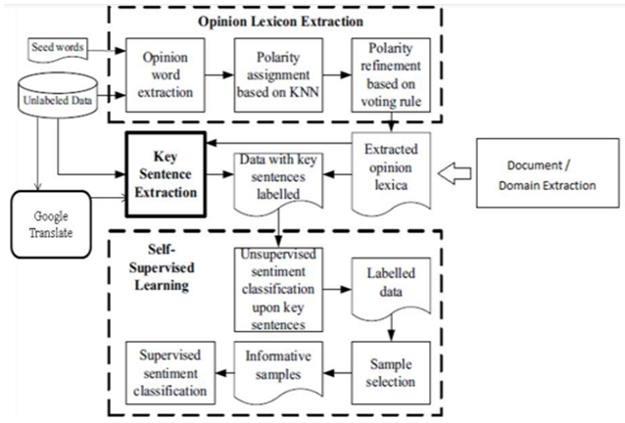
Block Diagram

Slide 10
SOFTWARE REQUIREMENTS:
Operating System : Windows 10
Platform : DOT NET TECHNOLOGY
Front End : ASP.Net 4.0
Back End : SQL SERVER 2014

Slide 11
HARDWARE REQUIREMENTS:
Keyboard
Mouse
Hard disk 500GB
Ram 4 Gb

Slide 12
CONCLUSION
This work introduced code-mixed dataset of the under-resourced Dravidian languages. This data set comprises more than 60,000 comments annotated for sentiment analysis and offensive language identification. To improve the research in the under-resourced Dravidian languages, we created an annotation scheme and achieved a high interannotator agreement in terms of Krippendorff 훼 from voluntary annotators on contributions collected using Google Form. We created baselines with gold standard annotated data and presented our results for each class in precision, recall, and F-Score. We expect this resource will enable the researchers to address new and exciting problems in code-mixed research. In future work, we intend to investigate whether we can apply these corpora to build corpora for other under-resourced Dravidian languages.

Slide 13
REFERENCE
[1] Agarwal A, Xie B, Vovsha I, Rambow O, Passonneau R (2011) Sentiment analysis of twitter data. In: Proceedings of the Workshop on Language in Social Media (LSM 2011), Association for Computational Linguistics, Portland, Oregon, pp 30–38,
[2] Agrawal R, Chenthil Kumar V, Muralidharan V, Sharma D (2018) No more beating about the bush : A step towards idiom handling for Indian language NLP. In: Proceedings of the Eleventh International Conference on Language Resources and Evaluation (LREC-2018), European Languages Resources Association (ELRA), Miyazaki, Japan,
[3] Bali K, Sharma J, Choudhury M, Vyas Y (2014) “I am borrowing ya mixing ?” an analysis of English-Hindi code mixing in Facebook. In: Proceedings of the First Workshop on Computational Approaches to Code Switching, Association for Computational Linguistics, Doha, Qatar, pp 116–126,
[4] Barman U, Das A, Wagner J, Foster J (2014) Code mixing: A challenge for language identification in the language of social media. In: Proceedings of the First Workshop on Computational Approaches to Code Switching, Association for Computational Linguistics, Doha, Qatar, pp 13–23,
[5] Caruana R, Niculescu-Mizil A (2006) An empirical comparison of supervised learning algorithms. In: Proceedings of the 23rd international conference on Machine learning, pp 161–168

Slide 14
[6] Chakravarthi BR (2020) HopeEDI: A multilingual hope speech detection dataset for equality, diversity, and inclusion. In: Proceedings of the Third Workshop on Computational Modeling of People’s Opinions, Personality, and Emotion’s in Social Media, Association for Computational Linguistics, Barcelona, Spain (Online), pp 41–53,
[7] Chakravarthi BR, Priyadharshini R, Jose N, Kumar M A, Mandl T, Kumaresan PK, Ponnusamy R, R L H, McCrae JP, Sherly E (2021) Findings of the shared task on offensive language identification in Tamil, Malayalam, and Kannada. In: Proceedings of the First Workshop on Speech and Language Technologies for Dravidian Languages, Association for Computational Linguistics, Kyiv, pp 133–145,
[8] Chanda A, Das D, Mazumdar C (2016) Unraveling the English-Bengali code-mixing phenomenon. In: Proceedings of the Second Workshop on Computational Approaches to Code Switching, Association for Computational Linguistics, Austin, Texas, pp 80–89,
[9] Cieliebak M, Deriu JM, Egger D, Uzdilli F (2017) A twitter corpus and benchmark resources for German sentiment analysis. In: Proceedings of the Fifth International Workshop on Natural Language Processing for Social Media, Association for Computational Linguistics, Valencia, Spain, pp 45–51,
[10] Clarke I, Grieve J (2017) Dimensions of abusive language on twitter. In: Proceedings of the First Workshop on Abusive Language Online, Association for Computational Linguistics, Vancouver, BC, Canada, pp 1–10,

