Slide 1
SECURE WIRELESS CONTROLLER FOR HAND HELD REMOTE OPERATION OF TRAFFIC SIGNAL IN PEAK HOURS

Slide 2
Abstract
This paper covers the design and implementation of an intelligent traffic management system for an isolated intersection. The vehicular traffic management system employs Field Programmable Gate Array (FPGA) as the central decision-making unit and combines its speed and high number of I/O with other system components such as the ESP8266 Wi-Fi module, to record real-time traffic information and apportion green time for each phase of traffic signal. The design and implementation incorporate three different operational modes namely, fixed time mode, sensor actuated mode and remote control mode, to alleviate vehicular traffic congestion and also reduce the risk of accidents at intersections. The incorporation of remote control mode, which enables an authorized personnel to remotely control the traffic, using a cloud-based application running on a portable device, makes this system different from previous works. Simulation using a prototype of the model on a model intersection, shows that the system can reduce waiting time and increase throughput at the intersections.

Slide 3
Existing System
It is compatible with existed traffic signal controller so that it can be fast and cost−effectively deployed.
In order to fast and cost−effectively deploy the STSC system, our idea is that the RSU controller has to be compatible with the existed infrastructure so that there is no need to replace the traditional traffic controllers.
However, some limitations exist for the use of intelligent traffic control, for example avoiding traffic jams is considered beneficial for both the environment and the economy, but improvement in traffic flow can lead to an increase in demand.
The major problem of the existing traffic light systems is that the transition timing slots are fixed within the code.

Slide 4
Disadvantage of Existing System
The problem of vehicular traffic congestion is one that accompanies development and urbanization in every country.
Urbanization is inevitable and hence its accompanying road traffic congestion problem, various ways must be devised to reduce the road traffic congestion as much as possible.
One attempt by government to handle the congestion problem is to construct more roads.
The work seeks to address two main problems, heavy traffic jams during peak hours and allocation of green-time to roads when there is no traffic on them using image processing based traffic light controller.

Slide 5
PROPOSED SYSTEM :
The proposed STSC system is designed by a unified system architecture with an RSU middleware which organized by modular functional design.
The proposed algorithm is innovative, the lack of some traffic protection measures, such as maximum green time and minimum green time, may lead to unsafe cases for pedestrians.
In order to quickly and cost-efficiently deploy the proposed STSC system, one key successful factor is that it should be compatible with legacy traffic signal controllers.
In this paper, a multi-modal smart traffic control system (STSC) for the infrastructure in the smart city is proposed, which can be widely applied for the intelligent transportation system in smart city applications.

Slide 6
ADVANTAGE
The human traffic conductors are however not efficient since the humans, though supposed to act as feedback control system.
The existing controller is not very efficient and has led to car waiting times as high as 6 minutes and long queue length on the West – East and East – West roads during rush hour.
The human traffic controllers are used mostly as a solution to the congestion caused by drastic change in traffic dynamics; malfunctioning traffic signals or to give right of way to priority/emergency vehicles such as fire trucks, ambulances, police responding to duty call, etc.
The fixedtime mode is used to control traffic during maintenance or when there is sensor failure.

Slide 7
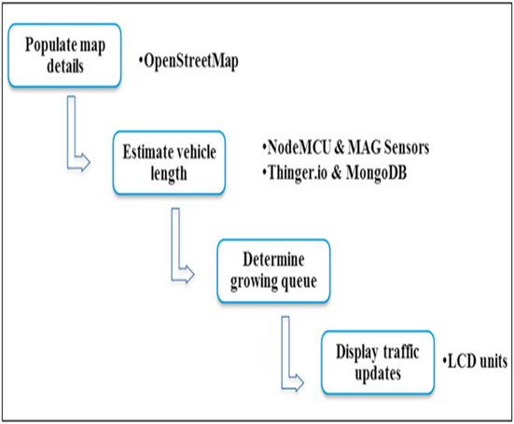
Block Diagram

Slide 8
SOFTWARE REQUIREMENTS:
Operating System : Windows 10
Platform : DOT NET TECHNOLOGY
Front End : ASP.Net 4.0
Back End : SQL SERVER 2014

Slide 9
HARDWARE REQUIREMENTS:
Keyboard
Mouse
Hard disk 500GB
Ram 4 Gb

Slide 10
CONCLUSION
An intelligent traffic system has been designed and implemented. A prototype of the system has been built and tested. Currently, the prototype is showcased in the College of Engineering Innovation Center, Kwame Nkrumah University of Science and technology, Kumasi - Ghana. Next improvement will incorporate surveillance cameras to enable remote viewing for remote control and secondly will use the cloud database for coordination of traffic flow through adjacent intersections.

Slide 11
REFERENCE
[1] Yasin H. Modelling and Control of Hybrid Vehicle. International Journal of Innovative Technology and Interdisciplinary Sciences, 2019; 2(3); 212-222.
[2] Rehman Y. A., Khan A. and Tariq M. Modeling, design and analysis of intelligent traffic control system based on integrated statistical image processing techniques, in 2015 12th International Bhurban Conference on Applied Sciences and Technology (IBCAST), Islamabad 2015, p. 169–174.
[3] Ramzanzad M. and Rashidy Kanan H. A new method for design and implementation of intelligent traffic control system based on fuzzy logic using FPGA, 13th Iranian Conference on Fuzzy Systems (IFSC), Qazvin 2013, p. 1–4.
[4] Lahade S. V and Hirekhan S. R. (2015) Intelligent and adaptive Traffic Light Controller (IA-TLC) using FPGA.
[5] El-Medany W. M. and Hussain M. R. (2007) FPGA-based advanced real traffic light controller system design.

Slide 12
[6] Chen Y. R., Chen K. P. and Hsiung P. A. Dynamic traffic light optimization and control system using model-predictive control method, IEEE 19th International Conference on Intelligent Transportation Systems (ITSC), Rio de Janeiro 2016, p. 2366–2371.
[7] Li N., Xiong G., Song W., Gong J. and Jiang Y. A micro-intelligent traffic behavior test platform using visual information processing, in 2nd International Conference on Measurement, Information and Control, Harbin 2013, p. 1475- 1478.
[8] Nellore K. and Hancke G. P. Traffic management for emergency vehicle priority based on visual sensing,” Sensors (Switzerland), 2016; 16 (11); 1892.
[9] Heung T. H., Ho T. K. and Fung Y. F. Coordinated road-junction traffic control by dynamic programming, IEEE Transactions on Intelligent Transportation Systems, 2005; 6(3); 341-350.
[10] Bhate S., Kulkarni P., Lagad S., Shinde M. and Patil S. (2018) IoT based Intelligent Traffic Signal System for Emergency vehicles.

