Slide 1
ONLINE PLANT SALES RECOMMENDER SYSTEM USING MACHINE LEARNING

Slide 2
Abstract
In today's technical era, every startup or a company attempt to establish a better sort of communication between their Plants and the users, and for that purpose, they require a type of mechanism which can promote their plant effectively, and here the recommender system serves this motive. It is basically a filtering system that tries to predict and show the items that a user would like to purchase. By analyzing the preference of the users, companies can decide which plant to be launched in the market to procure more benefits. These systems are proved to be very beneficial in variety of domains involving music, books, movies, research articles and plants in common. In this paper, we review various mechanisms and techniques that are required for recommender systems for recommending the plants or items in the domain of fashion and books.

Slide 3
Existing System
The recommended collaborative filtering recommendation (CF) by analysing existing user behaviours and information is widely used in the industry.
For learning the weights of the embedding layers, collaborative filtering was the solution to find similar customers and plants, creating customers and plants embeddings learned from existing ratings.
Deep learning techniques with different neural network architectures can be applied to the recommendation systems to identify the different patterns and behaviours of the customers in e-commerce applications.

Slide 4
Disadvantage of Existing System
The complex problems using unstructured data can be efficiently solved using different machine learning techniques.
It is observed that major problems in item-based RSs are the impact of context awareness, loss of neighbor transitivity, and sparsity.
This method is useful for the formation of latent factors (predictions) in the scope of RSs to resolve the problems faced by the approach of collaborative filtering.
Collaborative filtering is the most popular technique used for recommendation systems but the major drawback with this approach is its inability to solve the cold start problem.

Slide 5
PROPOSED SYSTEM :
The basic goal of a recommendation system is to propose something new that meets the user’s wants or preferences for plants or information services.
The proposed system depends on statistical analysis to solve the problem of a cold-start by providing a recommendation depending on the preferences matrix of the plants.
The proposed system is a part of the commercial environment, which involves an e-commerce website, an e-bank system, and customers.
The proposed RS system is employed on an e-commerce website that is a specialist in selling computers and their peripheral instruments, so it is possible to say that diversity and scalability problems are controlled.

Slide 6
ADVANTAGE
In many of the learning applications, the ratings are found very sparse and this causes collaborative based methods to reduce its performance in the recommendation.
It is a type of neural network consisting of convolution layers capturing global and local computational characteristics to enhance efficiency and precision.
The paper suggested a training regression model for several metrics that predict system performance based on a variety of parameters that characterize historical user activity in the system.
These factors increase the amount of competition between global commercial sites, which increases the need to work efficiently to increase financial profits.

Slide 7
TITLE | AUTHOR | DESCRIPTION
HCRS, A HYBRID CLOTHES RECOMMENDER SYSTEM BASED ON USER | X.HU, W.HU AND O.LI | One of the unique features of this system is the ability to recommend clothes in terms of both user ratings and clothing attributes.
RECOMMENDER SYSTEM BASED ON CONSUMER PLANT REVIEWS | ACIAR, S.ET AL., 2007 | Consumer reviews, opinions and shared experiences in the use of a plant is a powerful source of information about consumer preferences that can be used in recommender systems.

Slide 8
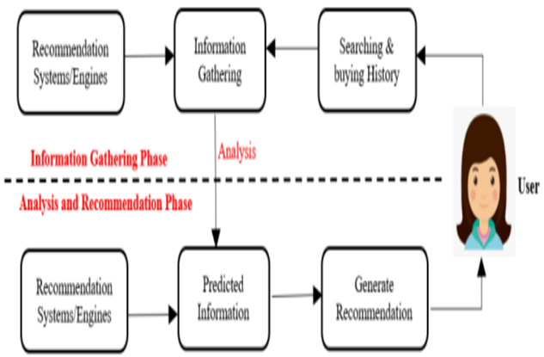
Block Diagram

Slide 9
SOFTWARE REQUIREMENTS:
Operating System : Windows 10
Platform : DOT NET TECHNOLOGY
Front End : ASP.Net 4.0
Back End : SQL SERVER 2014

Slide 10
HARDWARE REQUIREMENTS:
Keyboard
Mouse
Hard disk 500GB
Ram 4 Gb

Slide 11
CONCLUSION
Recommendation algorithms are generally designed and developed to provide recommendations on the basis of popular items. But it should not be restricted to that only. It should provide diversity because same and known items can make the customer bored. Therefore, there could be more exactness which can be used in order to detect books and fashion styling.

Slide 12
REFERENCE
[1] X.Hu, W.Hu and Q.Li, “HCRS, A hybrid clothes recommender system based on user,” in proceedings of the ratings and plant features, pp 270-274, 2014. View at: Google Scholar
[2] Xiang Liu, 2017. Fashion Evaluation Method for Clothing Recommendation Based on Weak Appearance Feature.
[3] Aciar, S. et al., 2007. Recommender System Based on Consumer plant Reviews.pdf.
[4] Baltrunas, L., 2011. Context-Aware Collaborative Filtering Recommender Systems., 4 (April), p.172.
[5] H.Li, F.Cai and Z.Liao, “Content Based-Filtering Recommendation Algorithm Using”, in Proceedings of the HMM, pp. 275-277, 2012.

Slide 13
[6] Driskill, R. & Riedl, J., 1999. Recommender Systems for E-Commerce: Challenges and Opportunities. American Association for Artificial Intelligence, pp.73–76.
[7] L.C. Wang, X.Y. Zeng, L.Koehl, and Y. Chen “Intelligent fashion recommender system: Fuzzy logic in personalized garment design,” IEEE Transactions on Human-Machine Systems, vol.45 no.1 pp 95-109,2015
[8] Dutta, R. & Mukhopadhyay, D., 2008. Offering a Recommendation System in E-commerce. IEEE.
[9] Swati Pandey, T.Senthil Kumar “Costomization of recommendation System using Collaborative Filtering Algorithm on Cloud using Mahout”, International Journal of Research in Engineering and Technology.
[10] Dr. Senthil Kumar Thangavel, Neetha Susan Thampi “Performance Analysis of Various Recommendation Algorithms Using Apache Hadoop Mahout”, International Journal of Scientific & Engineering Research Vol 4, 2013. Available at: academia.edu

