Slide 1
IOT BASED COVID 19 PATIENT MONITORING SYSTEM FROM HOME

Slide 2
Abstract
Medical Surveillance Solutions are the most important in the brief developing country populace enhances demands for caretaking. Covid-19 is as a substitute contagious it is very important to quarantine covid-19 humans but at the equal time medical examiners need to check fitness of covid-19 sufferers moreover. With the boosting kind of instances it's miles turning into tough to preserve a tune on the health and well-being problems of several quarantined humans. Below the encouraged machine design of a Wi-Fi sensor network based upon IoT innovation. It is normally used for accumulating as well as moving the unique sensors tracking data regarding the human beings in healthcare centers.

Slide 3
This software consists of Wireless primarily based network (Wi-Fi), having absolutely exceptional sensing gadgets related to the transmitter area the ones are Heart beat sensing unit, Temperature stage sensing unit blood pressure sensor and pulse oximeter. These sensors are straight away connected to the affected man or woman and accumulate the client issues by using way of the use of sensing devices. The same statistics is sending out wirelessly to the receiver location this is with the medical agent and by way of that receiver trouble he'll definitely reap all updates in their clients. And additionally it's going to genuinely deliver voice word to humans to take there medicines suitable time. And one sharp buzzer will in fact there at patient with a view to virtually advocate emergency state of affairs of clients. When patient will press emergency button then the buzzer will be ON.

Slide 4
Existing System
Internet of Things (IoT) is the state-of-the-art exchange of net which is the growing have a examine region mainly inside the fitness care.
Health care is offered the intense relevance now a-days through manner of each United States with the improvement of the specific corona virus.
In this paper, a portable bodily checking shape is proven, that can often examine the customer's heartbeat, temperature in addition to exclusive simple specifications of the space.

Slide 5
Disadvantage of Existing System
An Iota framework is offered to check people' health and fitness problems as well as notify them to keep bodily distancing.
In most of the agricultural regions, the medical middle might no longer be in a hand reap distance for the natives So commonly people forget any type of shape of teenybopper fitness problems that's displayed in onset via variant of vital components like frame temperature degree, heartbeat fee and many others.
The equal information is delivering out wirelessly to the receiver region which is with the clinical agent and additionally by using that receiver problem he's going to get all updates in their sufferers.

Slide 6
PROPOSED SYSTEM :
In this paper, COVID 19 centre monitoring and management system has been proposed and integration of different sensor network with Internet of Things (IoT).
The proposed research and methodology was done related to COVID 19 centre management with internet of things (IoT) based architecture for monitoring patient health status.
The proposed system enables monitoring patients from their homes that save governmental cost and time through measuring the changes in patient's medical readings.

Slide 7
ADVANTAGE
The modern technology used for farming which gives better performance in productivity and quality.
Intercommunication of security and other agencies makes efficient way of handling all the operations related to management of pandemic conditions.
It is found that blynk based application has more advantages if widgets are appropriate for mobile devices.
Data fusion means the process to reach higher efficiency results to deal with multiple and heterogeneous data sources.

Slide 8
TITLE | AUTHOR | DESCRIPTION
Smart healthcare support for remote patient monitoring during covid-19 quarantine | Olutosin Taiwoa,, Absalom E. Ezugwub, | Due to the full acceptance of the above control practices, frequent hospital contact visits are being discouraged.
Smart health monitoring systems: an overview of design and modelling | Mirza Mansoor Baig, Hamid Gholamhosseini | Health monitoring systems have rapidly evolved during the past two decades and have the potential to change the way health care is currently delivered.

Slide 9
TITLE | AUTHOR | DESCRIPTION
Context-Driven personalized service discovery in pervasive environments | Katharina Rasch, Fei Li, Sanjin Sehic, Rassul Ayani ,Schahram Dustdar, | This paper proposes a proactive service discovery approach for pervasive environments addressing these implicit requests.
E-health Monitoring System | Aleksandar Kotevski, Natasa Koceska, SasoKoceski, | This kind of solutions are very useful especially when a treatment includes monitoring of some vital parameters for long period of time.

Slide 10
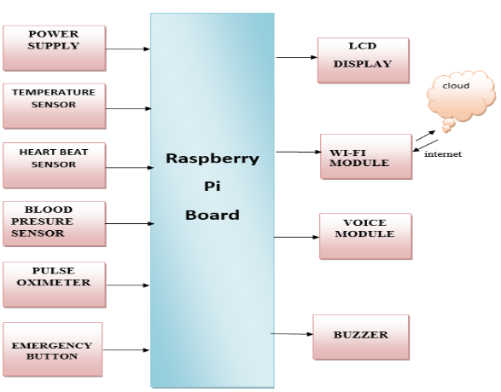
Block Diagram

Slide 11
SOFTWARE REQUIREMENTS:
Operating System : Windows 10
Platform : DOT NET TECHNOLOGY
Front End : ASP.Net 4.0
Back End : SQL SERVER 2014

Slide 12
HARDWARE REQUIREMENTS:
Keyboard
Mouse
Hard disk 500GB
Ram 4 Gb

Slide 13
CONCLUSION
In this challenge, an Iot a framework is offered to check people' health and fitness problems as well as notify them to keep bodily distancing. The suggested device incorporates a wearable Iota node with a cell phone software program, via which the Iota sensor node can collect someone's health standards, collectively with temperature stage and moreover blood oxygen saturation, and the cellular smart phone attaches to the network to ship out the statistics to the net server. The paper encouraged a Super high frequency distance-tracking method which runs every for interior as well as outside environments to alert individuals to maintain the physical distancing.

Slide 14
Applying ML components on body specifications makes it viable to check player's' wellness situations and to alert people in real time. A voice coughing-detector always maintains track of the patron's voice and documents the variety and moreover severity of coughing. The fog-based totally server is carried out to process gotten information from an Iota node the usage of a cell community or wife hyperlink. In addition, regionally refining the facts makes it possible to make use of the Iota node inside the atmospheres without net connection or fog-based totally networks. The gadget can assist members in monitoring their regular obligations in addition to lessen the risk of publicity to the Corona virus.

Slide 15
REFERENCE
1.Olutosin Taiwoa,, Absalom E. Ezugwub,"Smart healthcare support for remotepatient monitoring during covid-19 quarantine", Information in Medicine Unlocked, volume.20,2020,pp.100428.
2.Mirza Mansoor Baig, Hamid Gholamhosseini “Smart health monitoring systems:an overview of design andmodelling”, j Med Syst, volume. 37,2013,pp.9898.
3.Katharina Rasch, Fei Li, Sanjin Sehic, Rassul Ayani ,Schahram Dustdar, “Context-Drivenpersonalized service discovery in pervasive environments”, world wide web, volume. 14(4), 2011,pp.295-319.
4.Aleksandar Kotevski, Natasa Koceska, SasoKoceski, “E-health Monitoring System”, International Conference on Applied Internet and Information Technologies ,2016,pp.259-265.

Slide 16
5.Sparsh Agarwal, Chiew Tong Lau, “Remote Health Monitoring Using Mobile phones and web services”, telemedicine and e-health journal, volume.16(5),2010,pp.603–607.
6.Prosanta G., Tzonelih H.,“BSN-care: a secure IoT-based modern healthcare system using body sensor network”,IEEE Sensors journal volume. 16(5),2016,pp.1368–1376.
7.Minh P., Yehenew M., Ha D., Weihua S. “Delivering home healthcare through a cloud-based smart home invironment”, volume.81, 2018, pp.129–140.

Slide 17
8.Eren D., Erdem K., Radosveta S., Burhan Ş.“Smart home assistant for ambient assited living of elderly people with dementia”, International Workshop on IoT, M2M and Healthcare (IMH2017), volume.113, 2017, pp. 609-614
9.Bilal Ghazal, Khaled A1-Khatib,“Smart home automation system for elderly and handicapped people using XBee”, International Journals of smart Home, volume.9(4), 2015, pp. 203-210.
10.Md. Raseduzzaman Ruman, Amit Barua, Waladur Rahman, Khan Roushan Jahan, Md. Jamil Roni; Md. Foyjur Rahman, ”IoT Based Emergency Health Monitoring System”, International Conference on Industry 4.0 Technology (I4Tech)IEEE, 2020,pp.159-162.

