Slide 1
Fabric Defects Detection using Convolution Neural Network and Multispectral Imaging

Slide 2
Abstract
Manual inspection of textiles is a long, tedious, and costly method. Technology has solved this problem by developing automatic systems for textile inspection. However, Jacquard fabrics present a challenge because patterns can be complex and seemingly random to systems. Only a few in-depth studies have been conducted on jacquard fabrics despite their important and intriguing nature. Previous studies on jacquard fabrics are of simple patterns. This paper introduces a new and novel field in fabrics defect detection. Complex-patterned jacquard fabrics are much more challenging. In this paper, novel defect detection models for jacquard-patterned fabrics are presented. Owing to the lack of available databases for jacquard fabrics, we compiled and experimented on our own novel dataset. Our dataset was collected from plain, undyed jacquard fabrics with different complex patterns.

Slide 3
In this study, we used and tested several deep learning models with image pre-processing and convolutional neural networks (CNNs) for unsupervised detection of defects. We also used multispectral imaging, combining normal (RGB) and near-infrared (NIR) imaging to improve our system and increase its accuracy. We propose two systems: a semi-manual system using a simple CNN network for operation on separate patterns and an integrated automated system that uses state-of-the-art CNN architectures to run on the entire dataset without prior pattern specification. The images are preprocessed using contrast-limited adaptive Histogram Equalization (CLAHE) to enhance their features. We concluded that deep learning is efficient and can be used for defect detection in complex patterns. Proposed method of EfficientNet CNN gave high accuracy reaching 99% approximately. We also found that multispectral imaging is more advantageous and yields higher accuracy.

Slide 4
Existing System
In order to further verify the effectiveness of the proposed model for defect classification, its classification performance is compared with the other three existing approaches.
This paper also compares the CNN with three existing methods with the same defect type.
It can be seen from the experimental results that the proposed CS-CNN method outperforms the other four existing methods on this dataset.

Slide 5
Disadvantage of Existing System
The development of a flexible, efficient, reliable, and integrated real-time vision system for industrial applications is an essential issue in quality control processes in various industries.
However, these methods do not consider the problem of fabric defect classification in small sample sizes.
The CNN cannot handle the small sample sizes problem very well in classification, a new algorithm for fabric defect classification has been developed by combining compressive sensing and the CNN (CS-CNN).

Slide 6
PROPOSED SYSTEM :
The general hardware and software platform, developed for solving this problem, is presented while a powerful novel method for defect detection after multi resolution decomposition of the fabric images is proposed.
In this paper a real-time pilot system for defect detection and classification has been proposed and demonstrated.
This paper proposes a real-time pilot system for defect detection and classification of web textile fabric based on standard, low price, hardware components and supported by very fast and effective software solutions.

Slide 7
ADVANTAGE
The most popular CNNs simply stack convolution layers deeper and deeper, hoping to achieve better performance.
The purpose of this study is to introduce an automatic inspection system for jacquard-patterned fabrics to efficiently detect defects.
The advantage of multispectral imaging was tested using this simple CNN model across 10 different patterns.
We also found that multispectral imaging is more advantageous and yields a higher accuracy.

Slide 8
TITLE | AUTHOR | DESCRIPTION
FDAS: A knowledge-based framework for analysis of defects in woven textile structures | K. Srinivasan, P. H. Dastor, P. Radhakrishnaihan, and S. Jayaraman, | The proposed scheme can serve as the underlying framework for a vision-based inspection system. The classification framework has been incorporated in software.
Computer vision techniques for detecting fabric defects | W. K. Wong and J. L. Jiang, | In other words, most of them cannot be applied to fabrics with different patterns under controlled environment.

Slide 9
TITLE | AUTHOR | DESCRIPTION
Developments in Jacquard woven fabrics | A. M. Seyam, | The capacity of Jacquard shedding systems in the production of smart electronic textiles, industrial textiles, and shaped seamless garments are also described.
Research on finite element segmentation algorithm for Jacquard images | Y. Liu and X. Li, | This paper presented a novel adaptive finite element segmentation algorithm to extract pattern structures within a jacquard image.

Slide 10
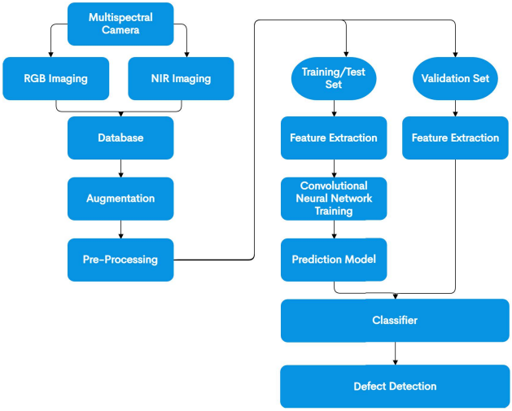
Block Diagram

Slide 11
SOFTWARE REQUIREMENTS:
Operating System : Windows 10
Platform : DOT NET TECHNOLOGY
Front End : ASP.Net 4.0
Back End : SQL SERVER 2014

Slide 12
HARDWARE REQUIREMENTS:
Keyboard
Mouse
Hard disk 500GB
Ram 4 Gb

Slide 13
CONCLUSION
In this study, unsupervised complex-patterned jacquard fabric defect detection systems were introduced. A new and extensive image database was collected and tested. The images were preprocessed using CLAHE to enhance their features. These systems use Convolutional Neural Networks (CNNs) to detect defective fabrics. Test results for single RGB and multispectral imaging are provided. We concluded that deep learning is efficient and can be used for defect detection in complex patterns. EfficientNet CNN gave high accuracy reaching 99% approximately. We also found that multispectral imaging is more advantageous and yields a higher accuracy. These systems exhibit high detection rates. Much work and research can still be conducted in the field of jacquard fabrics.

Slide 14
REFERENCE
[1] K. Srinivasan, P. H. Dastor, P. Radhakrishnaihan, and S. Jayaraman, ‘‘FDAS: A knowledge-based framework for analysis of defects in woven textile structures,’’ J. Text. Inst., vol. 83, no. 3, pp. 431–447, 1992.
[2] W. K. Wong and J. L. Jiang, ‘‘Computer vision techniques for detecting fabric defects,’’ in Applications of Computer Vision in Fashion and Textiles. Sawston, U.K.: Woodhead Publishing, 2018, pp. 47–60.
[3] A. M. Seyam, ‘‘Developments in Jacquard woven fabrics,’’ in Specialist Yarn and Fabric Structures (Woodhead Publishing Series in Textiles). Sawston, U.K.: Woodhead Publishing, 2011, ch. 10, pp. 223–263,

Slide 15
[4] Jacquard Fabric Review. Accessed: Dec. 22, 2021. [Online]. Available: https://tissura.com/articles/jacquard-fabrics
[5] K. Hanbay, M. F. Talu, and Ö. F. Özgüven, ‘‘Fabric defect detection systems and methods—A systematic literature review,’’ Optik, vol. 127, no. 24, pp. 11960–11973, Dec. 2016,
[6] Z. Feng, J. Yin, G. Chen, and J. Dong, ‘‘An algorithm for segmentation of jacquard images based on Mumford–Shah model,’’ in Proc. Int. Conf. Intell. Mechatronics Autom., 2004, pp. 617–620.
[7] Y. Liu and X. Li, ‘‘Research on finite element segmentation algorithm for Jacquard images,’’ in Proc. IEEE Int. Conf. Mechatronics Autom., vol. 4, Jul./Aug. 2005, pp. 1813–1816.

Slide 16
[8] Z. Feng, J. Yin, J. Qiu, X. Liu, and J. Dong, ‘‘Jacquard image segmentation method based on fuzzy optimization technology,’’ in Rough Sets, Fuzzy Sets, Data Mining, and Granular Computing (Lecture Notes in Computer Science), vol. 3642, D. Ślęzak, J. Yao, J. F. Peters, W. Ziarko, and X. Hu, Eds. Berlin, Germany: Springer, 2005, doi: 10.1007/11548706_29.
[9] Y. Zhang, Y. C. Tong, and J. Z. Yao, ‘‘Texture segmentation and contour extraction of warp knitting jacquard fabric image,’’ Appl. Mech. Mater., vols. 201–202, pp. 1203–1206, Oct. 2012.
[10] G. Jiang, D. Zhang, C. Honglian, A. Zhang, and Z. Gao, ‘‘Automatic identification of Jacquard warp-knitted fabric patterns based on the wavelet transform,’’ Fibres Textiles Eastern Eur., vol. 104, pp. 53–56, Mar. 2014.

