Slide 1

Cyber Threat Predictive Analytics for Improving Cyber Supply Chain Security

Slide 2
Abstract
Cyber Supply Chain (CSC) system is complex which involves different sub-systems performing various tasks.
Security in supply chain is challenging due to the inherent vulnerabilities and threats from any part of the system which can be exploited at any point within the supply chain.
This can cause a severe disruption on the overall business continuity. Therefore, it is paramount important to understand and predicate the threats so that organization can undertake necessary control measures for the supply chain security.
Cyber Threat Intelligence (CTI) provides an intelligence analysis to discover unknown to known threats using various properties including threat actor skill and motivation, Tactics, Techniques, and Procedure (TT and P), and Indicator of Compromise (IoC).

Slide 3
This paper aims to analyse and predicate threats to improve cyber supply chain security.
We have applied Cyber Threat Intelligence (CTI) with Machine Learning (ML) techniques to analyse and predict the threats based on the CTI properties.
That allows to identify the inherent CSC vulnerabilities so that appropriate control actions can be undertaken for the overall cyber security improvement.
To demonstrate the applicability of our approach, CTI data is gathered and a number of ML algorithms, i.e., Logistic Regression (LG), Support Vector Machine (SVM), Random Forest (RF), and Decision Tree (DT), are used to develop predictive analytics using the Microsoft Malware Prediction dataset.

Slide 4
The experiment considers attack and TTP as input parameters and vulnerabilities and Indicators of compromise (IoC) as output parameters.
The results relating to the prediction reveal that Spyware/Ransom ware and spear phishing are the most predictable threats in CSC.
We have also recommended relevant controls to tackle these threats.
We advocate using CTI data for the ML predicate model for the overall CSC cyber security improvement.

Slide 5

Existing
Cyber Threat Intelligence (CTI ) provides technical indicators, context, and actionable advice relating to existing and emerging threat.
CTI provides evidence-based knowledge of threat actor's motives, intents, TTPs, and indicators of compromise (IoC) and control mechanisms relating to the existing and emerging threat.

Slide 6
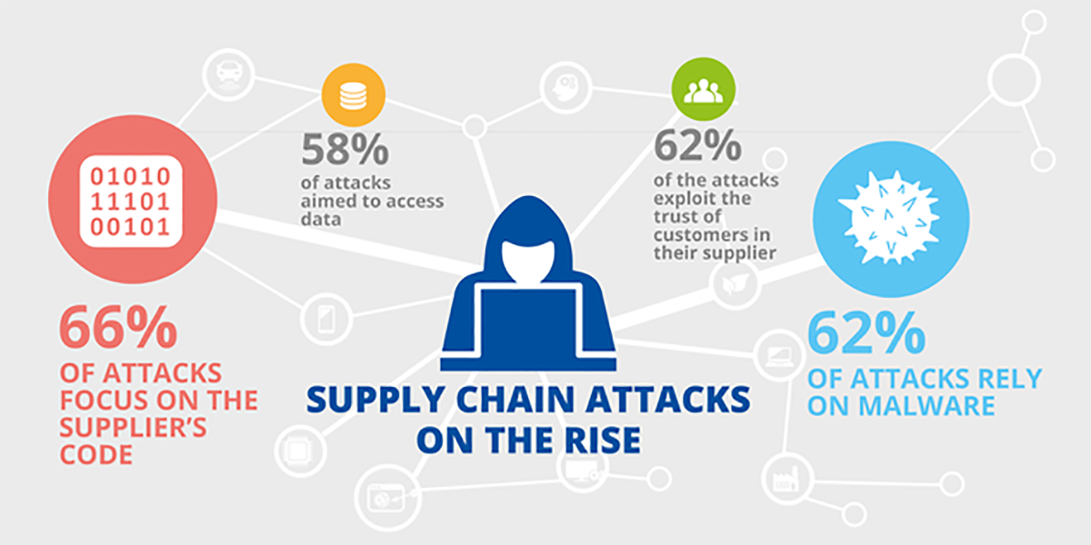
Proposed
The proposed approach includes additional concepts related to CSC such as supply chain actor and controls.
A dynamic privacy protection model was proposed by to address threats relating to wireless communication.
We used a running example from a smart grid system to analyze the proposed approach and demonstrate the applicability of the work.

Slide 7

Advantages
The goal of the ML techniques is to evaluate if the algorithm can predict the performance of classification as an attack or not after a training phase.
The approach adopts the CTI process to gather and analyse the threat data and ML techniques to predicate the threat.
ML techniques are used on classification algorithms to learn a dataset for performance accuracies and predictive analytics.

Slide 8
Disadvantages
We used AUC_ROC (Area Under Curve – Receiver Operating Characteristics) to model the selection metric for the bi-multiclass classification problem to distinguish between the probabilities of the given classes.
Cyber security incident reporting platform provides individuals and organizations with a system to reports cyber incidents they have experienced unexpectedly or any unusual network issues, or suspected fraud or cybercrime activities.

Slide 9

Conclusion
The integration of complex cyber physical infrastructures and applications in a CSC environment have brought economic, business, and societal impact for both national and global context in the areas of Transport, Energy, Healthcare, Manufacturing, and Communication.

Slide 10
This paper aims to improve CSC security by integrating CTI and ML for the threat analysis and predication. We considered the necessary concepts from CSC and CTI and a systematic process to analyse and predicate the threat.
The experimental results showed that accuracies of the LG, DT, SVM, and RF algorithms in Majority Voting and identified a list of predicated threats.
We also observed that CTI is effective to extract threat information, which can integrate into the ML classifiers for the threat predication.
This allows CSC organization to analyse the existing controls and determine additional controls for the improvement of overall cyber security.
It is necessary to consider the full automation of the process and industrial case study to generalize our findings.

