Slide 1
ATTRACT RANK:DISTRICT ATTRACTION RANKING ANALYSIS BASED ON TAXI BIG DATA

Slide 2
Abstract
The city’s district attraction ranking plays an essential role in the city’s government because it can be used to reveal the city’s district attraction and thus help government make decisions for urban planning in terms of the smart city. The traditional methods for urban planning mainly rely on the district’s GDP, employment rate, population density, information from questionnaire surveys and so on. However, as a comparison, such information is becoming relatively less informative as the explosion of an increasing amount of urban data. What’s more, there is a serious shortcoming in these methods, i.e., they are independent representations of the attraction of a district and do not take into account the interaction among districts. With the development of urban computing, it is possible to make good use of urban data for urban planning.

Slide 3
To this end, based on taxi big data obtained from Guangzhou, China, this paper proposes a district attraction ranking approach called Attract Rank, which for the first time uses taxi big data for district ranking. An application system is developed for demonstration purposes. Firstly, the entire Guangzhou city is divided into a number of districts by using Constrained K-means. Secondly, the original Page Rank algorithm is extended to integrate with the taxi’s OD (origin-destination) points to establish the OD matrix, whereby the attraction ranking of each district can be calculated. Finally, by visualizing the results and case studies obtained from Attract Rank, we can successfully obtain the pattern of how attractions of districts change over time and interesting discoveries on urban lives, therefore it has wide applications in urban planning and urban data mining.

Slide 4
Existing System
Different computing modes have different computation and communication capacities and how to integrate and utilize these computing modes with existing big data infrastructures remains challenging.
However, more errors may exist in the collected due to the device fault or misjudgement caused by passenger’s strange behaviors.
Existing data for traffic estimation and prediction tasks are heterogeneous in the spatial and temporal ranges.

Slide 5
Drawbacks
Its goal is to use data from various sources to solve some of the problems encountered in today’s urbanization process, such as air pollution, traffic congestion, and energy waste.
The problem we are studying in this paper, namely the nature of the city’s region, is one of the key challenges in this research direction.
This work made the breakdown of flow patterns instead of the impact of the place in attracting visitors, which is our aim in this paper.

Slide 6
PROPOSED SYSTEM :
A study proposed a method for measuring the centrality of locations that incorporates the number of people attracted to the location and the diversity of activities in which visitors engaged.
The proposed system aims to identify fuel-saving paths according to request from passengers and current routes in progress, and reduce the amount of vehicles in circulation.
They also highlighted the need for a frequent in-situ calibration to maintain the consistency of some sensors, therefore a procedure for a field calibration is proposed.

Slide 7
Benefits
It confirms that our algorithm can be used to explore the lifestyle of different city districts.
We pre processed the taxi data and used the technique of converting the GPS coordinates into the plane rectangular coordinate system, extracting the OD pairs and saving them to the database.
This is a big advantage over GPS data, where privacy is a serious concern and is the primary reason for limited coverage. This advantage allows researchers to capture high coverage of trips and develop generalizable methods, while preserving the privacy of users’ data.

Slide 8
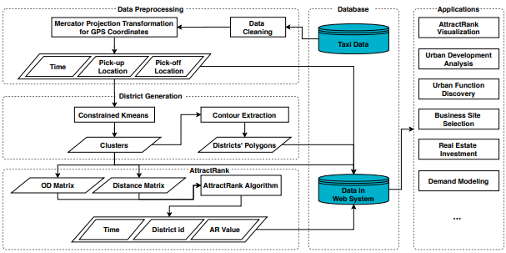
Data flow Diagram

Slide 9
SOFTWARE REQUIREMENTS:
Operating System : Windows 10
Platform : DOT NET TECHNOLOGY
Front End : ASP.Net 4.0
Back End : SQL SERVER 2014

Slide 10
HARDWARE REQUIREMENTS:
Keyboard
Mouse
Hard disk 500GB
Ram 4 Gb

