Slide 1
Tracing IP address and details of unidentified participants while academic sessions

Slide 2
Abstract
Distance Learning has been steadily gaining popularity. More and more universities and colleges are offering online course to increase enrollments. However, one question remains for those who teach online courses: who is doing the real course work? In this paper we will survey the commonly used methods to prevent e-Cheating, look at a few e-Proctors, and illustrate how biometrics is being used for that purpose. In particular we propose a new and alternative method to monitor student activities: using students’ IP addresses and timestamps to assist detecting possible cheating behavior. Our results show that IP addresses are applicable to categorize a student as suspect of collusion/cheating during exam. Thus it reduces the number of students an instructor has to pay special attention to for the purpose of preventing dishonesty.

Slide 3
Existing System
We show the existence of IP address cycles, that is, IP addresses that the devices use to connect to the Internet over long periods of time.
They are ideally positioned for snooping the users’ activities, as has been shown in existing work.
Existing international laws and agreements that might touch on these issues were not written for the Internet and need to be tested on cases involving Internet cyber-attacks.

Slide 4
Disadvantage of Existing System
One possible solution to the problem is to use biometrics since biometrics cannot be easily transferable between two people.
A biometric system is designed to solve a matching problem through the live measurements of human body features.
We looked at how biometrics can provide a solution to the problem and surveyed the existing proposals of using biometrics to authenticate remote students.

Slide 5
PROPOSED SYSTEM :
In particular we propose a new and alternative method to monitor student activities: using students’ IP addresses and timestamps to assist detecting possible cheating behavior.
To increase their incomes, advertisers propose advanced features that enable to target specific users based on a wide range of criteria ranging from their demographics to their prior purchases.
To protect users against tracking, several countermeasures have been proposed, ranging from browser extensions that leverage filter lists, to features natively integrated into popular browsers like Firefox and Brave to combat more modern techniques like browser fingerprinting.

Slide 6
ADVANTAGE
To mitigate the privacy implications of IP tracking, we can look at the advantages and disadvantages of different solutions.
Advantages include the fact that special-purpose tracking and analysis features are only needed on the edge routers and the special-purpose tracking routers.
This would allow IP assignments to be more stable over time, which would be a significant advantage from the perspective of tracking and tracing the individual or entity responsible for an attack originating from a particular IP address.

Slide 7
TITLE | AUTHOR | DESCRIPTION
Using Biometrics Authentication via Fingerprint Recognition in E-exams in E-Learning Environment | Alotaibi, S. (2010). | A new approach shall be proposed so as to ensure that no unauthorised individuals are permitted to give the exams.
Towards Security Goals in Summative E-Assessment Security | Apampa, K., Wills, G., & Argles, D. (2009). | In this paper, we do not discard the fundamental C-I-A security goals; rather we define security goals which are specific to summative e-assessment security.

Slide 8
TITLE | AUTHOR | DESCRIPTION
Private key generation from on-line handwritten signatures | Hao, F., & Chan, C. (2002). | This technology will permit commercial transactions to be carried out across insecure networks without fear of tampering or forgery.
A palm print-based cryptosystem using double encryption | Kumar, A., & Kumar, A. (2008). | We propose a novel cryptographic construct incorporating biometrics which insures a secure communication between two channels just by using Palmprint.

Slide 9
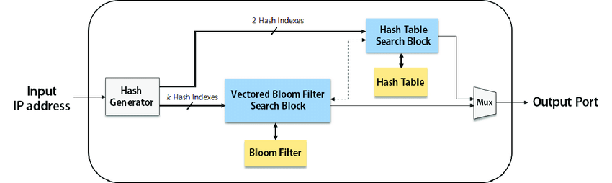
Block Diagram

Slide 10
SOFTWARE REQUIREMENTS:
Operating System : Windows 10
Platform : DOT NET TECHNOLOGY
Front End : ASP.Net 4.0
Back End : SQL SERVER 2014

Slide 11
HARDWARE REQUIREMENTS:
Keyboard
Mouse
Hard disk 500GB
Ram 4 Gb

Slide 12
CONCLUSION
In this paper we listed the commonly used methods to prevent e-Cheating and recognized the inadequacy of using them to achieve the goal of eliminating student dishonesty in Distance Learning. We looked at how biometrics can provide a solution to the problem and surveyed the existing proposals of using biometrics to authenticate remote students. We looked into three commercially available products that have been tested by some universities to proctor e-Exams. Above all we proposed a new method of using IP addresses to single out cheating suspects for online exams. Our results show that the method is effective at identifying student collusion during exam.

Slide 13
REFERENCE
Alotaibi, S. (2010). Using Biometrics Authentication via Fingerprint Recognition in E-exams in E-Learning Environment. The 4th Saudi International Conference, The University of Manchester, UK.
Apampa, K., Wills, G., & Argles, D. (2009). Towards Security Goals in Summative E-Assessment Security. International Conference for Internet Technology and Secured Transactions, pp: 1-5.
Christe, B. (2003). Designing online courses to discourage dishonesty. Educause Quarterly, 4:54-58.
Flior, E., & Kowalski, K. (2010) Continuous Biometric User Authentication in Online Examinations, Seventh International Conference on Information Technology, pp: 488-492.
Hao, F., & Chan, C. (2002). Private key generation from on-line handwritten signatures. Information Management & Computer Security, 10(2): 159–164.

Slide 14
Kumar, A., & Kumar, A. (2008). A palmprint-based cryptosystem using double encryption. Proc. of SPIE, 6944:1-9.
Lardinois, F. (2008). The Proctor at Home: Using Technology to Keep Online Students from Cheating.
Monrose, F., Reiter, M., & Wetzel, S. (1999). Password Hardening Based on Keystroke Dynamics. Proc. of the ACM Conference in Computer and Communications Security, pp: 73–82.
Penteado, B., & Marana, A. (2009). A Video-Based Biometric Authentication for e-Learning Web Applications. Enterprise Information Systems. Lecture Notes in Business Information Processing, 24(IV): 770-779.
Rabuzin, K., Baca, M., & Sajko, M. (2006). E-learning: Biometrics as a Security Factor. International MultiConference on Computing in the Global Information Technology, pp: 64.

