Slide 1
Software toolset for storage browsing and permission based access to geospatial data using blockchain

Slide 2
Abstract
Blockchain’s foundations of decentralisation, cryptographic security and immutability make it a strong contender in reshaping the healthcare landscape worldwide. Blockchain solutions are currently being explored for: (1) securing patient and provider identities; (2) managing pharmaceutical and medical device supply chains; (3) clinical research and data monetisation; (4) medical fraud detection; (5) public health surveillance; (6) enabling truly public and open geo-tagged data; (7) powering many Internet of Things-connected autonomous devices, wearables, drones and vehicles, via the distributed peer-to-peer apps they run, to deliver the full vision of smart healthy cities and regions; and (8) blockchainenabled augmented reality in crisis mapping and recovery scenarios, including mechanisms for validating, crediting and rewarding crowdsourced geo-tagged data, among other emerging use cases.

Slide 3
Geospatially-enabled blockchain solutions exist today that use a crypto-spatial coordinate system to add an immutable spatial context that regular blockchains lack. These geospatial blockchains do not just record an entry’s specifc time, but also require and validate its associated proof of location, allowing accurate spatiotemporal mapping of physical world events. Blockchain and distributed ledger technology face similar challenges as any other technology threatening to disintermediate legacy processes and commercial interests, namely the challenges of blockchain interoperability, security and privacy, as well as the need to find suitable and sustainable business models of implementation. Nevertheless, we expect blockchain technologies to get increasingly powerful and robust, as they become coupled with artifcial intelligence (AI) in various real-word healthcare solutions involving AI-mediated data exchange on blockchains.

Slide 4
Existing System
A split in the blockchain that could be caused by consensus protocol change (difference of opinion within community) or mining a different version of an existing block (attack) as examples.
The amount of medication importation also plays a role in the verifable authenticity of the product, especially with a weak or nonexistent supply chain management system.
Geospatially-enabled blockchain solutions exist today that use a crypto-spatial coordinate system to add an immutable spatial context that regular blockchains lack.

Slide 5
Disadvantage of Existing System
Blockchain technology and crypto currencies are being touted as the “solution” to problems in many different, disparate sectors throughout multiple industries.
It is hoped that some of the same underlying features of blockchain that solved the “double spend” problem along with the immutability of some ledgers will similarly help address the medical fraud, corruption, and abuse that is rampant in some health care systems.
The frst issue is interoperability, to have blockchains from different providers and services seamlessly talk to each other as appropriate.

Slide 6
PROPOSED SYSTEM :
In this paper, we propose a decentralized digital rights management model of spatial data, which can provide a novel way of solving the existing copyright management problem or other problems in spatial data infrastructure for data sharing.
In this paper, we propose a spatial data digital rights management model (GDRM-OM) while using the advantages of blockchain technology, smart contract technology, and IPFS technology.
The use of smart contract in the proposed model can not only help data owners to conduct the copyright management of their data, but also earn some incomes for their work.

Slide 7
ADVANTAGE
The larger the block capacity, the more data are carried in the network, and the slower the transmission speed of the network, hence reducing the operating efficiency of the entire blockchain system.
The use of the smart contract enables the model to perform digital rights management functions in real time, efficiently and automatically.
These characteristics indicate that blockchain technology has the advantages of complete decentralization, security, and tamper resistance.

Slide 8
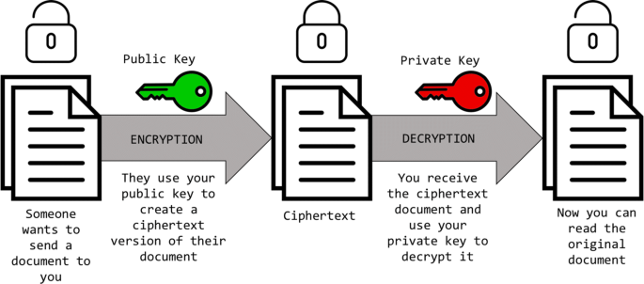
Block Diagram

Slide 9
SOFTWARE REQUIREMENTS:
Operating System : Windows 10
Platform : DOT NET TECHNOLOGY
Front End : ASP.Net 4.0
Back End : SQL SERVER 2014

Slide 10
HARDWARE REQUIREMENTS:
Keyboard
Mouse
Hard disk 500GB
Ram 4 Gb

Slide 11
CONCLUSION
Blockchain and DLT have the potential to beneft all the above application areas and many more, but also face similar challenges as those faced by any other technology threatening to disintermediate legacy processes and commercial interests, namely the challenges of blockchain interoperability, security and privacy, as well as the need to fnd suitable and sustainable business models of implementation. Nevertheless, we expect blockchain technologies to get increasingly powerful and robust, as they become coupled with artifcial intelligence (AI) in various real-word healthcare solutions. AI-mediated health data exchange on blockchains will play important roles in shaping the future of these technologies in healthcare.

Slide 12
REFERENCE
1. Bitcoin NS. A peer-to-peer electronic cash system. Bitcoin.org (online). 2009. https://bitcoin.org/bitcoin.pdf. Accessed 14 June 2018.
2. Buterin V. The meaning of decentralization. Medium (online). 2017. https ://medium.com/@VitalikButerin/the-meaning-of-decentralization-a0c92 b76a274. Accessed 14 June 2018.
3. Buterin V. Ethereum white paper. GitHub (online). 2018. https://githu b.com/ethereum/wiki/wiki/White-Paper. Accessed 14 June 2018.
4. Goldreich O. Foundations of cryptography: volume 1, basic tools. Cambridge: Cambridge University Press; 2008.
5. Waldman J. Blockchain— Blockchain fundamentals. MSDN (online). 2018 Mar. https://msdn.microsoft.com/en-us/magazine/mt845650.aspx. Accessed 14 June 2018.

Slide 13
6. Piper Jafray—Research (2018). http://www.piperjafray.com/3col. aspx?id=103. Accessed 14 June 2018.
7. Hashed Health (2018). https://hashedhealth.com/. Accessed 14 June 2018.
8. Geer L. Illinois opens Blockchain development partnership with hashed health. The Illinois Blockchain Initiative (online). 2017 Aug. https://illin oisblockchain.tech/illinois-opens-blockchain-development-partnership-with-hashed-health-fe3891e500bb. Accessed 14 June 2018.
9. Professional Credentials Exchange (2018). https://www.procredex.com/. Accessed 14 June 2018.
10. Naujeck J. Blockchain is the ‘shiny new penny’. The Ledger (Nashville Edition). 2018;42(20):online. http://www.tnledger.com/editorial/Artic le.aspx?id=106706 (requires access from a US IP address). Accessed 14 June 2018.

