Slide 1
Scientific method for determining age Agriculture and Food & of boiled rice

Slide 2
Abstract
Rice ageing commences during preharvest and continues with the postharvest storage. It dramatically involves the changes in physical and physicochemical properties of the rice grain such as cooking, pasting, and thermal properties. The present report reviews and reveals the effect of rice ageing on the changes of rice physical properties. The studies discovered that, during ageing, cooked aged rice had a harder texture and much fluffier than fresh rice and also less in stickiness and adhesiveness. The viscosities such as final and setback viscosity of aged rice increased dramatically after the short to intermediate term of storage. These were affected by two major factors such as time and temperature of storage. During ageing, aged rice grain at higher temperature and longer time showed a significant increase hardness of cooked rice, peak temperature, and the conclusion temperature. However, the pasting and the breakdown viscosity of rice decreased with longer aging times.

Slide 3
Existing System
Some of rice components namely rice bran and rice bran oil contained some minor components which are reported to have some biological effects.
The unique taste of rice provides easy way to combine rice with the other food to achieve better taste and nutritional balance.
High-amylose rice varieties with similar chemical composition including amylase content that were cooked under the same conditions had differences in the starch digestion rate and the glycemic and insulin responses.

Slide 4
Disadvantage of Existing System
The storage conditions are important in the aging process and they could impact on the number of changes in rice physical properties such as textural properties, pasting, color, flavor, composition and eating quality.
Rice during storage undergoes numerous changes in its physical properties and chemical composition, and these changes cause impact on rice cooking and eating quality.
It is well documented that starch-lipid complex formation impacts on rice pasting behavior. Peak temperature and peak width appear to be the most notable impacts of storage of aging rice.

Slide 5
PROPOSED SYSTEM :
As rice aged, it is proposed that the denaturation of protein bodies occurred during the aging process, and this denaturation would be associated with the exposure of hydrophobic groups of protein molecules, which leading to a decrease in the extractability of proteins for each fraction.
We propose that release of free phenolic acids alters integrity of the cell wall and at the same time the phenolic acids exert an effect via their antioxidant activity on the formation of FFA that can further complex with amylose during storage.

Slide 6
ADVANTAGE
Rice is typically consumed as cooked and although a minor amount is used as an ingredient in the several processed foods.
The determination of the percentage of syneresis from the freeze-thawed flour gels are used to evaluate the ability of the starch to withstand the undesirable physical changes which occur during freezing and thawing.
Cooking method used is conventional method (a combination of boiling and steaming) and modern method (rice cooker steaming). Rice used in this study were black rice and brown rice with broken. skin.

Slide 7
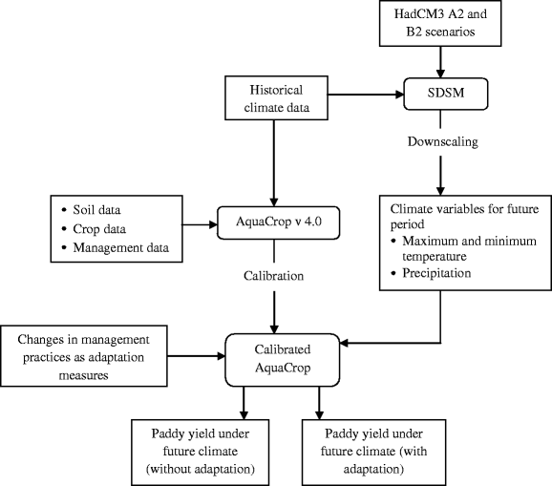
Block Diagram

Slide 8
SOFTWARE REQUIREMENTS:
Operating System : Windows 10
Platform : DOT NET TECHNOLOGY
Front End : ASP.Net 4.0
Back End : SQL SERVER 2014

Slide 9
HARDWARE REQUIREMENTS:
Keyboard
Mouse
Hard disk 500GB
Ram 4 Gb

Slide 10
CONCLUSION
Aging of rice is coincided during harvested to until consumption. It affects the physical and chemical properties of rice, and moreover, physicochemical properties such as pasting properties and cooking properties. Cooked aged rice shows harder texture and is less sticky than cooked fresh rice. This is profound in rice stored at high temperature rather than at lower temperature. Aged rice at higher temperature and longer time had harder texture and much fluffier than fresh rice and also less in stickiness and adhesiveness. Aging of rice showed that viscograms for the BD of rice samples decreased over the time, and the peak seen in aged samples disappeared.

Slide 11
REFERENCE
Biliaderis, C. G. and Tonogai, J. R. 1991. Influence of lipids on the thermal and mechanical properties of concentrated starch gels. Journal of Agricultural and Food Chemistry 39(5): 833-840.
Champagne, E. T. 2004. Rice: Chemistry and Technology. American Association of Cereal Chemists: Minnesota, U.S.A.
Evans, I. D. and Lips, A. 1992. Viscoelasticity of gelatinized starch dispersions. Journal of Texture Study 23(1): 69-86.
Fan, J. and Marks, B. P. 1999. Effects of rough rice storage conditions on gelatinization and retrogradation properties of rice flours. Cereal Chemistry 76(6): 894- 897.
Karim, A. A., Norziah, M. H. and Seow, C. C. 2000. Methods for the study of starch retrogradation. Food Chemistry 71(1): 9-36.

Slide 12
Kaur, K. and Singh, N. 2000. Amylose-lipid complex formation during cooking of rice flour. Food Chemistry 71(4): 511-517.
Morris, V. J. 1990. Starch gelation and retrogradation. Trends in Food Science and Technology 1: 2-6.
Noomhorm, A., Kongseree, N. and Apintanapong, N. 1997. Effect of aging on the quality of glutinous rice crackers. Cereal Chemistry 74(1): 12-15.
Ohno, T. and Ohisa, N. 2005. Studies on textural and chemical changes in aged rice grains. Food Science and Technology Research 11(4): 385-389.
Perez, C. M. and Juliano, B. O. 1981. Texture changes and storage of rice. Journal of Texture Studies 12(3): 321- 333.

