Slide 1
Milk pasteurization other than heat treatment

Slide 2
Abstract
This paper deals with milk processing with emphasis on pasteurization. The heat treatment of milk is important in terms of product quality and health safety. The goal of this paper is determination of heat consumption, inactivation effect and Pasteur criterion, by which pasteurization effectiveness is evaluated. The methodical part contains calculations, which were used for estimation of results and description of a pasteurization station used for milk processing. Results obtained in usual working time confirmed that necessary heating and cooling performance were achieved for guarantee of high-quality milk production. Real specific heat consumption was 51.69 kJ/kg. It was achieved by use of regeneration sections in the pasteurizer. These sections allow for a repeated use of 82 % of heat used for heating of raw milk in pasteurization.

Slide 3
Existing System
Some potentially dangerous microorganism may exist when we use conventional method for milk pasteurization.
Several different standard protocols exist for conducting ALP assays, each based on different sample preparatory methods or ALP substrate.
Some concern exists about these different tests with regard to their status as validated ALP assays. Understandard conditions of assay, the ALP method has been shown to be are markably valuable tool for the routine assessment of milk pasteurization validation, yet some concerns still exist.

Slide 4
Disadvantage of Existing System
The aim of this study was to determine the impact of different milk pasteurization temperature and time combinations on the survival of the selected microbes.
Milk contains bacteria when improperly handles create conditions where bacteria can multiply Antibiotic residues in milk due to use of antibiotics widely in food producing animals, supposed problems for the both dairy industry and consumers.
The use of sunshine to cook and pasteurize contaminated water and milk could provide a new approach to these debilitating problems.

Slide 5
PROPOSED SYSTEM :
In order to inactivate highly heat-resistant spores, higher temperatures (≥150◦C) for very short times (<1 s) have been proposed.
A study was conducted by the International Dairy Federation and the International Organization for Standardization to evaluate the reproducibility of a chemilumine scent method for ALP at 50,100,350, and 500mU/mL in the whole milk of multiple species to meet new regulations in the US and proposed regulations in the EC.
This method is proposed as an alternative for dairy industries and remote areas where expensive instruments are unavailable.

Slide 6
ADVANTAGE
The energy demand of food production is compared to its nutrition energy efficiency.
The efficient surface of plates is burnished, which, combined with turbulent flow, is manifested by minimizing of incrustations and dirt generation.
The pasteurization process of milk is efficient if the milk retains pasteurization temperature for the duration needed to inactivate pathogenic microbiota in the milk.

Slide 7
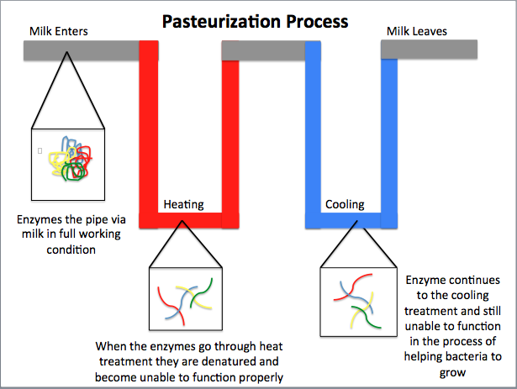
Block Diagram

Slide 8
SOFTWARE REQUIREMENTS:
Operating System : Windows 10
Platform : DOT NET TECHNOLOGY
Front End : ASP.Net 4.0
Back End : SQL SERVER 2014

Slide 9
HARDWARE REQUIREMENTS:
Keyboard
Mouse
Hard disk 500GB
Ram 4 Gb

Slide 10
CONCLUSION
The research paper deals with the heat treatment of milk, which is an important part of the production of high-qualityand healthy milk for human nutrition. Pasteurization is the main heat process in dairy industry. Results of the work show that the operation of the pasteurizer, together with machine control and automation achieves necessary heating and cooling capacity for production of high-quality milk and dairy products. Theoretical specific heat consumption for pasteurization of milk is 287.15 kJ/kg, but real specific heat consumption was 51.69 kJ/kg. It was achieved by using regeneration sections in the pasteurizer. These sections allow reusing 82 % of heat used in pasteurization.

