Slide 1
Develop an innovative solution to conversion of excess milk to usable products

Slide 2
Abstract
The dairy industry generates excessive amounts of waste and by-products while it gives a wide range of dairy products. Alternative biotechnological uses of these wastes need to be determined to aerobic and anaerobic treatment systems due to their high chemical oxygen demand (COD) levels and rich nutrient (lactose, protein and fat) contents. This work presents a critical review on the fermentation-engineering aspects based on defining the effective use of dairy effluents in the production of various microbial products such as bio fuel, enzyme, organic acid, polymer, biomass production, etc.

Slide 3
In addition to microbial processes, techno-economic analyses to the integration of some microbial prod-ucts into the bio refinery and feasibility of the related processes have been presented. Overall, the inclusion of dairy wastes into the designed microbial processes seems also promising for commercial approaches. Especially the digestion of dairy wastes with cow manure and/or different substrates will provide a positive net present value (NPV)and a payback period (PBP) less than 10 years to the plant in terms of biogas production.

Slide 4
Existing System
A drawback exists in lactase production that related to its intracellular nature and rises downstream processing costs.
The studies on valorization of dairy waste, some studies also focus on integration of the valorization process into the existing dairy plants.
To determine how dairy waste can be used more efficiently in biorefinery, develop a bioprocess design to improve the existing dairy/food industry by identifying new processes to be integrated into the dairy industry.

Slide 5
Disadvantage of Existing System
These effluents, particularly high-fat-containing substrates, can cause serious organic loading problems in the local sewage drainage system.
Due to high organic compositions of dairy industry by-products, direct disposal of these products can cause environ-mental problems.
The most striking of thedairy industry wastes is whey, which is discarded from milk and threatens environmental problems and human health .

Slide 6
PROPOSED SYSTEM :
The proposed technology will create new competitive balanced consumer dairy products and preventive products for specialized and rehabilitation nutrition, as well as biotech products with desired functional properties.
The use of hydrolysates is in demand mainly as a component of infant milk formula for preventive and therapeutic purposes, but the demand for them is met mainly with imported products.
However, one of the criteria for the country’s food security is the level of self-sufficiency in agricultural products.

Slide 7
ADVANTAGE
Among these, whey powder provides higher efficiency than whey in microbial processes because it contains high concentrations of lactose and other nutrients.
However, diauxic growth of microorganisms in the presence of both glucose and galactose after hydrolysis reduces the ethanol production efficiency.
It seems modern biological treatments are more efficient than traditional ones for the recovery and conversion of wastes into products and energy resources.

Slide 8
TITLE | AUTHOR | DESCRIPTION
Continuous production of lactic acid from whey permeate by lactobacillus helveticus in a cell-recycle reactor | Aeschlimann, A., von Stockar, U., 1991. | Using this recycled system, the volumetric lactic acid productivity was about twice as much as with a nonrecycled system.
A review on the lactic acid fermentation from low-cost renewable materials: recent developments and challenges | Ahmad, A., Banat, F., Taher, H., 2020. | The high yield productivity of lactic acid by utilizing economical and easily available substrates has received immense attraction in the petrochemical industry.

Slide 9
TITLE | AUTHOR | DESCRIPTION
Cheese whey wastewater: characterization and treatment | Carvalho, F., Prazeres, A.R., Rivas, J., 2013. | CWW composition is highly variable due to raw milk used, the fraction of non valorized cheese whey and the amount of cleaning water used.
Advances in bio hydrogen production processes: an approach towards commercialization | Das, D., 2009. | This yield appears too low to be economically viable as an alternative to the existing chemical or electrochemical processes of hydrogen generation.

Slide 10
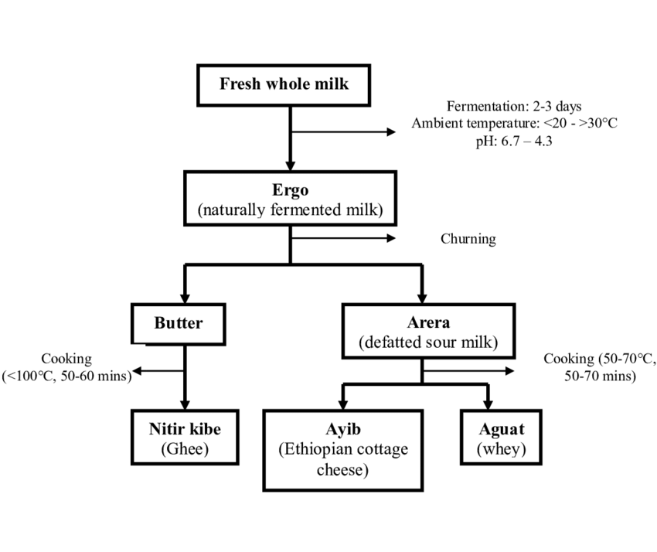
Block Diagram

Slide 11
SOFTWARE REQUIREMENTS:
Operating System : Windows 10
Platform : DOT NET TECHNOLOGY
Front End : ASP.Net 4.0
Back End : SQL SERVER 2014

Slide 12
HARDWARE REQUIREMENTS:
Keyboard
Mouse
Hard disk 500GB
Ram 4 Gb

Slide 13
CONCLUSION
Dairy industry wastes and by-products are defined as the most important environmental pollutants with their lactose, protein and fat contents. A suitable treatment strategy has not been determined for the treatment of these wastes with high COD values. The potential use of dairy wastes as a carbon source in microbial production processes (such as biofuels, organic acids, enzymes, polymers, and biomass) has been frequently evaluated and its usability as the substrate has been determined. Additionally, dairy wastes can be mixed with other substrates (such as cow manure or potato stem) and integrated into anaerobic digestion processes, and some studies have shown that this co-digestion could be profitable for facilities depending on techno-economic analysis.

Slide 14
REFERENCE
Aeschlimann, A., von Stockar, U., 1991. Continuous production of lactic acid from whey per-meate by lactobacillus helveticus in a cell-recycle reactor. Enzym. Microb. Technol. 13(10), 811–816.
Ahmad, A., Banat, F., Taher, H., 2020. A review on the lactic acid fermentation from low-cost renewable materials: recent developments and challenges. Environ. Technol. Innov. 20,101138.
Bhosale, P., Bernstein, P.S., 2005. Microbial xanthophylls. Appl. Microbiol. Biotechnol. 68 (4),445–455.
Blaschek, K.M., Wendorff, W.L., Rankin, S.A., 2007. Survey of salty and sweet whey composition from various cheese plants in Wisconsin. J. Dairy Sci. 90 (4), 2029–2034.
Carvalho, F., Prazeres, A.R., Rivas, J., 2013. Cheese whey wastewater: characterization and treatment. Sci. Total Environ. 445, 385–396.

Slide 15
Das, D., 2009. Advances in bio hydrogen production processes: an approach towards commercialization. Int. J. Hydrog. 34 (17), 7349–7357.
El-Shora, H.M., Metwally, M.A.A., 2008. Production, purification and characterisation of pro-teases from whey by some fungi. Ann. Microbiol. 58 (3), 495–502.
Feijoo, G., Moreira, M., Roca, E., Lema, J., 1999. Use of cheese whey as a substrate to produce manganese peroxidase by bjerkandera sp BOS55. J. Ind. Microbiol. Biotechnol. 23 (2),86–90.
Ghaly, A.E., Kamal, M.A., 2004. Submerged yeast fermentation of acid cheese whey for pro-tein production and pollution potential reduction. Water Res. 38 (3), 631–644.
Hublin, A., Zokić, T.I., Zelić, B., 2012. Optimization of biogas production from co-digestion ofwhey and cow manure. Biotechnol. Bioprocess Eng. 17 (6), 1284–1293.

