Slide 1
Develop a simple but effective Tele-consultation application for farmers to fecilitate agriculture

Slide 2
Abstract
Decision support tools, usually considered to be software-based, may be an important part of the quest for evidence-based decision-making in agriculture to improve productivity and environmental outputs.
These tools can lead users through clear steps and suggest optimal decision paths or may act more as information sources to improve the evidence base for decisions.
Yet, despite their availability in a wide range of formats, studies inseveral countries have shown uptake to be disappointingly low.

Slide 3
This paper uses a mixed methods approach toinvestigate the factors affecting the uptake and use of decision support tools by farmers and advisers in the UK.
Through a combination of qualitative interviews and quantitative surveys, we found that fifteen factors are influential in convincing farmers and advisers to use decision support tools, which include usability, cost-effectiveness, performance, relevance to user, and compatibility with compliance demands.
This study finds a plethora of agricultural decision support tools in operation in the UK, yet, like other studies, shows that their uptake is low. A better understanding of the fifteen factors identified should lead to more effective design and deliveryof tools in the future.

Slide 4
Existing System
More specifically, SFTs presented in scientific papers are not indicated as a significant replacement of an existing tool,
The factors affecting adoption readiness of SFTs showed a constant trend of change. SFTs from research projects and commercial products were indicated as a significant replacement of existing solutions, but not bringing major changes in existing agricultural systems.
Therefore, to assist the delivery of existing tools, and the design of future tools, we identify a number of key characteristics affecting the use of DST by farmers and advisers in the UK.

Slide 5
Disadvantage of Existing System
The focus was on economic impact and less on labor and environmental issues.
We examined the published indicators to create a list of KPIs to be used for assessing the impact of SFTs in terms of three main issues associated with agricultural systems that are of high importance for end-users and the general public: farm economics,
Fertilization is indeed one of the targets for variable rate application to ensure yield maintenance or even increase yield with the least possible nutrients applied and EU research projects seem to fund this issue to a great extent.

Slide 6
PROPOSED SYSTEM :
Each of the manufacturers was asked to give a presentation describing the purpose of their system and the factors that they had considered when designing the system.
A farmer need to know when to plant, when to irrigate, when to fertilize, and when to harvest. Also they need to know how to protect ourselves from pesticides and from harvesting after harvest.
An administrator is a controller for everything being equal. The administrator can sign in with the managerial secret word and afterward get to this site. They can acknowledge or dismiss any solicitation.

Slide 7
ADVANTAGE
The economic and environmental challenges that SFTs face were determined by a set of key performance indicators (KPIs).
This may be explained by research projects assessing several aspects of SFT performance, while scientific papers focus mainly on technological achievements and commercial products in terms of the SFT economic gains for the end-user.
Smart farming is based on a precise and resource-efficient approach and attempts to achieve higher efficiency on agricultural goods production with increased quality in a sustainable basis.

Slide 8
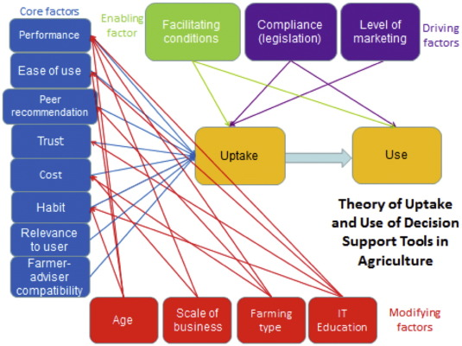
Block Diagram

Slide 9
SOFTWARE REQUIREMENTS:
Operating System : Windows 10
Platform : DOT NET TECHNOLOGY
Front End : ASP.Net 4.0
Back End : SQL SERVER 2014

Slide 10
HARDWARE REQUIREMENTS:
Keyboard
Mouse
Hard disk 500GB
Ram 4 Gb

Slide 11
CONCLUSION
It was concluded that the inventory of SFTs described in this study is important in the sense that it provides researchers with existing SFT developments to seek new research challenges, policy-makers with information on the current status of SFTs to design incentives for higher adoption rates, and farmers with an opportunity to acquaint themselves with the SFTs that are available. However, this work also identified the fact that researchers and SFT providers in most cases did not produce quantitative impact results with the use of their SFTs, which makes our study still indicative about the impact of SFTs, as we analyzed mainly qualitative criteria. In addition, this inventory should be updated regularly as the technology is moving fast and new farmers are getting more aware of the available SFTs on the market. Therefore, a follow-up to the present study would be beneficial in creating an inventory also including data-related technologies, practices, standards, and agreements, as well as numerical results of SFT impact in real conditions.

Slide 12
REFERENCE
Gomiero, T.; Pimentel, D.; Paoletti, M.G. Is There a Need for a More Sustainable Agriculture? Crit. Rev. Plant Sci. 2011, 30, 6–23.
World, B. ICT in Agriculture (Updated Edition): Connecting Smallholders to Knowledge, Networks, and Institutions; World Bank: Washington, DC, USA, 2017.
Wang, N.; Zhang, N.; Wang, M. Wireless sensors in agriculture and food industry—Recent development and future perspective. Comput. Electron. Agric. 2006, 50, 1–14.
Aqeel ur, R.; Abbasi, A.Z.; Islam, N.; Shaikh, Z.A. A review of wireless sensors and networks’ applications in agriculture. Comput. Stand. Interfaces 2014, 36, 263–270.
King, A. Technology: The Future of Agriculture. Nature 2017, 544, S21–S23.

Slide 13
Toth, C.; Jóźków, G. Remote sensing platforms and sensors: A survey. Isprs J. Photogramm. Remote Sens. 2016, 115, 22–36.
Mahan, J.R.; Yeater, K.M. Agricultural applications of a low-cost infrared thermometer. Comput. Electron. Agric. 2008, 64, 262–267.
Polo, J.; Hornero, G.; Duijneveld, C.; García, A.; Casas, O. Design of a low-cost Wireless Sensor Network with UAV mobile node for agricultural applications. Comput. Electron. Agric. 2015, 119, 19–32.
Rose, D.C.; Chilvers, J. Agriculture 4.0: Broadening Responsible Innovation in an Era of Smart Farming. Front. Sustain. Food Syst. 2018, 2.
Walter, A.; Finger, R.; Huber, R.; Buchmann, N. Opinion: Smart farming is key to developing sustainable agriculture. Proc. Natl. Acad. Sci. USA 2017, 114, 6148.

