Slide 1
User friendly data visualization tool for interpretation of groundwater isotope data

Slide 2
Abstract
Management of groundwater systems requires realistic conceptual hydrogeological models as a framework for numerical simulation modelling, but also for system understanding and communicating this to stakeholders and the broader community. To help overcome these challenges we developed GVS (Groundwater Visualisation System), a stand-alone desktop software package that uses interactive 3D visualisation and animation techniques. The goal was a user-friendly groundwater management tool that could support a range of existing real-world and pre-processed data, both surface and subsurface, including geology and various types of temporal hydrological information.

Slide 3
GVS allows these data to be integrated into a single conceptual hydro geological model. In addition, 3D geological models produced externally using other software packages, can readily be imported into GVS models, as can outputs of simulations (e.g. piezometric surfaces) produced by software suc h as MODFLOW or FEFLOW. Boreholes can be integrated, showing any down-hole data and properties, including screen information, intersected geology, water level data and water chemistry. Animation is used to display spatial and temporal changes, with time-series data such as rainfall, standing water levels and electrical conductivity, displaying dynamic processes.

Slide 4
Existing System
Water-level measurements serve as primary data required for calibration and testing of ground-water models, and it is often not until development of these models that the limitations of existing water-level data are fully recognized.
These limitations, statistical analysis of data from existing networks can provide useful guidance in evaluating these networks and a firmer basis for network modifications.
However, water-level monitoring in the United States is fragmented and largely subject to the vagaries of existing local projects.

Slide 5
Disadvantage of Existing System
A common problem is the localised scale view, and the lack of understanding of the wider context of a whole system and the potential catchment links.
Our early activities involved developing visualisation applications for groundwater systems to analyse large data sets in areas with water management and salinity concerns or other resource use issues.
A specific aim of the GVS model development was to use 3D visualisation, combined with animation, to demonstrate the impact of over 40 years of groundwater abstraction.

Slide 6
PROPOSED SYSTEM :
SAR, the sodium adsorption ratio index, is an important parameter to determine the use of groundwater for irrigation purposes.
Several innovative uses of long-term waterlevel monitoring have been proposed in addition to the more conventional uses described thus far.
If one of the purposes of a network is to monitor ambient ground-water conditions, or the effects of natural, climatic-induced hydrologic stresses, the observation network will require wells that are unaffected by pumping, irrigation, and land uses that affect ground-water recharge.

Slide 7
ADVANTAGE
Common misconceptions of surface water-ground water connectivity, recharge processes, base flow in drainage systems, and groundwater-dependent ecosystems (GDE) further challenge efficient groundwater management practices.
The advantage of considering stratigraphy and developing layer boundaries within a 3D geological model is that the 3D hydrogeological model developed is usually more realistic.
The 3D model, however, must be adapted to the grid format of the simulatio n software being used.

Slide 8
TITLE | AUTHOR | DESCRIPTION
Configuration of the limestone aquifers in the central part of Egypt using electrical measurements | Abou Heleika, M.M., Niesner, E., 2009. | The integrated analyses carried out represent a significant and cost-effective method for delineating the main aquifer in this area.
How scientific knowledge informs community understanding of groundwater | Baldwin, C., Tan, P.-L., White, I., Hoverman, S., Burry, K., 2012. | Robust information is integral to any good decision-making process. Information needs to be seen as credible by the community and defensible by scientists and independent reviewers.

Slide 9
TITLE | AUTHOR | DESCRIPTION
Upper Condamine Groundwater Model Calibration Report | Barnett, B.G., Muller, J., 2008. | In particular changes to the manner in which diffuse areal recharge is represented in the model were required.
GWVis: A tool for comparative ground-water data visualization | Best, D.M., Lewis, R.R., 2010. | The Ground-Water Visualization application (GWVis) presents ground-water data visually in order to educate the public on ground-water issues.

Slide 10
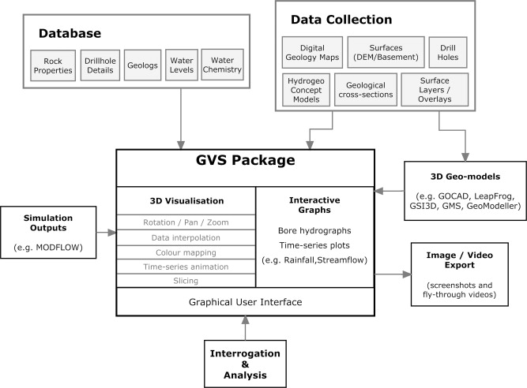
Block Diagram

Slide 11
SOFTWARE REQUIREMENTS:
Operating System : Windows 10
Platform : DOT NET TECHNOLOGY
Front End : ASP.Net 4.0
Back End : SQL SERVER 2014

Slide 12
HARDWARE REQUIREMENTS:
Keyboard
Mouse
Hard disk 500GB
Ram 4 Gb

Slide 13
CONCLUSION
GVS has been highly successful as a tool that enhances community/stakeholder understanding and knowledge of groundwater systems, is of value for training and educational purposes and provides effective support to management and decision making. The software was utilised as a major component in several projects aimed at development of community understanding of groundwater condition and use, and the need for management. The models produced also provide useful visuals for reporting, plus become permanent data repositories. We are continuing to develop the system and its capability, both in its current application, and in an up-scaled form applied to regional basin groundwater systems.

Slide 14
REFERENCE
Abou Heleika, M.M., Niesner, E., 2009. Configuration of the limestone aquifers in the central part of Egypt using electrical measurements. Hydrogeol. J. 17 (2), 433– 446.
Artimo, A., Mäkinen, J., Berg, R.C., Abert, C.C., Salonen, V.-P., 2003. Threedimensional geological modeling and visualization of the Virttaankangas aquifer, southwestern Finland. Hydrogeol. J. 11 (3), 378–386.
Baldwin, C., Tan, P.-L., White, I., Hoverman, S., Burry, K., 2012. How scientific knowledge informs community understanding of groundwater. J. Hydrol. 474 (2012), 74–83.
Barnett, B.G., Muller, J., 2008. Upper Condamine Groundwater Model Calibration Report. A report to the Australian Government from the CSIRO Murray-Darling Basin Sustainable Yields Project. CSIRO, Australia, 51 pp.
Best, D.M., Lewis, R.R., 2010. GWVis: A tool for comparative ground-water data visualization. Comput. Geosci. 36 (11), 1436–1442.

Slide 15
Bleakley, A., and Durick, A. 2000. Central Lockyer Groundwater Model. Queensland Department of Natural Resources and Mines. Brisbane.
Cowan, E.J., Beatson, R.K., Fright, W.R., McLennan, T.J., Mitchell, T.J., 2002. Rapid geological modeling. Applied Structural Geology for Mineral Exploration and Mining, International Symposium, 23–25 September 2002, Kalgoorlie.
Dhont, D., Luxey, P., Chorowicz, J., 2005. 3-D modeling of geological maps from surface data. AAPG Bull. 89 (11), 1465–1474.
Exon, N.F., 1976. Geology of the Surat Basin in Queensland. Bureau of Mineral Resources, Australia, Bulletin 166.
James, A., Cox, M., Hawke, A., Young, J., 2010a. A 3D visualisation model applied to a thick, multi-layered alluvial groundwater system under stress: Condamine Valley, Qld. Groundwater 2010, Canberra, 31 October–4 November, 2010, 1 pp.

