Slide 1
Use of digital technology or making physical prototype for micro irrigation system to improve Water Use Efficiency of Irrigation sector

Slide 2
Abstract
A systematic attempt to determine the conditions under which, micro irrigation (MI) systems become the “best bet technology” in terms of realizing the potential benefits, and extent of reduction in crop water requirement possible through such systems is crucial for assessing our ability to address future water scarcity at the regional and national level. The ultimate objective of this research is to find out under what conditions micro irrigation system offer the best bet technology, and what benefits it can yield. The research aims at determining the potential benefits from the use of MI systems in India. This is done through assessing: a] the conditions that are favourable for MI system adoption; b] the field level and aggregate level impacts of the systems on water use; and c] the yield and economic benefits from adoption.

Slide 3
The research also aims at assessing the potential future coverage of MI systems in India, and the potential reduction in aggregate water requirement in crop production. The research used extensive review of published and unpublished literature on the feasibility, and physical and economic impacts of various MI systems; results from field experiments carried out by IWMI in one location in Gujarat on the techno-economic viability of some MI devices; data from field-based research carried out by IWMI researchers on the economic viability of MI systems; and statistics on MI adoption in India.

Slide 4
Existing System
The creation of WUAs supports the active participation of communities and ensures required capacity building in user groups for enhanced implementation of projects and conservation of existing water resources.
Non-existent electric feeders at farms as electricity provides better pressured water.
Water is an absolute imperative for the existence of life on earth and a common driver of various economic activities (agriculture, industry, etc.).

Slide 5
Disadvantage of Existing System
Such efforts are crucial for assessing our ability to address problems of water scarcity in the future at the regional and national level.
They cited high initial cost (including mis-targetted subsidies), clogging of drippers and cracking of pipes, lack of adequate technical inputs, damages done by rodents; high cost of spare components; and insufficient extension education effort as the major problems in the slow rate of adoption of drips.
In areas where agricultural processing units are concentrated, provision of all critical inputs including subsidies would not be a problem, as they could come from these processing units.

Slide 6
PROPOSED SYSTEM :
In surface irrigation systems in particular, adaptive real-time control has been proposed for the management of temporal infiltration variability.
Water used for industrial and domestic purposes account for approximately 20% and 10% of the total global water usage, respectively.
This has led to improved WUE, and some of the water saved has been used for environmental purposes.

Slide 7
ADVANTAGE
The actual field performance in the irrigation systems is not as good as that shown in experiments and demonstrations.
The incremental value of outputs, an important factor which influences the economic performance of drip system is the cost of installation of the system.
The farmers should be made to pay the full cost of the system initially, and subsidies be paid in installments based on periodic review of system performance.

Slide 8
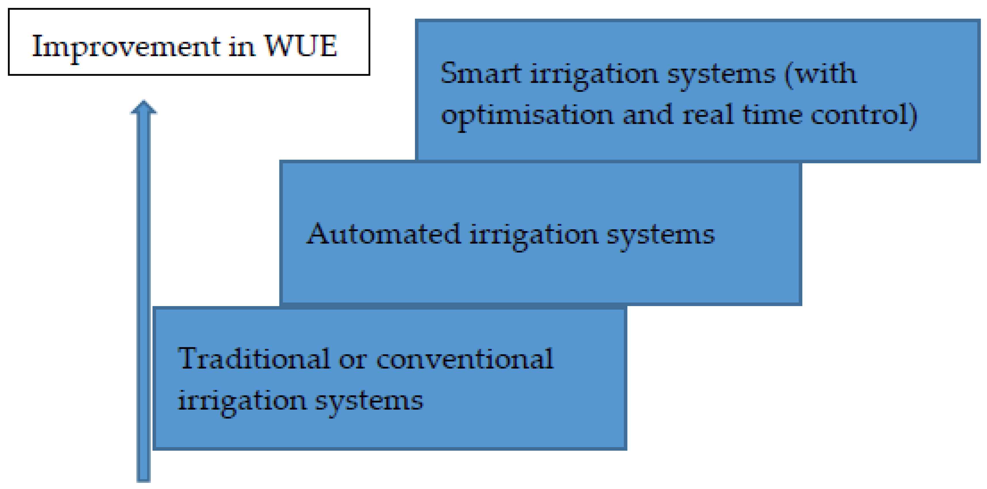
Block Diagram

Slide 9
SOFTWARE REQUIREMENTS:
Operating System : Windows 10
Platform : DOT NET TECHNOLOGY
Front End : ASP.Net 4.0
Back End : SQL SERVER 2014

Slide 10
HARDWARE REQUIREMENTS:
Keyboard
Mouse
Hard disk 500GB
Ram 4 Gb

Slide 11
CONCLUSION
Adoption of MI systems is likely to pick up fast in arid and semi arid, well-irrigated areas, where farmers have independent irrigation sources, and where groundwater is scarce. Further, high average land holdings, large size of individual plots, and a cropping system dominated by widely spaced row crops, which are also highvalued, would provide the ideal environment for the same. The extent of real water-saving and water productivity improvements at the field level through adoption of MI systems would be high for widely spaced row crops, in arid and semi arid conditions, when the groundwater table is deep or aquifer is saline. In hard rock areas with poor groundwater potential, MI adoption would result in improved efficiency of water use, but would not reduce the total groundwater draft.

Slide 12
REFERENCE
Ahmad, M. D., I, Masih and H. Turral (2004), Diagnostic analysis of spatial and temporal variations in crop water productivity: A field scale analysis of the rice-wheat cropping system of Punjab, Pakistan, Journal of Applied Irrigation Science, 39 (10).
Behera, B.P. and N. Sahoo, (1998), Economic evaluation of a drip irrigation system in Orissa. Environment and Ecology, Vol. 16(2): 297-299.
Central Ground Water Board (1998), Groundwater Problems of Mehsana District. Report, Central Ground Water Board, West-Central region, Ahmedabad.
Chavez, H. and F. Andrew (1974), Drip irrigation increase yields, lowers water costs. Citrus and Vegetable Magazine, Vol. 38: 1,6 and 18.
Dahake, S.G., S. P. Lambe, H.V. Kalpande; D.M. Nikhade and V.V. Kalpande (1998), Utility perception of orange growers about drip irrigation system. Jouranal of Soils and Crops, Vol. 8(2): 154-156.

Slide 13
Desale, P.G., P.P. Pawar and R.P. Patil (2003), Economics analysis of drip irrigation for banana. Indian Journal of Agricultural Economics, July-September, Vol. 58, No. 3, p. 506.
Deepak, and others (2005), Water Demand Management: A Strategy to Deal with Water Scarcity, paper presented at the 4th Annual Partners’ Meet of IWMI-Tata Water Policy Research Programme, February
Dhawan, B. D. (2000), Drip Irrigation: Evaluating Returns, Economic and Political Weekly, pp 3775-3780, October 14.
Frederick, K. D. (1993), Balancing Water Demand with Supplies: The Role of Management in a World of Increasing Scarcity, Technical Paper 189, World Bank, Washington D. C.,
Kumar, M. Dinesh and O. P. Singh (2001), Market Instruments for Demand Management in the Face of Scarcity and Overuse of Water in Gujarat, Western India, Water Policy, 5 (3): 387-403.

